Slide 1
The Parkerian Hexad
CSH6 Chapter 3
“Toward a New Framework for Information Security”
Donn B. Parker

Slide 2
Topics
The Classic Triad
Parkerian Hexad
Confidentiality
Possession
Integrity
Authenticity
Availability
Utility
Functions of INFOSEC Personnel
CSH6 Ch 3

Slide 3
The Classic Triad
C – I – A
Notes:
Explain what these letters stand for.
Can you think of other shorthand summaries of what information security involves?

Slide 4
The Parkerian Hexad
Protect the 6 atomic elements of INFOSEC:
Confidentiality
Possession or control
Integrity
Authenticity
Availability
Utility
Notes:
See
Kabay, M. E. (1996). The NCSA Guide to Enterprise Security: Protecting Information Assets. McGraw-Hill (New York). ISBN 0-07-033147-2. xii + 388 pp. Index.
for extensive discussion of these issues.

Slide 5
Why “Parkerian?”
Notes:
http://technetcast.ddj.com/tnc_program.html?program_id=79
Donn Parker
Donn B. Parker is a retired (1997) senior management consultant at SRI International in Menlo Park, California who has specialized in Information security and computer crime research for 30 of his 47 years in the computer field. He has written numerous books, papers, articles, and reports in his specialty based on interviews of over 200 computer criminals and reviews of the security of many large corporations.
He received the 1992 Award for Outstanding Individual Achievement from the Information Systems Security Association and the 1994 National Computer System Security Award from U.S. NIST/NCSC, The Aerospace Computer Security Associates 1994 Distinguished Lecturer award, and The MIS Training Institute Infosecurity News 1996 Lifetime Achievement Award.
The Information Security Magazine identified him as one of the five top Infosecurity Pioneers (1998). He formed the International Information Integrity Institute (I-4) at SRI that has been serving over 75 corporate members for 9 years to keep them aware of the most advanced information security concepts and controls.
* * *
Listen to (or watch) a 1 hour 49 minute audio conference on Early Computer Crime moderated by Donn Parker with pioneer researchers Whitfield Diffie (Sun Microsystems), John Markoff (The New York Times), Peter Neumann (Computer Science Lab at SRI) and Cliff Stoll (author of The Cuckoo’s Egg) recorded on 2000-03-27. See page
http://technetcast.ddj.com/ tnc_program.html?program_id=79
for various audio and video streaming formats.

Slide 6
Confidentiality
Restricting access to data
Protecting against unauthorized disclosure of existence of data
E.g., allowing industrial spy to deduce nature of clientele by looking at directory names
Protecting against unauthorized disclosure of details of data
E.g., allowing 13-yr old girl to examine HIV+ records in Florida clinic
Notes:
1. The Canadian consumer-tracking service Air Miles inadvertently left 50,000 records of applicants for its loyalty program publicly accessible on their Web site for an undetermined length of time. The Web site was offline as of 21 January until the problem was fixed.
2. An error in the configuration or programming of the F. A. O. Schwarz Web site resulted paradoxically in weakening the security of transactions deliberately completed by FAX instead of through SSL. Customers who declined to send their credit-card numbers via SSL ended up having their personal details — address and so forth — stored in a Web page that could be accessed by anyone entering a URL with an appropriate (even if randomly chosen) numerical component.
3. Prof. Ross Anderson of Cambridge University analyzed requirements on the AMAZON.COM online bookstore for credit card number, password, and personal details such as phone number. He identified several risks: (1) merchant retention of credit card numbers poses a far higher risk of capture than of capture in transit; (2) adding a password increases the likelihood of compromise because so many naïve users choose bad passwords and then write them down; (3) even the British site for Amazon contravenes European rules on protecting consumer privacy; (3) such practices make it easier for banks to reject their clients' claims of fraudulent use of their credit-card numbers.

Slide 7
Possession
Control over information
Preventing physical contact with data
E.g., case of thief who recorded ATM PINs by radio (but never looked at them)
Preventing copying or unauthorized use of intellectual property
E.g., violations by software pirates
Notes:
1. In Beijing, a court ordered two software pirates to compensate Microsoft for stealing their software and making illegal copies. This was the first case in which the Chinese justice system condemned miscreants for violations of intellectual property rights.
2. Hitachi, IBM, NEC, Pioneer and Sony (the ""Galaxy Group"") announced their agreement on a new digital watermark standard that would embed a cryptographic code in every frame of a digital multimedia work. New digital equipment would not allow copies of such works."
3. The Norwegian company FAST makes software that can download MP3 files. The International Federation of the Phonographic Industry (IFPI) lodged a complaint that resulted in criminal prosecution of FAST for facilitating the theft of illegally posted copyrighted music from the Web. The IFPI was also contemplating a complaint against Lycos, whose search engine catalogs these illegal snippets of intellectual property.

Slide 8
Confidentiality & Possession Losses
Locating
Disclosing
Observing, monitoring, and acquiring
Copying
Taking or controlling
Claiming ownership or custodianship
Inferring
Exposing to all of the other losses
Endangering by exposing to any of the other losses
Failure to engage in or to allow any of the other losses to occur when instructed to do so

Slide 9
Integrity
Internal consistency, validity, fitness for use
Avoiding physical corruption
E.g., database pointers trashed or data garbled
Avoiding logical corruption
E.g., inconsistencies between order header total sale & sum of costs of details
Notes:
1. Sun Valley, ID uses a computer-based identification and authorization system using a computer-generated pass with a bar code, radio-linked scanners and computers, and so on. The system works very well. Unfortunately, after a hard disk crash in mid-December 1997, the operators found that — surprise — they had no backups for the data they lost. Thousands of users were asked to re-register with the area.
2. At the Stanford University Graduate School of Business, system administrators installed additional disk capacity to their servers. They then reloaded files from a corrupt backup tape on 7 Mar. The faculty and student files were destroyed, leaving many faculty members and graduate students without their research files. [This incident again demonstrates the importance of VERIFYING THE READABILITY of backups. It also strengthens my belief in the wisdom of making TWO backups before attempting to reload a system.]
3. The RAND Corporation reported that CD-ROMs can deteriorate within 5-10 years -- much faster than the 50 years usually quoted. This instability is quite apart from the even more serious problem of incompatibility of medium, where a perfectly good storage device becomes unreadable because of changes in technology. Ever try to read an 8-inch floppy disk from the 1970s on your DVD player?
4. Pity Mr Cody Johnston, a commercial trucker in Bozeman, MT. He admittedly broke speeding laws and paid a fine, but the local newspaper reported his misdemeanor as a sexual deviation charge, which potentially includes homosexuality and bestiality. Apparently the court computer system printed out a list of convictions using erroneous labels for the internal codes. Mr Johnston sued the court and the newspaper for libel.
5. A Social Security Administration employee who become angry with a woman with whom he argued in an Internet chat room used a fellow-employee's terminal to fill in a death date for the woman in her SSA records. She applied for a loan at her bank and discovered that she was ""cyberdead."" Jorge Yong admitted culpability, resigned and paid $800 in fines and damages.

Slide 10
Authenticity
Correspondence to intended meaning
Avoiding nonsense
E.g., part number field actually contains cost
Avoiding fraud
E.g., sender’s name on e-mail is changed to someone else’s
Notes:
1. According to the British National Criminal Intelligence Service, the explosion in credit-card counterfeiting and other credit fraud is largely due to increased activity by Asian Triads. Losses grew by 500% between 1991 and 1998, with total theft estimated at £25M in the UK in 1998.
2. In Newmarket, Ontario (near Toronto), thieves in cahoots with a gas-station employee installed a miniature camera focused on the debit-card PIN pad. Videos of customers punching in their PINs, coupled with account information provided by the criminal employee sufficed to let the gang create fake debit cards to pillage accounts. The criminals got into the habit of visiting ATMs at midnight so they could steal two days' worth of maximum withdrawals. Police reported total thefts in the hundreds of thousands of dollars. The criminals were arrested just before a planned expansion to five more gas stations.
3. The Transportation Federal Credit Union was robbed of over $1M by Asian crime groups which developed algorithms for generating valid debit-card numbers (with a success rate of about 50%). The fake cards were then used to extract money from the victimized accounts. Unfortunately, a software error at the Union precluded verification of the encrypted checksums on the cards' magnetic strips.
4. In Finland, high-tech thieves installed a ""small black card reader"" on top of the regular slot for inserting debit and credit cards in an ATM. With the codes from their extra card reader plus some standard shoulder-surfing to garner PINs, the thieves were able to create 60 counterfeit cards and stole the equivalent of U$36,600.
5. A father and his teenaged daughter were arrested in Michigan in mid-December after allegedly using a scanner, computer, and color printer to create counterfeit U$20 bills and spending $2,800 of the fake money on Christmas presents. Donald Gill of Fairgrove, MI was held in jail pending Federal felony charges. His 17-year-old girl was released on bail and charged under state laws (minors are not subject to federal felony laws).

Slide 11
Integrity & Authenticity Losses
Insertion, use, or production of false or unacceptable data
Modification, replacement, removal, appending, aggregating, separating, or reordering
Misrepresentation
Repudiation (rejecting as untrue)
Misuse or failure to use as required

Slide 12
Availability
Timely access to data
Contextual
No absolutes
Depends on needs & expectations
Delays can cause problems
Losses due to decreasing value of information (e.g., stock trading)
Medical informatics – dangers
Critical infrastructure – SCADA
Ordering supplies
Taking orders
Notes:
1. Installation of some new software on the ETrade Web-based stock brokerage caused intermittent, serious failures that interrupted electronic trading for several hours on Wednesday 3 February. Some customers interviewed by R. Scott Raynovich, writing for Wired, stated that they would pull their brokerage business out of Etrade for failing to provide consistent service. An anonymous investor reportedly said, "I'm trusting these guys with thousands of dollars of my money, and they can't provide me consistent access to it," said one ETrade customer, who asked to remain unnamed because he feared retribution from ETrade officials as he attempted to transfer money to another service. Hours, sometimes days, go by with me unable to put money into a suddenly hot stock, pull out of one that's tanking, or try to get in on an IPO. I'm disgusted with this company."
2. E-Trade, the online stock trading firm, was severely embarrassed when its computers crashed on the 3rd, 4th and 5th of February because of software quality problems. Clients were up in arms over the difficulties they experienced in buying and selling stocks quickly -- the much-touted advantages of electronic trading via the Internet.
3. The Charles Schwab online stock brokerage computers went down at 09:37 on 1999-02-24 for about 90 minutes, causing disruption for its clients, who were normally placing an average of 153,000 trades a day online — 28% of the market for online securities trading.
4. On 21 Feb 1999, there was a 15 hour period when many ISPs in the UK were down due to (1) a problem on a transatlantic link maintained by Teleglobe and (2) the simultaneous upgrade of a mail server on the Cable Internet ISP. Malcolm Park noted in RISKS that many users of the affected ISPs complained about interference with their Net-dependent business. He pointed out that businesses should know that the Internet has no guarantee of service; at the very least, it would be appropriate for anyone dependent on the Net to have a contract with a backup ISP. [MK comments: here in Vermont, I have two ISPs -- and have often had to resort to the secondary one when the first one's local node is saturated or malfunctioning. Unfortunately, I still have only one set of wires between our home out in the boondocks and the central switch -- but at least the set includes three different phone numbers.]

Slide 13
Utility
Usefulness for specific purposes
Avoid conversion to less useful form
E.g., replacing dollar amounts by foreign currency equivalent
Using inconsistent metrics (e.g., meters instead of yards without documentation)
Printing information in wrong font; e.g., Cyrillic instead of Roman
Prevent impenetrable transforms
E.g., employee encrypts source code and loses decryption key
Notes:
1. The entire Y2K debacle is a case of a change in the environment’s rendering a data storage format less useful than it was previously.

Slide 14
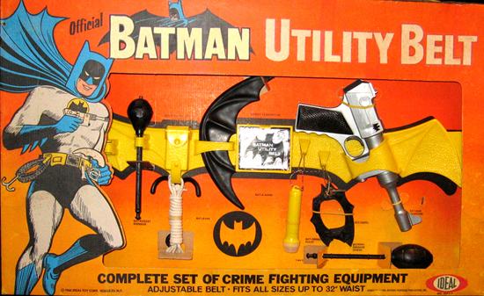
Availability & Utility Losses
Destruction , damage, or contamination
Denial, prolongation, acceleration, or delay in use or acquisition
Movement or misplacement
Conversion or obscuration

Slide 15
Functions of INFOSEC Personnel (1)
Avoid
Deter
Educate
Detect
Correct
Prevent
Recover
Mitigate
Punish/reward
Transfer
Investigate

Slide 16
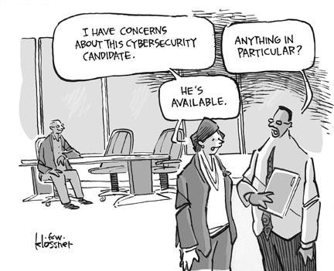
Functions of INFOSEC Personnel (2)
Avoidance: e.g., prevent vulnerabilities and exposures
Deterrence: make attack less likely
Detection: quickly spot attack
Prevention: prevent exploit
Mitigation: reduce damage
Transference: shift control for resolution
https://pbs.twimg.com/media/CTp2uFKUwAA2My8.jpg

Slide 17
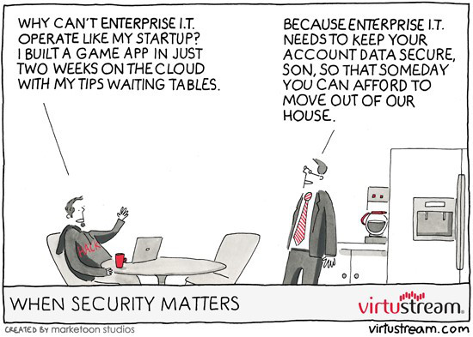
Functions of INFOSEC Personnel (3)
Investigation: characterize incident
Sanctions & rewards: punish guilty, encourage effective responders
Recovery: immediate response, repair
Correction: never again
Education: advance knowledge and teach others
https://cloudcomputingfuture.files.wordpress.com/2014/06/virtustream-when-security-matters.jpg?w=840

Slide 18
Now go and study

