Slide 1
Identity Theft
CJ341/IA241 – Cyberlaw & Cybercrime
Lecture #4
M. E. Kabay, PhD, CISSP-ISSMP
School of Cybersecurity, Data Science & Computing
Norwich University

Slide 2
DON’T PANIC*
This long presentation has a great deal of useful information
You should pore over every detail of every slide as you swot for quizzes and exams.
___________________
* See http://video.movies.go.com/hitchhikersguide/

Slide 3
Topics
Video: USPIS on identity theft
Identity Theft and Assumption Deterrence Act (18 USC §1028)
Overview of Identity Theft & Consequences
Identity Theft Statistics
Methods Used by ID Thieves
  Carding
  Dumpster® Diving
  Credit-Card Skimming
  Shoulder Surfing
  Retail Scams
  Internet Scams
  Government Impersonation
Responding to ID Theft

Slide 4
Video: USPIS
Identity Crisis (12')
http://www.mekabay.com/cyberwatch/uspis_ic.zip

Slide 5
What ID Thieves Do
Locate identifying data
  Social Security Number
  Driver's License
  Home address, telephone number
  Mother's maiden name
  Or just misuse of handle (screen name) for forged messages
Create new credit cards, bank accounts
Default on loans in victim's name
Ruin reputations, credit records
Victims have to prove their innocence

Slide 6
Consequences for Victims
Credit-card expenses relatively easy to correct IFF
  Victim checks statement immediately and
  Reports questionable transactions within time limit
Bank-account thefts much more difficult to correct
  Money stolen is client’s, not bank’s
  Client has great difficult recovering funds
Bill-collectors hound victims relentlessly
Bad credit records difficult to correct, ruin plans, cause loss of jobs or interfere with hiring
Criminal accusations put victims at serious risk of erroneous arrest or deportation
Victims may be nailed for child support of total strangers

Slide 7
Identity Theft and Assumption Deterrence Act (18 USC §1001)*
Identity theft fastest growing form of fraud today
  Criminals use SSN, public records to establish line of credit in victim's name
  Debts assigned to victim
  Burden of proof of innocence placed on victim
  Catastrophic results on innocent people
Felony
  Up to 20 years jail
_____
* http://www.law.cornell.edu/topn/identity_theft_and_assumption_deterrence_act_of_1998

Slide 8
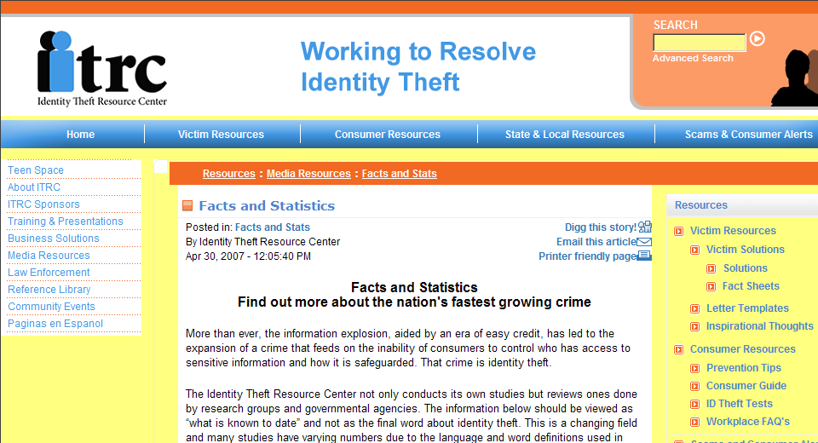
Identity Theft Statistics
Identity Theft Resource Center
http://www.idtheftcenter.org/artman2/publish/m_facts/Facts_and_Statistics.shtml
_____
Notes:
See also
National Crime Victimization Survey (NCVS) http://www.ojp.usdoj.gov/bjs/cvict.htm
U.S. Department of Justice
Yearly data collections from 1973 onward; revised 1992; reports for 1973-2005 online
Random sample of 77,200 households
134,000 individuals
Contacted every 6 months
Follows them for 3 years
Results available as PDF reports and XLS data sets from BJS Web page
http://www.ojp.usdoj.gov/bjs/abstract/it05.htm

Slide 9
Identity Theft Statistics (cont’d)
Victimization Data (individuals)
  2004: US Bureau of Justice Statistics estimated 3.6M new households victimized in ½ of year
  2001 to 2002: Increased 11-20% (Harris Interactive study)
  2002-2003: Increased 80% between
  2006: 15M new victims in USA – 1 new victim every 2 seconds (Gartner Group 2006)
Business Losses
  2005: estimated loss due to identity theft in US: $57B
  Loss of a single laptop computer with unencrypted data can cost $90K due to requirements for victim notification, public relations efforts, class action lawsuits

Slide 10
Law Enforcement Perspectives
2007 ID Analytics study
  Real-people identify theft = 10-15% of all cases
  Made-up identities fabricated with stolen data + false data = 85-90% of cases
Identity Theft becoming #1 crime in USA
  Majority of convictions are of repeat offenders
  Criminals also involved in substance abuse, narcotics trafficking, violent crime & robbery

Slide 11

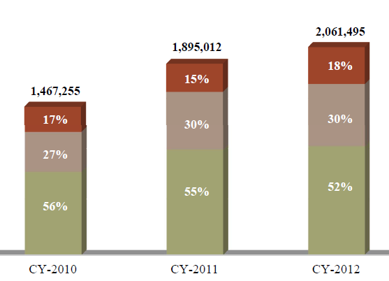
Federal Trade Commission 2012 Report
Consumer Sentinel
Network Complaint
Type % 2010-2012
ID theft #1 economic
crime in USA
  $21B stolen
  12.6M victims
Visit ITAC (Identity
Theft Assistance
Center) at
http://www.identitytheftassistance.org/pageview.php?cateid=47
http://ftc.gov/sentinel/reports/sentinel-annual-reports/sentinel-cy2012.pdf

Slide 12
Techniques used by Identity Thieves
Carding
Dumpster® Diving
Skimming
Shoulder Surfing
Retail Scams
Internet Scams
  Phishing
  Pharming

Slide 13
Carding
Stealing victim's credit card info
  Often from unencrypted data on networks, laptop computers & stolen backup media
  Using for theft
Create fake credit cards
  Numbers on cards include check digits
  Programs on 'Net generate fake card numbers with valid check digits
Deliver goods to real owner's address
  Or later, to drop-point
QUESTION: why don't banks and other credit-card issues take better measures to prevent carding?

Slide 14

The Shadowcrew Case
Operation Firewall
  US Secret Service
  Investigated Shadowcrew
Discovered international gang
w/ 4000 members
  Massive (>1.5M) credit-card number theft, ID theft
  Phishing, spamming, sale of stolen goods through eBay, false ID documents (e.g., drivers’ licenses) used for ID theft, creation of fake plastic credit cards, interstate wire transfers of illegal gains using e-money
  Losses > $4M

Slide 15

Shadowcrew Prosecutions
For full resources, go to
  http://www.usdoj.gov/criminal/cybercrime/
  Use search field with
  “Shadowcrew” as subject
Indicted 19 leaders October 2004
  http://www.usdoj.gov/criminal/cybercrime/mantovaniIndict.htm
By November 2005 12 people had pleaded guilty to charges of conspiracy, trafficking in stolen credit card numbers, and causing more than $4M in losses
  http://www.usdoj.gov/criminal/cybercrime/mantovaniPlea.htm

Slide 16
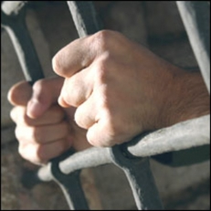
Shadowcrew Sentences
Member sentenced February 2006
  Kenneth J. Flury, 41, of Cleveland,
  OH
  32 mo in prison + 3 yrs supervised
  release
  $300K restitution to CitiBank
  http://www.usdoj.gov/criminal/cybercrime/flurySent.htm
Co-founder sentenced June 2006
  Andrew Mantovani, 24 of Scottsdale, AZ
  Fined $5K + 32 mo prison + 3 years supervised release
  5 others sentenced at same time
  By June 2006, 18 of 28 suspects arrested had pleaded guilty
  http://www.usdoj.gov/usao/nj/press/files/mant0629_r.htm

Slide 17
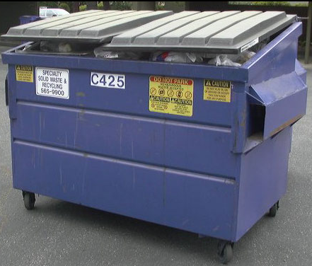
Dumpster® Diving
Get confidential information from garbage
  People discard valuable data
    Credit-card offers
    Bank statements
    Bills
    Even computer disks, tapes
NOT ILLEGAL to steal garbage placed on the curb in public space
But IS illegal to use the information for identity theft
SHRED confidential paper before discarding
WIPE confidential data on disks or DESTROY magnetic/optical media before discarding

Slide 18

Industrial Espionage:
Oracle vs Microsoft
Oracle Dumpster®-Dives vs MS (2000.06)
Bill Gates complained about Dumpster®
Diving of trash of organizations supporting MS in antitrust case
CEO Larry Ellison of Oracle admitted using private detectives to go through trash of
  Association for Competitive Technology
  Independent Institute
  Citizens for a Sound Economy
Suggested he would happily ship Oracle trash to MS in spirit of full disclosure.

Slide 19
Credit-Card Skimming
Criminal employees used to steal carbon papers from credit-card bills
  Electronic devices don't have carbon papers
Can dump data from electronic card readers
New portable devices allow cards to be scanned for future theft
Some ATMs equipped with fake readers on top of real card slot – record card data for later use or broadcast using wireless link
CHECK YOUR MONTHLY CREDIT-CARD STATEMENTS RIGHT AWAY

Slide 20
Shoulder Surfing
Observe key-entry on ATMs or phones from right behind user or even at a distance
Some gangs caught using telephoto lenses on movie cameras
Particularly common at crowded areas such as airports and bus terminals
STAND CLOSE TO THE KEYPAD to block visual access
WATCH OUT for people standing too close – tell them politely to back off

Slide 21
Retail Scams
Criminals conspire to trick clerks into quizzing customers
  Creep #1 stands near checkout
  Creep #2 phones clerk & claims to be security officer
    Tells clerk to assure customer that this is a routine security check to prevent fraud
    Demands details of ID to be read over phone
    Everything is then OK – but ID theft is in progress

Slide 22
Retail Scams (2)
Some stores offering automated access to new store credit-cards
  Terminals ask for SSN as sole identifier
  Criminals use someone else's SSN to set up card
  Jackpot the card at victim's expense
Suborning employees
  Criminals bribe employees to release list of credit-card transactions
  Access to dozens or hundreds of valid card #s and names

Slide 23
Internet Scams
Packet sniffing
  Capture TCP/IP traffic with identifying data
  Need access to server where data are received
  Or can use keystroke logger on victim's own computer
Phishing ("subscriber account update")
  See following slides taken from presentation to a meeting of NE ISSA (New England Information Systems Security Association)
Pharming: putting up fake Web sites

Slide 24
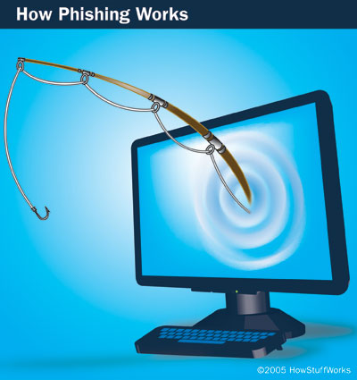
Phishing
Come with me, little child
Phishing Basics
Examples of Attacks
Effects
Anti-Phishing Measures
Public Education
Possible Solutions
Image provided courtesy of
How Stuff Works.com
http://computer.howstuffworks.com

Slide 25
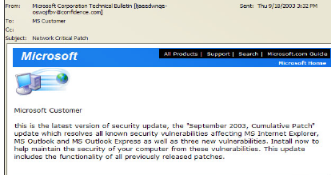
Come With Me, Little Child
From: Microsoft Corporation Technical Bulletin [ljseedwnge- Sent: Thu 9/18/2003 3:32 PM
oswojtfbv@confidence.com]
To: MS Customer
Cc:
Subject: Network Critical Patch
Microsoft Customer
This is the latest version of security update, the 'September 2003, Cumulative Patch'
update which resolves all known security vulnerabilities affecting MS Internet Explorer,
MS Outlook and MS Outlook Express as well as three new vulnerabilities. Install now to
help maintain the security of your computer from these vulnerabilities. This update
includes the functionality of all previously released patches.

Slide 26
Phishing Basics (1)
Pronounced "fishing"
Scam to steal valuable information such as credit cards, social security numbers, user IDs and passwords.
Also known as "brand spoofing"
Official-looking e-mail sent to potential victims
  Pretends to be from their ISP, retail store, etc.,
  Due to internal accounting errors or some other pretext, certain information must be updated to continue the service.

Slide 27
Phishing Basics (2)
Link in e-mail message directs the user to a Web page
  Asks for financial information
  Page looks genuine
    Easy to fake valid Web site
    Any HTML page on the real Web can be copied and modified
E-mails sent to people on selected lists or to any list
  Some % will actually have account
"Phishing kit"
  Set of software tools
  Help novice phisher imitate target Web site
  Make mass mailings
  May include lists of e-mail addresses
From Computer Desktop Encyclopedia v17.4
http://www.computerlanguage.com/

Slide 28
Serious Problem
"Illegal access to checking accounts, often gained via phishing scams, has become the fastest-growing form of consumer theft in the United States, accounting for a staggering $2.4 billion in fraud in the previous 12 months."
-- Gartner Group

Slide 29
Examples of Attacks
People's Bank - 'New Mail'
Citibank - 'Alert Service'
Paypal - 'Your Account Will Be Suspended'
Sovereign Bank - 'Unauthorized Account Access'
Citibank - 'Security Alert on Microsoft Internet Explorer'
eBay - 'TKO NOTICE: Verify Your Identity'
Verizon - 'Update your Verizon billing profile'
Washington Mutual Bank – 'Internet Banking Account'

Slide 30
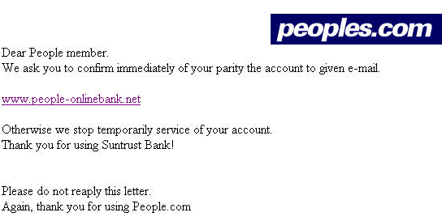
People's Bank
Not the proper domain for peoples.com

Slide 31
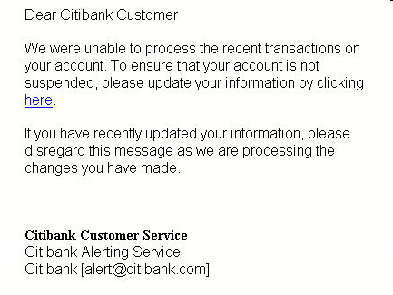
Citibank (Nov 10)
Links to
http://82.90.165.65/citi

Slide 32
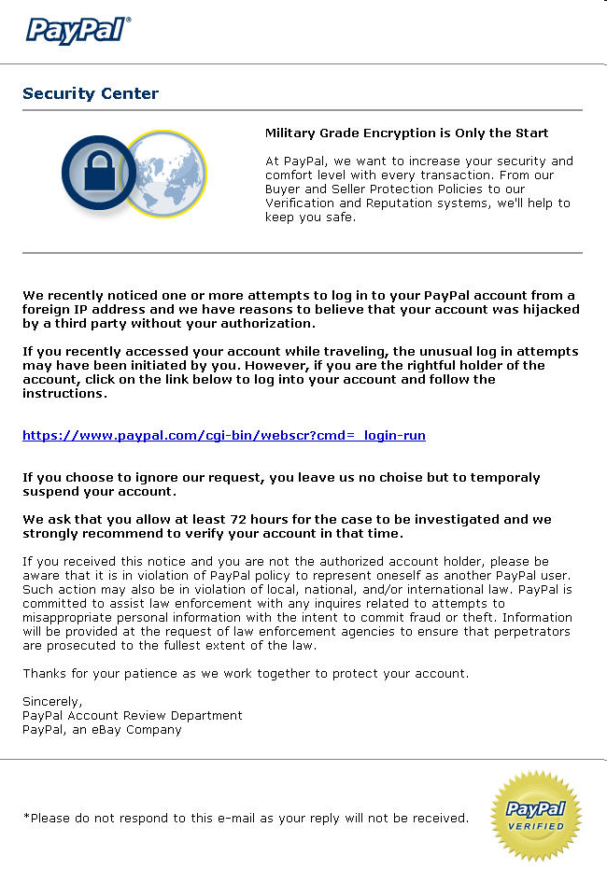
PayPal (1)

Slide 33
PayPal (2)
Actually links to
http://212.45.13.185/.paypal/index.php

Slide 34
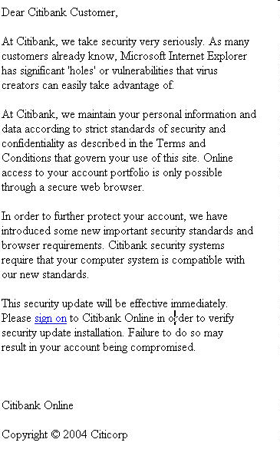
Citibank (Nov 1, 2004)
Links to
http://200.189.70.90/citi/

Slide 35
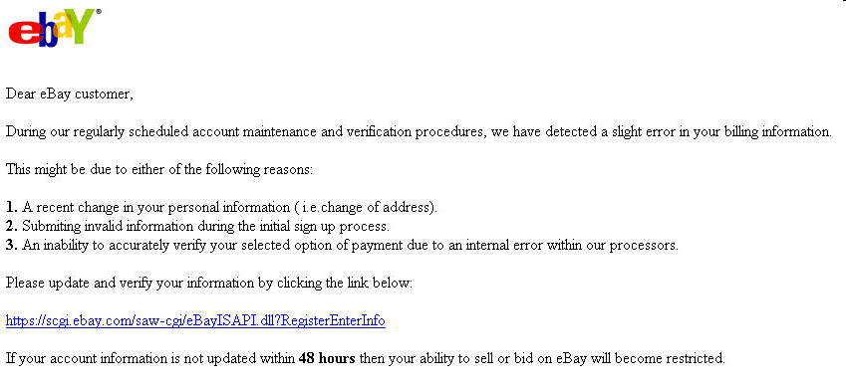
eBay (1)
http://signin-ebay.com-cgi-bin.tk/eBaydll.php

Slide 36
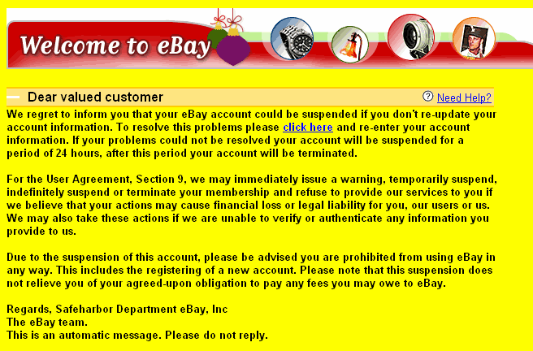

eBay (2) – Detailed Analysis
Received by MK 2004-11-17

Slide 37
eBay(2) Source Code
Extract of relevant section:
<p><STRONG><FONT face=arial>We regret to inform you that your eBay account could be suspended if you don't re-update your account information. To resolve this problems please </FONT><A
href="http://203.251.21.2/signin.ebay.com/ws2/eBayISAPI.dll/b2baf0b6a57d39abd6c44b48d6fe3559112c21e54b7e705ecc5116b3c7c38c37949e8aa81848934faf0821be04210e8c2ded3c4159edbee3ee1439f3892a3e91/"
target=_blank><FONT face=arial color=#0000ff>click here</FONT></A></STRONG><FONT face=arial> and re-enter your account information. If your problems could not be resolved your account will be suspended for a period of 24 hours, after this period your account will be terminated.<BR>

Slide 38
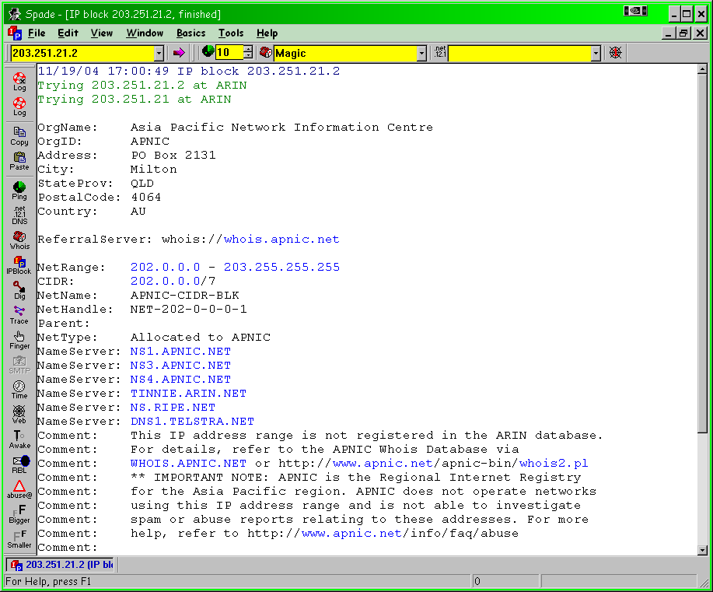
eBay (2) Reverse IP Lookup
Using SamSpade for Windows v1.4
Available free from
http://www.samspade.org/ssw/

Slide 39
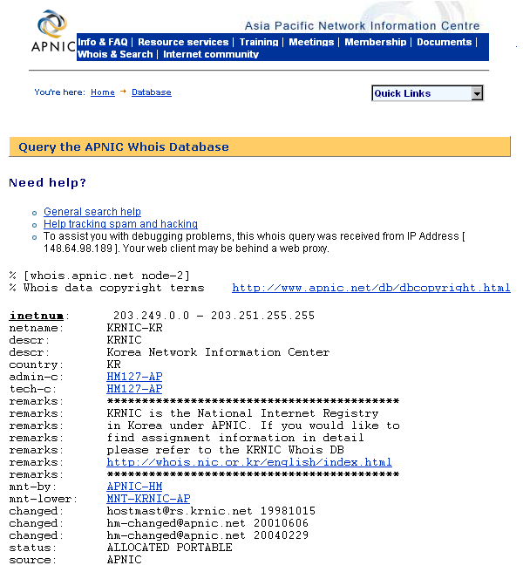
eBay (2) APNIC R-IP Lookup
Asia-Pacific Network
Information Center
Routes to KoreaNIC

Slide 40
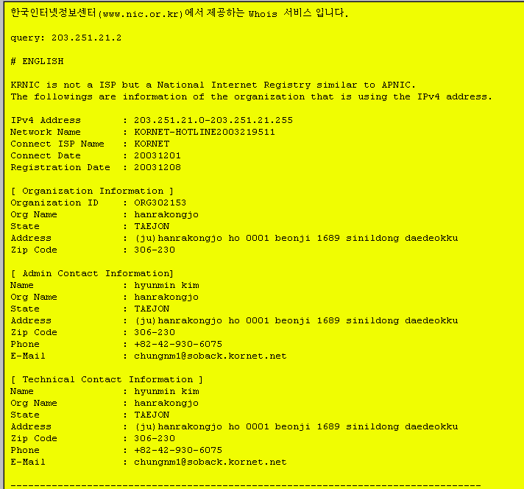
eBay (2) KRNIC R-IP Lookup
E-mail addresses
not always valid

Slide 41
Get a Job – and Lose Money
Free training offer is another spam scam
  By John Leyden
  Published Tuesday 2nd November 2004 12:35 GMT
  http://www.theregister.com/2004/11/02/training_spam_scam/
Apply for "training" and "job" at Credit Suisse
Fill in banking details (!)
Lose control over your financial information to criminals

Slide 42
Phishing Harms Firms
Harmful at many levels
  Threatens effective communication
  Undermines goodwill and trust
Customers
  Direct harm from stolen IDs, passwords
  Could perceive business as not taking adequate steps to protect users
Diminishes value of brand
  Could affect shareholders
  Possibility of liability for failure to exercise due diligence in protecting trademark
Slide based in part on material that is
copyright © 2004 Don Holden, CISSP
Used with permission (and thanks).
Notes:
The secondary risk is that consumers who suffer losses as a result of these attacks will accuse companies of not doing enough to prevent them. The costs here include litigation and unwanted attention from regulators (note that the Federal Trade Commission

Slide 43

Anti-Phishing Measures
Proclaim, Protect, Pursue
Proclaim in all correspondence the use of an official mark (e.g. TrustedSender stamp)
Protect all messages, Web pages with the mark
Pursue all impostors – actively seek reports of phishing
Copyright © 2004 Don Holden, CISSP
Used with permission (and thanks).
Notes:
MasterCard using NameProtect to get immediate intelligence reports when new phishing sites or scams are launched.
Brightmail also offers a service to notify companies when one of its millions of decoy email accounts or customers receives fraudulent email.

Slide 44
Public Education
Use digitally-signed documents ONLY
  Don't release unsigned documents
  Get consumers used to idea that an unsigned document is an untrustworthy document
Use public education campaigns
  "No one will ever ask you to confirm your password"
  "Don't believe alerts that address you as 'Dear Customer.'"
  Link to APWG documents; e.g.,
  http://www.antiphishing.org/consumer_recs.html

Slide 45
Possible Solutions
Strong Website authentication
Mail server authentication
Digitally-signed e-mail with desktop verification
Digitally-signed e-mail with gateway verification
AWPG: Proposed Solutions to Address the Threat of Email Spoofing Scams
http://tinyurl.com/5bo55

Slide 46
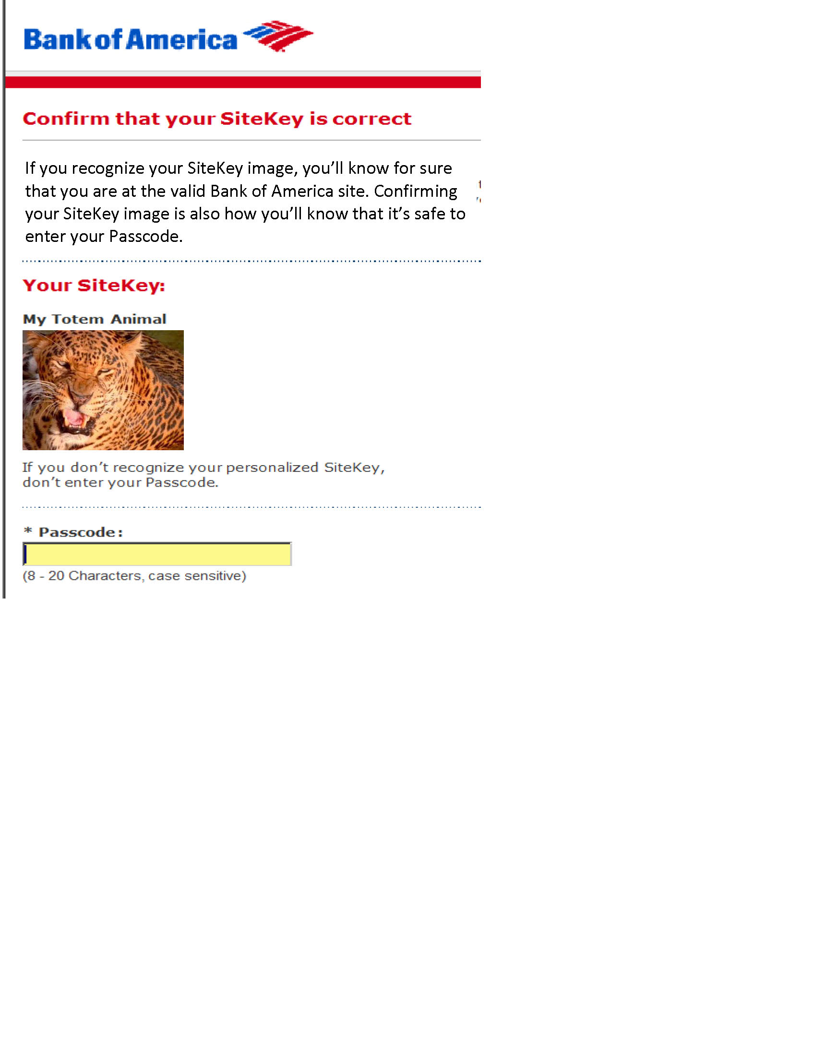
Authenticating a Website to a Registered User
User chooses from large range of photos
Associates a specific photo with logon
After entering userID, user sees login page with chosen image
If image matches recollection, user can safely enter password
See Kabay, M. E. (2007). “SiteKey tries to counter phishing.” Network World Security Strategies. http://tinyurl.com/3mepsz

Slide 47
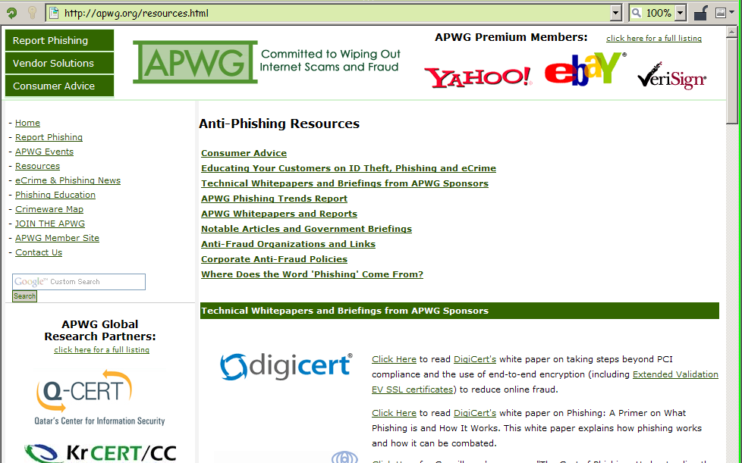
APWG Resources Page (Sep 2009)

Slide 48
Government Involvement
Criminals forge government IDs for social engineering
Some agencies are lax in verifying identity when issuing identifying documents
Some government agencies post confidential data on Web without adequate safeguards
  Include unnecessary details such as SSN
Theft from USPS system can provide valuable documents
  Applications, new credit cards, new documents

Slide 49
Responding to ID Theft
Prevent theft: restrict access to your SSN and other personal data
  SSN may be required by SSA, IRS employer, financial institution, lender
  Corner store or video rental should NOT be given SSN
NEVER give out credit-card or other personal data over the phone to someone who has called you. Ask for written documents.
Shred papers that include confidential info before discarding.
Destroy computer media before discarding.

Slide 50
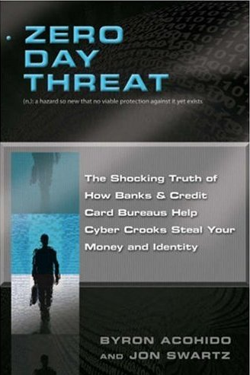
Interesting
Book (2008)
Journalists
Appeal to non-technical readers
Good stories of specific computer criminals followed chapter by chapter
Analysis of structural weaknesses in banking and credit systems
ISBN 1-402-75695-X
304 pp, $13.57 (Amazon, Sep 2008)

Slide 51
Now go and study

