Slide 1
Internet Fraud
CJ341/IA241 – Cyberlaw & Cybercrime
Lecture #7
M. E. Kabay, PhD, CISSP-ISSMP
School of Cybersecurity, Data Science & Computing
Norwich University

Slide 2
Topics
Internet Fraud & Con Artistry
Identity Theft / Phishing / Pharming / Vishing*
Online Auction Fraud
E-mail Scams / Chain letters / hoaxes
Online Prostitution & Mail-Order Brides
Human Trafficking
Cybercrimes involving Fraud
Mail and Wire Fraud
Access Devices
Stock Fraud
Identity Theft
Forgery
Computer Extortion
Cyberterrorism
* Vishing = Voice-mail Phishing
Criminals use VoIP systems to send fake messages to phones asking victim to call back and give name and credit-card number.

Slide 3
Fraud Defined
Deception for gain (i.e. personal)
Intent to deceive, trick, defraud
Examples
Bait and switch
Identity theft
Confidence games; e.g.,
Nigerian 419 advance-fee fraud
Pyramid (Ponzi) scams

Slide 4
Criminal & Civil Liability
Fraud = Criminal Act
Fraud = Civil wrong (A tort)
The Law provides remedies for civil wrongs
Example: Civil Fraud
Making a false representation to a person's detriment, which is relied upon by another
Existing federal laws seem to criminalize activity after damage is done
Consumer has already been defrauded
Include wire fraud, identity theft, credit card fraud, computer fraud
Trade laws, possibly including new federal CAN SPAM Act

Slide 5
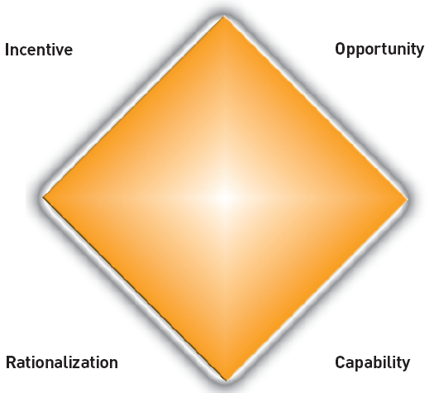
Elements of Fraud
Incentive: want or need to commit fraud.
Opportunity: weakness in system that right person could exploit. Fraud is possible.
Rationalization: I have convinced myself that this fraudulent behavior is worth the risks.
Capability: I have the necessary traits and abilities to be the right person to pull it off. I have recognized this particular fraud opportunity and can turn it into reality.
http://www.nysscpa.org/cpajournal/2004/1204/images/ex1p38.pdf

Slide 6
Elements of Fraud
A representation
Falsity of representation
Materiality of representation
Speaker’s knowledge of falsity of representation
Speaker’s intent it should be relied upon
The hearer’s ignorance of falsity of representation
Hearer’s reliance on representation
Hearer’s right to rely on representation
Hearer’s consequent and proximate injury caused by reliance on representation
Taylor v. State Compensation Insurance Fund, 175 Mont. 432, 913 P.2d 1242 (1996)
See http://wcc.dli.mt.gov/TOOLS/Fraud_Elements.htm

Slide 7
Identity Theft
18 USC § 1028
Criminalizes acts comprising fraud in connection with identification documents
See Class Lecture 4
Identity Theft Statistics
Methods Used by ID Thieves
Carding
Dumpster® Diving
Credit-Card Skimming
Shoulder Surfing
Retail Scams
Internet Scams
Government Impersonation
Responding to ID Theft

Slide 8
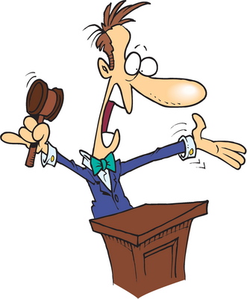
Online Auction Fraud
eBay, Yahoo, MSNBC. . .
Fundamental problems:
Thieves selling non-existent stuff
“Auctions” run by shills to drive up price
Auction anti-con-artist vigilante
Ordered a laptop via auction (2002)
6 weeks later received by FedEx lap-top sized box containing Montreal phonebook
Ludicrous auctions (selling family, island, etc.)
Illegal auctions (body parts, children)
21 year old Australian facing fraud charges for sale of non-existent iPods on Internet (Sep 2006)
Japan: Internet auction fraud = top cyber crime

Slide 9
Scams / Hoaxes
E-mail scams / Chain letters/ hoaxes
Example: Bill Gates giving away money
Don't forward unverified rumors; verify first at a number of Web sites (e.g., snopes.com, vmyths.com)
If it's too good to be true…
Phishing (see lecture 4)
Pharming (using fake Web sites for fraud)
Vishing – using voice mail for fraud

Slide 10
Snopes
http://www.snopes.com
Jeep at Half the Price: Two men are still making payments on a Jeep Cherokee they sent to the bottom of a frozen lake during a duck-hunting mishap.

Slide 11
Snopes (cont'd)

Slide 12
Online Prostitution & Mail-Order Brides
Prostitution said to be “world's oldest profession”
Unknown number of escort and mail-order bride Web sites
Exchange of money for service
Internet has revolutionized way these agencies conduct business
Studies show that many photos have dozens or hundreds of different names
Some photos actually gleaned from Google Images
Some “nubile 18 year olds” actually 75 year olds – or men

Slide 13
Online Prostitution (cont'd)
Fraud risks – Examples
Women themselves defrauding men (and vice versa);
Agencies scamming (e.g., requiring payment of funds for travel or visit; often once payment is wired, “love letters” stop).
Potential red flags:
Within few letters, professes true love
Repeated mention of honesty
Indicates poverty –no money
General (non-specific) communications, as some scammers “work” many individuals at a time
Legal Issues
Identity theft
International investigation of fraudulent activity
Immigration concerns

Slide 14
Human Trafficking (Slavery) Aided by Internet
Women (mostly) responding to Internet ads for work
E.g., “DA: Woman turned into sex slave after internet meeting”
< http://tinyurl.com/3tobt4n >
27-year-old Wisconsin woman tried to exchange housework for free lodging in NYC
Trapped in man’s apartment 9 days
Tied with hope, gagged, handcuffed
Repeatedly raped
Finally able to call her mother for help
Police found her bruised and shaking
Arrested owner of apartment

Slide 15
Mail & Wire Fraud
Mail & Wire Fraud statutes
Can be used to prosecute those who used computers and Internet to commit fraud
Even though not cybercrime- specific
Can be used in tandem
Use of mail or electronic communications in carrying out some other fraud exacerbates crime
Note general federal conspiracy provision (18 USC § 1341) could also apply & add to charges
Investigated by USPIS – United States Postal Inspection Service < https://postalinspectors.uspis.gov/ >

Slide 16
Mail & Wire Fraud (2)
Mail Fraud, 18 USC § 1341
An offense for anyone who, "having devised or intending to devise any scheme or artifice to defraud, or for obtaining money or property by means of false or fraudulent pretenses" uses U.S. mails or "any private or commercial interstate carrier" (e.g., FedEx) "for purpose of executing such scheme or artifice or attempting to do so"
Key Elements:
Defendant devised or intended to devise scheme to defraud (INTENT); and
Mails used for purpose of executing scheme to defraud (ACT)

Slide 17
Mail & Wire Fraud (3)
Wire Fraud, 18 USC § 1343
An offense for anyone who, "having devised or intending to devise any scheme or artifice to defraud, or for obtaining money or property by means of false or fraudulent pretenses, representations, or promises, transmits or causes to be transmitted by means of wire, radio, or television communication in interstate or foreign commerce, any writings, signs, signals, pictures, or sounds for purpose of executing such scheme or artifice [to defraud]"
Fraudulent activity involving interstate wire (electronic) communications (including Internet)
Key Elements:
1. Defendant intentionally participated in a scheme to defraud or for obtaining money or property by means of false or fraudulent pretenses (INTENT); and
2. that wire transmissions were used for purpose of executing scheme to defraud

Slide 18
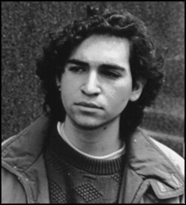
US v. LaMacchia (1994)
David LaMacchia was 21 year old MIT student
Invited anyone to upload and download illegal copies of proprietary software
Could not be tried under copyright violations 18 USC § 506(a) because no personal monetary benefit
Indicted under wire fraud statute
(cont’d)

Slide 19
US v. LaMacchia (cont'd)
Case dismissed
No money, no fraud
Court ruled that
illegal copies of intellectual property are not property that is
"stolen, converted or taken by fraud"
under Stolen Property Act
Led directly to passage of No Electronic Theft Act of 1997
Removed requirement for financial gain from 18 USC § 506(a) as basis for prosecution

Slide 20
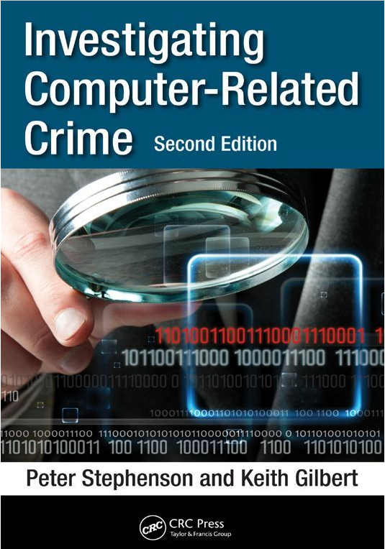
Anatomy of a Wire Fraud
True case study of complicated wire fraud attempted against small US credit union
Investigated by Norwich University’s
Prof Peter Stephenson, PhD, VSM, CISSP, CISM, FICAF
Director, Norwich University Center for Advanced Computing and Digital Forensics
Associate Professor of Digital Forensics
Chief Information Security Officer
Distinguished author
Keith Gilbert – NU BSc CSIA ‘2010

Slide 21
Wire Fraud Fundamentals (1)
WIRE FRAUD - 18 USC 1343, makes it Federal crime or offense for anyone to use interstate wire communications facilities in carrying out scheme to defraud.*
A person can be found guilty of that offense only if all of following facts are proved beyond a reasonable doubt:
That person knowingly and willfully devised scheme to defraud, or for obtaining money or property by means of false pretenses, representations or promises; and
That person knowingly transmitted or caused to be transmitted by wire in interstate commerce some sound for purpose of executing scheme to defraud.
_________________
* The 'Lectric Law Library - http://www.lectlaw.com/def2/w017.htm

Slide 22
Wire Fraud Fundamentals (2)
Not necessary for government to prove
All of details concerning precise nature and purpose of scheme; or that
Material transmitted by wire was itself false or fraudulent; or that
Alleged scheme actually succeeded in defrauding anyone; or that
Use of interstate wire communications facilities was intended as specific or exclusive means of accomplishing alleged fraud.

Slide 23
Wire Fraud Fundamentals (3)
What must be proved is that
Person knowingly and willfully devised or intended to devise scheme to defraud; and that
Use of interstate wire communications facilities was closely related to scheme because person either
Transmitted something or
Caused it to be transmitted
In interstate commerce
In attempt to execute or carry out scheme.

Slide 24
Wire Fraud Fundamentals (4)
To “cause” interstate wire facilities to be used is to
Do an act with knowledge that
Use of wires will follow in ordinary course of business or
Where such use can reasonably be foreseen.
Each separate use of interstate wire facilities in furtherance of scheme to defraud constitutes separate offense.

Slide 25
The Scenario – Intelligence Gathering
Fraudster obtains information about depositor including:
Name
Address
SSN
Password verification question/answer
Signature
Account balance
Account number
Phone number

Slide 26
Scenario – Gaining Access
The fraudster social engineers credit-union customer-service agents to obtain:
Access to customer's account
New password
Wire transfer
The fraudster social engineers phone company to obtain:
Telephone number redirect to throwaway cell phone

Slide 27
What Fraudster Needs to Commit Fraud
Customer name
Customer address
Customer social security number
Customer account number
Customer date of birth and other personal information such as mother's maiden name
Customer password to on-line banking
Customer account balance and date/amount of last transaction
Customer phone number as shown in credit union records

Slide 28
The Fraud (1): Background
Fraudster searches county property records
Targets several owners of large properties
With mortgages held by credit union
Fraudster gathers as much information from public records as possible
Uses cell phone camera to photograph signatures of owners on public copies of deeds
The fraudster goes to genealogy site and locates victim
Obtains maiden names of mother and other relatives

Slide 29
The Fraud (2)
The fraudster obtains
Phone numbers using reverse phone directories and
For a few dollars obtains Social Security Numbers, dates of birth and other personal information about owners from on-line services.
Armed with personally identifiable information, fraudster
Calls credit union and
Social engineers owner’s account number from customer service agent.
Several ways to do this such as woman pretending to be an owner's wife. . . .

Slide 30
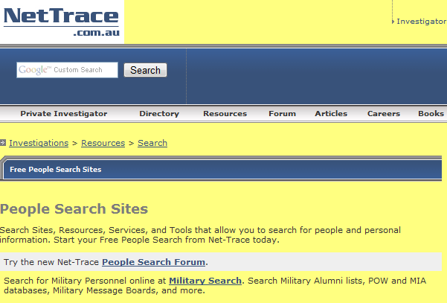
People Searches (1)

Slide 31
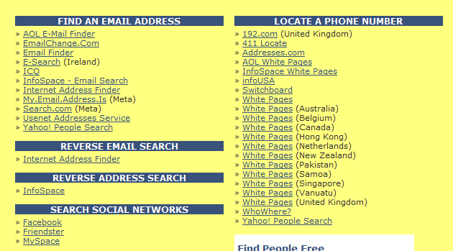
People Searches (2)

Slide 32
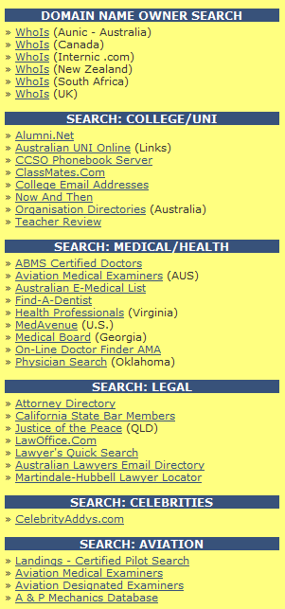
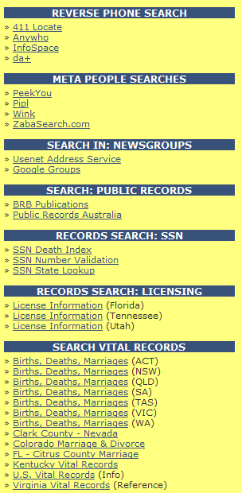
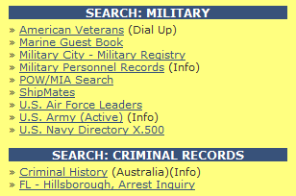
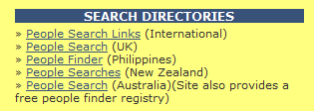
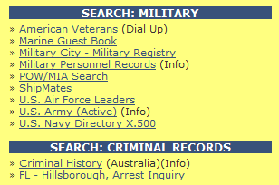
People Searches (3)

Slide 33
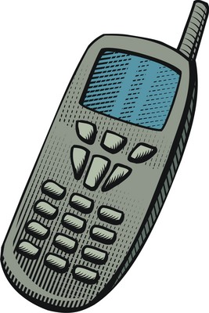
The Fraud (3): Redirect
The fraudster now has:
Name
Address
Phone number
Account number
Mother's maiden name
Victim's signature
Now fraud begins
The fraudster social engineers phone company to redirect victim's phone number to throw-away cell phone using credible pretext

Slide 34
The Fraud (4): Wire Transfer
Fraudster calls credit union and social engineers new password
Next, fraudster logs into victim's on-line account to gather account information
Then fraudster calls credit union again (some days may pass between calls) at different time of day to ensure different customer service agent
Requests wire transfer to bank in Spain
Call is made late Friday Spanish time

Slide 35
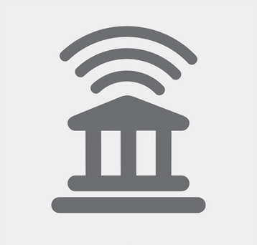
The Fraud (5): Authentication
The credit union authenticates fraudster
Mother's maiden name
Date of birth
Address, SSN, etc.
Date and amount of most recent transaction in account
Calls fraudster back on phone number of record (now redirected to fraudster's throw-away phone)
Faxes wire transfer form

Slide 36
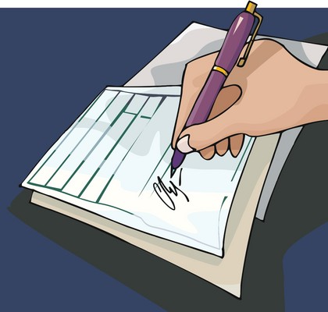
The Fraud (6): Signature
The fraudster:
Fills out form
Adds signature obtained from county mortgage records
Faxes form back to credit union
The credit union:
Compares signature
Transfers money ($600K in this case) out of victim's account to bank in Spain

Slide 37
Outcome
By coincidence, victim checked his account as all of this was happening and found that $600K was missing – called credit union
The credit union tried to stop transaction but was too late
Fraud-prevention officer contacted bank in Spain which was just closed; however, someone did answer phone
Spanish bank had stopped withdrawal of funds by fraudster since there had been “suspicious activity on account in past” (officer of Spanish bank)
Money was returned but fraudster never was caught.

Slide 38
Fraud & Access Devices
18 USC § 1029 (See Clifford p. 54+)
Federal crime to engage in certain activities involving "access devices"
"any card, plate, code, account number, electronic serial number, mobile identification number, personal identification number, or other telecommunications service, equipment, or instrument identifier, or other means of account access that can be used…to obtain money, goods, services, or anything of value"
Also prohibits activities involving counterfeit access devices
"any access device that is counterfeit, fictitious, altered, or forged, or an identifiable component of an access device or a counterfeit access device"

Slide 39
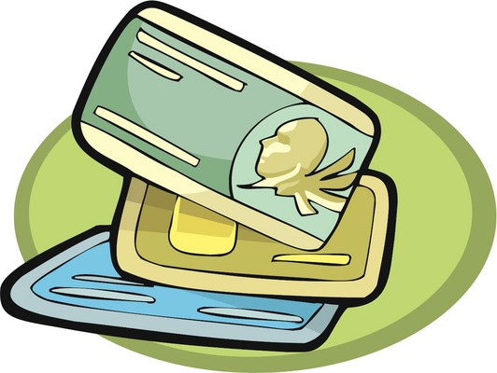
Fraud & Access Devices (cont'd)
Key:
Any unauthorized device designed or used for fraudulent access to resources
Money (e.g., fund transfers, payment); goods; services (e.g, phone cards, network, cable TV), anything of value
Includes credit cards obtained fraudulently or generated for fraud
Forbids production, trafficking in, control or custody of, or possession of device-making equipment with intent to defraud

Slide 40
Fraud & Access Devices: Marcus Abercrombie (2005)
GA man pled guilty to charges of access device fraud and conspiracy to commit access device fraud
Stole >$200K in all
Abercrombie & accomplices exchanged bar codes on merchandise
Bought items at significantly reduced prices
Returned merchandise to other stores
Received store credit for items in store debit cards
Also fenced fraudulently obtained Home Depot & Lowe's merchandise and store debit cards over eBay and through pawn shop
Renovated 2 homes using fraudulently- acquired store credit

Slide 41
Fraud & Access Devices (cont'd)
U.S.A.P.A.T.R.I.O.T. Act added new subsection to 18 USC § 1029 to confer extraterritorial jurisdiction (ability of government to exercise authority beyond its normal boundaries) where anyone acts outside jurisdiction of US and engages in any act that would constitute an offense if committed within jurisdiction of US, if two conditions are met:
offense involves access device issued, owned, managed or controlled by financial institution or other entity within jurisdiction of US; and
person transports, delivers, stores, or holds article used in commission of offense within jurisdiction of US

Slide 42
Pump ‘n’ Dump: Motley Fool
1996.03 – Iomega high-capacity removable disk drives slammed by false information
America Online's Motley Fool bulletin board
False information
Flaming and physical threats
Caused volatility of stock prices
People who know which way stock will rise or fall can make money on trades
Notes:
Date: Sun, 17 Mar 1996 19:56:44 -0500 (EST) From: Educom <educom@elanor.oit.unc.edu> Subject: Iomega Stock Volatility Blamed on AOL Postings (Edupage, 17 Mar 1996)
Iomega, maker of high-capacity removable disk drives, is focus of controversy on America Online's Motley Fool bulletin board. Company officials have complained to SEC that postings on Motley Fool and other BBSs have contained false information and may be contributing to volatility of its stock. Online exposure has "raised visibility of some stocks as well as interest in those stocks," says an outside spokesman for Iomega. "At same time, we're very concerned about how online services can be used to attempt to drive stock prices higher or lower through misinformation." Postings about Iomega escalated to flaming and physical threats last month, causing Motley Fool to pull some of more offensive ones, but critics of online BBSs note Iomega's problems are a result of practice of using "screen names" and lack of verification of information that's posted. "You don't know if person is a Ph.D. or in Sing Sing," says one critic. (*Wall Street Journal*, 15 Mar 1996, A5C)

Slide 43
Pump ‘n’ Dump: PairGain
1999.04: Gary Dale Hoke arrested by FBI
Employee of PairGain, CA telephone equipment company
Created bogus Web page
Simulated Bloomberg information service
Touted PairGain stock
“Undervalued – impending takeover”
Pointed to fake page using Yahoo msg boards
Investors bid up price of PairGain stock from $8.50 to $11.12 (130%)
13.7 M shares traded – 700% normal volume
Sentenced (Aug 1999) to home detention, probation, U$93K restitution
See < http://articles.latimes.com/1999/aug/31/business/fi-5307 >

Slide 44
Pump ‘n’ Dump: Emulex
2000.98: Emulex lost 60% of total share value
Mark Jakob, 23 years old
Fabricated news release
Sent from community college computer
Circulated by Dow Jones, Bloomberg
Claimed profit warning, SEC investigators, loss of CEO
Jakob profited by $240,000 in minutes
Notes:
RISKS 21.02
http://www.investors.com/editorial/tech05.asp

Slide 45
Forgery
Distinct offense in some states; e.g.,
"Any person who creates, alters, or deletes any data contained in any computer or computer network, who if such person had created, altered, or deleted a tangible document or instrument would have committed forgery…shall be guilty of crime of computer forgery." (Clifford, citing Georgia statutes)
Some states also specifically criminalize use of computers to commit fraud
Other states increase penalties if computer used to devise or execute scheme to defraud
Note: A person can be charged with violations of federal law AND state law

Slide 46
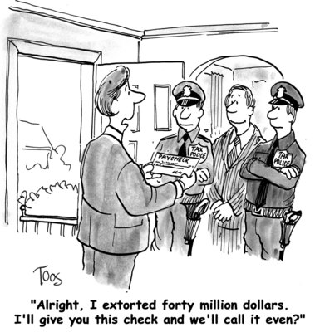
Extortion and Blackmail
Extortion: threatening harm unless victim complies with stated conditions
"Pay us money or we will cook your dog."
Blackmail: form of extortion involving revelation of something victim wants kept secret
"Pay us money or we will reveal that you cooked your dog.“
“Pay us money or we will reveal that you voted for _____.”

Slide 47
Computer Extortion / Blackmail
Some states expressly criminalize use of computer to commit extortion
Various Ways:
1. Include extortion into definition of computer fraud
2. Include computer extortion into state's general extortion statute
3. Make computer extortion an offense that incorporates authorized access/ hacking and cracking statutes

Slide 48
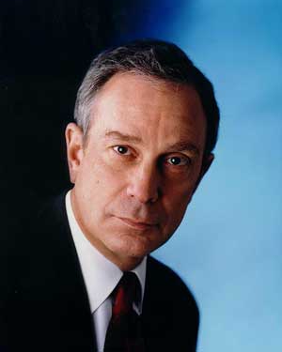
Computer Extortion / Blackmail: Examples
Mayor Michael Bloomberg (2000)
Oleg Zezov, 29 a Kazakhstani computer expert
Threatened multi-billionaire Bloomberg with release of company secrets (before Bloomberg became mayor of NYC)
Demanded $200K in payment
Arrested in sting operation in London
Sentenced to 4 years in federal prison

Slide 49
Cyberterrorism
"Leveraging of a target's computers and information technology, particularly via Internet, to cause physical, real-world harm or severe disruption with aim of advancing attacker's own political or religious goals." (Wikipedia)
A few states expressly outlaw cyberterrorism; e.g,. Connecticut has an offense described as "computer crime in furtherance of terrorist purposes“

Slide 50
Belgian ATC Fraud
1997.01 — Reuters
Belgian lunatic broadcasting false information to pilots
Air-Traffic Control caught false information in time to prevent tragedy
Serious problem for air safety
Police unable to locate pirate transmitter
Lunatic thought to be former ATC employee
Notes:
Radio pirate stirs panic in Belgian airspace
Reuters World Report January 22, 1997 05:54:00
Copyright 1997 Reuters Ltd. All rights reserved.@bThe following news report may not be republished or redistributed, in whole or in part, without prior written consent of Reuters Ltd.
BRUSSELS, Jan 22 (Reuter) ‑ A radio pirate posing as an air traffic controller has been broadcasting false instructions to pilots to disrupt their landings and cause accidents, air traffic authorities said on Wednesday.
But Brussels airport authority insisted there was no actual danger.
A spokesman for air traffic authorities told BRTN radio that unknown man has been misleading pilots since October by breaking into normal air traffic radio frequencies.
"He tells them how to land, normal messages ‑‑ a bit higher, a bit lower, a bit to left, right, that kind of instructions," he said. "He can only have bad intentions...this could lead to accidents."
The man, who operates mainly from eastern Belgium, is familiar with specialised air traffic vocabulary, he said.
"He knows so much about it that we believe he was involved (in air transport)...he is a major threat to air transport," he said.
Mobile teams have so far failed to catch radio pirate who is using a mobile transmitter.
Brussels airport authority chairman Eric Kirsch told BRTN that pilots flying to capital's airport were given strict security instructions.
"When a controller gives instructions to pilot, pilot has to repeat them so that controller can check that pilot has well understood them...This is why I can say...there is no danger," Kirsch said.
REUTER

Slide 51
Now go and study

