Slide 1
Cyberstalking, Spam & Defamation
CJ341/IA241 – Cyberlaw & Cybercrime
Lecture #8
M. E. Kabay, PhD, CISSP-ISSMP
School of Cybersecurity, Data Science & Computing
Norwich University

Slide 2
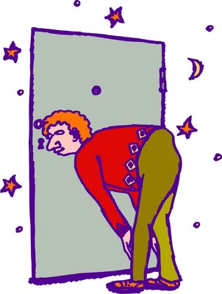
Topics
Cyberstalking
  Jane Hitchcock
  Choosing Victims
  Targeting Victims
  Cyberstalkers
  Law Enforcement Response
  Applicable Law
Spam and the CAN-SPAM Act
Defamation
  Cubby vs CompuServe (1991)
  Stratton Oakmont vs Prodigy (1995)
  Blumenthal v. Drudge & AOL (1998)
Libel and Freedom of Speech
Defenses

Slide 3

Cyberstalking
“Cyberstalking”
  Relatively new term – since early 90s
  Refers to harassment or physical threatening of a victim through electronic or digital means (Clifford)
  Term sometimes used
  interchangeably with online
  harassment or online abuse
  No uniform definition
Emerging crime
  Originally considered
  harmless
  CA first state to criminalize
  “stalking” behavior – after
  high profile events

Slide 4
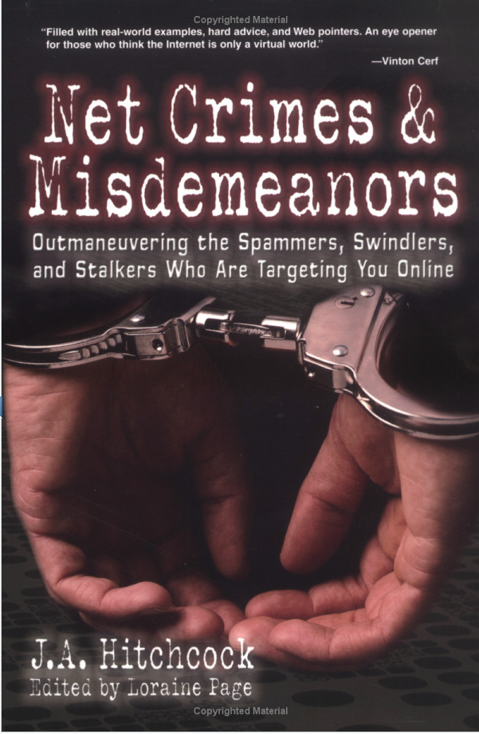
Jane Hitchcock
Literary agent & author
Victimized by mail-bombing (flooding) attack of her e-mail account
Targeted because of commentary she posted on a message board
After changing her e-mail address, harassment continued
Personal information posted on site
  Listed as a sexual deviant
  Looking to act out rape fantasies
Feared for her life

Slide 5
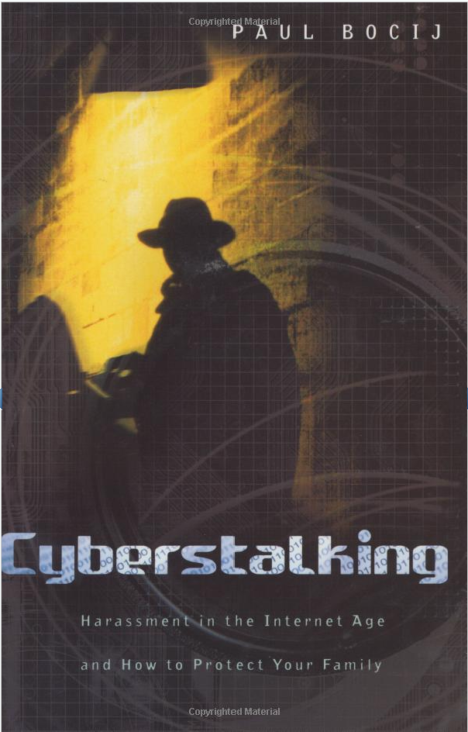
Cyberstalking
Continuous process
Not just one activity
Activities may cross into physical world
“Make no mistake: this kind of harassment can be as frightening and as real as being followed and watched in your neighborhood or in your home.”
  Vice President Al Gore
  http://tinyurl.com/3sue7kl

Slide 6
Choosing Victims
Accessibility
  Cyberstalkers may not have to look far to locate personal / electronic contact information
  Business cards
  Personal Web sites
  Google search
  Myspace, Facebook
Easy to communicate electronically

Slide 7
Targeting Victims
Cyberstalkers Target Victims
  E-mail
  Online forums
  Bulletin boards
  Chat rooms
  Spyware
  Spam
Examples
  Chat harassment /“flaming”
  Unsolicited/unwanted e-mail
  Tracing Internet activity
  Sending viruses,
  Sending obscene images

Slide 8
Tracking Down Cyberstalkers
Criminals take advantage of anonymity
  E-mail forgery, spoofing, anonymous remailers
  Fake registration information
But difficult to remain completely anonymous
  Methods may delay identification
  Cooperation of ISPs can help trace traffic using IP headers
  Wiretaps can collect evidence if suspect identified
  Forensic evidence lies on computer systems

Slide 9
Law Enforcement Response
Enactment of state statutes
  Many states have added cyberstalking-specific legislation
  Or amended pre-existing laws to address stalking via technology
Finite Resources of LEOs
  $$
  Time
Coordination / cooperation needed
  Tracking across state lines
    Jurisdictional issues
    Search warrants, court orders

Slide 10
Applicable Law
No federal statute specifically directed at cyberstalkers
  Statutes do exist to prosecute sending of obscene, abusive or harassing communications [46 USC § 223(a) – see next slide]
Patchwork application of state and/or federal law
  State law varies from jurisdiction to jurisdiction
  Some states have cyberstalking-specific statutes

Slide 11
Obscene, Abusive or Harassing Communications 46 USC § 223(a)
See Clifford pp 30-31
An offense to use a telecommunications device in interstate or foreign communications to:
  make, create, solicit, and initiate transmission of any comment, request, suggestion, proposal, image, or other communication which is obscene, or child pornography, with intent to annoy, abuse, threaten, or harass
  make, create, solicit, and initiate transmission of any comment, request, suggestion, proposal, image or other communication which is obscene or child pornography knowing recipient is under age 18, regardless of whether the maker initiated the communication

Slide 12
Obscene, Abusive or Harassing Communications (cont’d)
  make telephone call or utilize telecommunications device, whether or not conversation or communication ensues, without disclosing identity and with intent to annoy, abuse, threaten, or harass;
  make or cause the telephone of another repeatedly or continuously to ring, with intent to harass;
  make repeated calls or initiate communication with a telecommunication device, solely to harass;
  knowingly permit any telecommunications facility under his or her control to be used to commit any of the above activities
Penalties include fines, imprisonment up to 2 years or both

Slide 13
Corporate Cyberstalking
Corporate Cyberstalking: incidents that involve organizations – companies, government
46 USC § 223(b)
  Federal crime to make an obscene or indecent communication for commercial purposes or to allow a telephone facility to be used for this purpose
  Federal crime to use telephone to make an indecent communication for commercial purposes which is available to anyone under the age of 18 or to allow a telephone facility to be used for this purpose

Slide 14
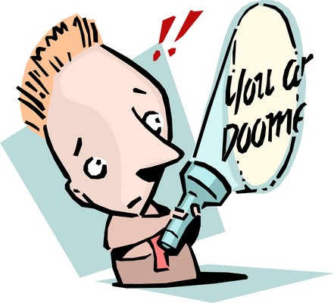
Threats: 18 USC § 875
Federal crime to transmit in interstate or foreign commerce a communication:
  Demanding a ransom for the release of a person;
  Intending to extort money;
  Threatening to injure a
  person;
  Threatening to damage
  property
Requires a threat (so may
not always apply to
cyberstalking)

Slide 15
Threats (cont’d)
Examples – Clifford pp 32-34
U.S. v. Kammersell: 10th Circuit Court held that defendant who allegedly sent threatening communication from his computer to another could be prosecuted under the statute even though the defendant and the recipient were located in the same state because the jurisdictional element (Interstate commerce) was satisfied – finding message was transmitted over interstate telephone lines and traveled through a server located outside the state
U.S. v. Alkhabaz: Defendant, Uof Mich. Student, used e-mail to communicated with a friend, much about descriptions of fantasized sexual violence against a female classmate; he was prosecuted for sending “threats” via interstate commerce. District court dismissed finding the e-mail message was not a “true threat” and was protected by the First Amendment; 6th Circuit Court affirmed the decision as it did not rise to the level of a threat

Slide 16
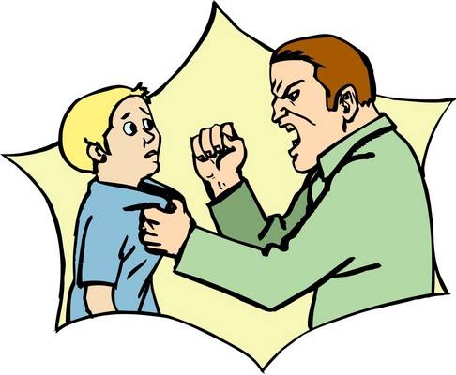
Stalking: 18 USC § 2261A
Federal crime to
  Travel in interstate or foreign commerce with intent to kill, injure, harass, or intimidate another, placing that person in reasonable fear of death or serious bodily injury to themselves or to a family member; or
  Use mail or any facility of interstate or foreign commerce to engage in a course of conduct that places a person in reasonable fear
  of death or serious bodily injury to
  themselves or to a family member
Key: Person must be placed in
reasonable fear of death or
bodily injury

Slide 17
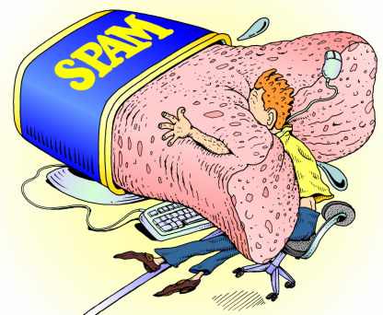
Spam (not SPAM™)
Can CAN-SPAM Can Spam?
Spam Statistics
Responding to Spam
Image from URL below. Permission for re-use currently being sought but original author unknown.
http://marketingreview.web-log.nl/photos/uncategorized/spam_fun.jpg

Slide 18
Can CAN-SPAM Can Spam?
CAN-SPAM* Act: “Controlling the Assault of Non-Solicited Pornography and Marketing Act of 2003” - Took effect Jan. 1, 2004
Does not outlaw spam
Requires spammers:
  To identify themselves clearly,
  Use no fraudulent headers
  Must honor consumer requests to cease sending mail
_____
*SPAM in all-uppercase is a trademark of Hormel Foods. Spam or spam are acceptable jargon terms for unsolicited commercial e-mail.

Slide 19
CAN-SPAM (cont’d)
CAN-SPAM Act added provisions to US Code, including to Title 18, making it a federal crime to
  Access a protected computer without authorization and intent to transmit multiple commercial electronic messages
  Use a protected computer to replay or retransmit multiple commercial electronic messages with intent to deceive or mislead recipients
  Falsify header information in multiple commercial messages
  Register using false identity for 5 or more electronic mail accounts or 2 or more domains and intentionally initiate transmissions from such accounts or domains
  Falsely represent oneself to be the registrant or the legitimate successor in interest to the registrant of 5 or more IP addresses and initiate messages from such addresses

Slide 20
CAN-SPAM (cont’d)
Multiple defined as >100 messages during 24-hr period
Punishment: fines and/or imprisonment
Also possibility of criminal forfeiture:
  Any property traceable to the proceeds obtained from the offense and/or
  Any equipment, software, or technology used to commit the offense

Slide 21
Spam Statistics
Spamcop
  Day, week, month, year statistics
  http://www.spamcop.net/spamstats.shtml
Spamhaus
  Worst ISP offenders
  http://www.spamhaus.org/statistics/networks.lasso
Ciphertrust
  Phishing botnets & corporate targets
  http://www.ciphertrust.com/resources/statistics/
CAUCE: Coalition Against Unsolicited Commercial Email
  Politics, reports, history
  http://www.cauce.org/

Slide 22
Responding to Spam
Don’t respond directly to spam
  Giving away fact that address is valid
  Will be added to lists sold to victims
Don’t send abusive responses to REPLY-TO address:
  Could be false
  Intended to spark wave of abuse at innocent victim
Do use antispam tools
  E.g., Cloudmark < http://www.cloudmark.com >
  Report to abuse@<isp> only if message is very new to you (minutes)

Slide 23
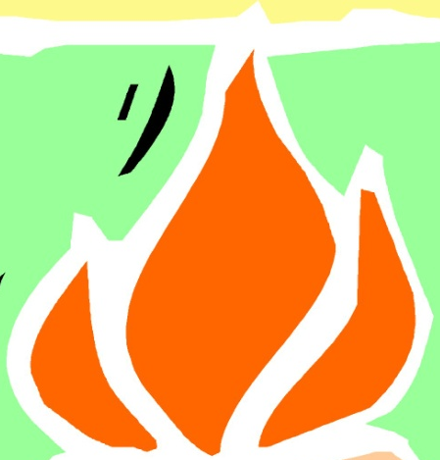
Defamation
Issues
Cubby v CompuServe
Stratton Oakmont v Prodigy
Blumenthal v Drudge & AOL
Libel & Freedom of Speech
Limitations on Lawsuits
Defamation of a Business
Suarez Corp v Brock Meeks
Defenses Against Defamation Actions
Rights of the Plaintiff

Slide 24

Defamation
Defamation
  Invasion of reputation and good name
  Making a statement to the public about another person that harms that person’s reputation (Burgunder p. 612)
Basis for complaint
  False statement
    Spoken = slander
    Written = libel
  About another person
  In the presence of others (public)
  Harm to reputation
    Exposes victim to hatred, contempt, ridicule
    Tendency to injure person in work

Slide 25
Defamation - Issues
Internet makes it easy to disseminate defamatory statements
  Written
  Oral (e.g., online audio clips)
No or little skill required to post / disseminate
Difficulty ascertaining person who made statement (anonymity, aliases)
Liability
  Person making statement may have no money for meaningful monetary recovery
  Who should be held responsible for harmful comments? ISPs?
    ?Question: Who is responsible for blog content? ISP?

Slide 26
Cubby v CompuServe (1991)
One of 1st important cases to address responsibility of ISPs for transmitting defamatory comment
CompuServe was one of largest ISPs at time
Thousands of discussion forums
Forums usually managed by owners
  Independent individuals or corporations
  E.g., Security forums were run by NCSA
Journalism forum participant posted allegedly libelous text
  Cubby Inc. filed libel suit against CompuServe
  Court held CompuServe could not be held liable for such defamatory postings
  Analogous to standards for library, bookstore, news-stand
http://epic.org/free_speech/cubby_v_compuserve.html

Slide 27
Stratton Oakmont v Prodigy (1995)
Facts:
  Allegedly libelous attack on company and president posted on Prodigy
  Prodigy advertised its responsibility for running a family-friendly ISP
  It promulgated “content guidelines” & used removal software
Court ruled in favor of plaintiff’s contention that Prodigy was more like publisher than distributor
Thus attempts to censor/control content led to legal responsibility for content
But in practice, moderators cannot control publication in most lists
http://www.issuesininternetlaw.com/cases/stratton.html

Slide 28
Blumenthal v Drudge & AOL (1998)
Gossip columnist had agreement with AOL to create, edit, and update content of the Drudge Report; AOL could edit or remove content that it determined to violate AOL’s terms of service.
Drudge transmitted alleged defamatory statements about Blumenthal who was about to begin work as an assistant to the President
Blumenthal sued Drudge and AOL for defamation
http://epic.org/free_speech/blumenthal_v_drudge.html

Slide 29
Blumenthal v Drudge & AOL (cont’d)
Decision: AOL immune from suit
Section 230 of Communication Decency Act of 1996 provides “No provider or user of an interactive computer service shall be treated as the publisher or speaker of any information provided by another information content provider.”
  Immunizes providers of interactive computer services from civil liability in tort with respect to material disseminated by them but created by others.
  Congress decided not to treat providers of interactive computer services like other information providers (e.g., newspapers)
http://www4.law.cornell.edu/uscode/html/uscode47/usc_sec_47_00000230----000-.html

Slide 30
Libel &Freedom of Speech
Not all speech is protected by 1st Amendment
  Free speech has its limitations
  Does not permit the making of false or misleading statements (no “Defamation of Character”)
No inalienable right to disseminate defamation
Opinions are usually not considered defamatory even if they do cause harm
Civil tort as remedy for damage is not precluded by 1st Amendment

Slide 31

Limitations on Lawsuits
Public officials are restricted in bringing defamation actions
  Must prove “actual malice”
Also applies to public figures
  De facto standard of visibility
  Includes people who don’t
  necessarily want to be public
  figures

Slide 32

Defamation of a Business
Can a business sue anyone for defamation?
Current trends
  <companyname>sucks.com
  Many legal actions against
  such sites
    But many plaintiffs
    have lost
  Sometimes employees
  bound by employment
  contracts restricting public
  comment

Slide 33
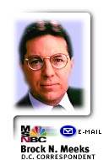

Suarez Corp v Brock Meeks (1994)
Brock Meeks a journalist for online commentary via e-mail and Web
  Suarez Corp accused Meeks of defamation
Meeks raised issue of meta-public figure
  Pointed out that public figures supposed by jurisprudence to have
    Public visibility
    Increased opportunity to rebut charges
  Therefore plaintiffs qualified as equivalent to public figures
  Case settled with $64 payment and promise of notification to plaintiff

Slide 34

Defenses Against Defamation Actions
Truth
  Not sufficient in all
  jurisdictions
  May have to prove good
  motives
Privilege
  Publication in discharge of
  official duty
  Legislative or judicial
  proceedings
  Report in public journal about such proceedings
  Charge or complaint to public official leading to a warrant

Slide 35
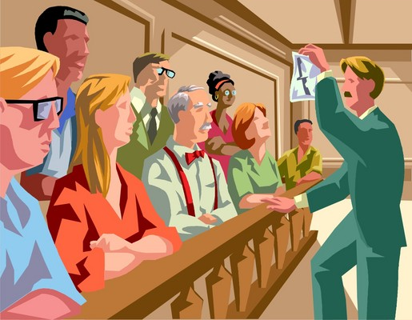
Rights of the Plaintiff
Demand correction of published libel
  If not demanded, plaintiff may lose rights for later complaint, recovery
  Or will have to show stronger proof of loss, damage
    Loss of reputation
    Shame
    Mortification
    Hurt feeling

Slide 36
Now go and study

