Slide 1
Trade Secrets & Industrial Espionage
CJ341/IA241 – Cyberlaw & Cybercrime
Lecture #11
M. E. Kabay, PhD, CISSP-ISSMP
School of Cybersecurity, Data Science & Computing
Norwich University

Slide 2
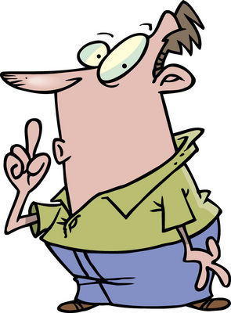
Topics
Definition of Trade Secrets
Protection
Polices & Law
Damages
International Issues
Industrial Espionage

Slide 3

Definition
“In most states, a formula, pattern, physical device, idea, process, compilation of information or other information that
  provides a business with a
  competitive advantage, and
  is treated in a way that can
  reasonably be expected to
  prevent the public or
  competitors from learning
  about it, absent improper acquisition or theft.”*
Sometimes referred to as confidential information or proprietary knowledge
See also Burgunder p. 212
_____
* http://www.nolo.com/dictionary/trade-secret-term.html

Slide 4

Purpose of Trade Secret Laws
Protect valuable creative ideas at various stages of development
Patents cover completed inventions & processes
  Require inventions be
    novel and
    Nonobvious
Trade secrets require only information be valuable

Slide 5
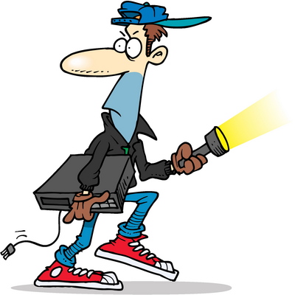
Misappropriation Defined
Trade secret holder entitled to remedies when misappropriation occurs:
Acquiring trade secret by improper means
Disclosing or using trade secret reasonably knowing that such
conduct violates duty to maintain
confidence
While reasonably knowing of
impropriety, using or disclosing secret
received from another who improperly
obtained it
While reasonably knowing about
fiduciary breach, using or disclosing
secret that was disclosed by another
under such a duty to maintain
confidence
(See Burgunder p. 213)

Slide 6


State Laws on Trade Secrets
State Level: Most states have separate statutes criminalizing trade secret theft
American Law Institute (ALI)
  1995: Restatement (Third) of Unfair Competition
National Conference of Commissioners on Uniform State Laws
  1979: formulated
  UTSA
  Uniform Trade Secrets Act
  Model for state legislatures to follow to pass statutes that codify policies
  By 2005, 44 states & District of Columbia had statutes based on UTSA

Slide 7
Trade Secret Policies & Law
Formula
Pattern
Compilation
Program
Device
Method
Technique
Process
Uniform Trade Secrets Act (UTSA)
  Information
  Derives independent economic value
  from secrecy
  Subject of reasonable efforts
  to maintain secrecy
Contrast with patent (“patent” means “open”)
Unauthorized use of trade secret can lead to civil tort for misappropriation

Slide 8

UTSA Remedies for Misappropriation
Damages ($)
  Amount needed to compensate the trade secret holder for losses
  Amount of unjust enrichment earned by unlawful use or disclosure
Injunctions
  Preventing use
    Including “threatened misappropriation”
  To obtain preliminary injunction, must prove:
    Irreparable harm
    Strong likelihood of success of winning if case goes to trial

Slide 9


Borland & Symantec 1992
Eugene Wang
  Former CEO of Borland Int’l
  Resigned 2 months after
  management shuffle
  Became VP of Symantec
Borland officials searched his e-mail
  Found files sent via MCI Mail
  10 msgs to Symantec CEO
  Contained confidential info
Borland filed civil & criminal
charges
  Scotts Valley Police Department
  Provisions of CA penal code applied
http://catless.ncl.ac.uk/Risks/13.87.html#subj2

Slide 10
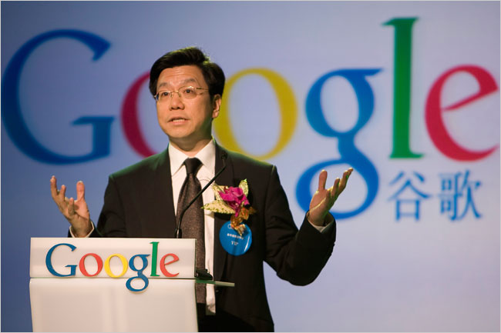
Microsoft and Google (2000):
Non-Compete Clause
Microsoft hired Kai-Fu Lee
  VP for R&D
  Lee agreed if he left Microsoft
  he wouldn’t work for 1 year in
  competitive capacity
  Quit and worked as head of
  Google China
  TRO (temporary restraining order) issued
  Dispute eventually settled
UTSA – Civil provisions
  Doesn’t authorize government to bring criminal actions
  Some states have separate criminal statutes for trade secret theft

Slide 11

Federal Level
Trade Secrets Act (18 USC §1905)
  http://www.law.cornell.edu/uscode/html/uscode18/usc_sec_18_00001905----000-.html
Economic Espionage Act (18 USC §1831 et seq.)
  http://www.law.cornell.edu/uscode/html/uscode18/usc_sec_18_00001831----000-.html
http://www.law.cornell.edu/uscode/

Slide 12

(Federal) Trade Secrets Act
18 USC §1905
Covers
  Unauthorized disclosure
  Of secrets relevant to
  government work
    Contracts
    Investigations
    Reports
  By government employee
  or agent only
Text on next slide

Slide 13
Trade Secrets Act (Text)
Whoever, being an officer or employee of the United States or of any department or agency thereof, any person acting on behalf of the Office of Federal Housing Enterprise Oversight, or agent of the Department of Justice as defined in the Antitrust Civil Process Act (15 U.S.C. 1311–1314), or being an employee of a private sector organization who is or was assigned to an agency under chapter 37 of title 5, publishes, divulges, discloses, or makes known in any manner or to any extent not authorized by law any information coming to him in the course of his employment or official duties or by reason of any examination or investigation made by, or return, report or record made to or filed with, such department or agency or officer or employee thereof, which information concerns or relates to the trade secrets, processes, operations, style of work, or apparatus, or to the identity, confidential statistical data, amount or source of any income, profits, losses, or expenditures of any person, firm, partnership, corporation, or association; or permits any income return or copy thereof or any book containing any abstract or particulars thereof to be seen or examined by any person except as provided by law; shall be fined under this title, or imprisoned not more than one year, or both; and shall be removed from office or employment.
http://www4.law.cornell.edu/uscode/html/uscode18/usc_sec_18_00001905----000-.html

Slide 14
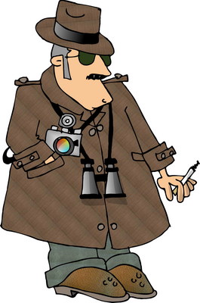
Economic Espionage Act of 1996 (EEA)
18 USC §1831 et seq.
Criminalizes unauthorized disclosure of government OR commercial secrets by anyone
Includes penalties for those receiving such information
See text on next slide

Slide 15
EEA Text
§ 1831. Economic espionage
(a) In General.— Whoever, intending or knowing that the offense will benefit any foreign government, foreign instrumentality, or foreign agent, knowingly—
  (1) steals, or without authorization appropriates, takes, carries away, or conceals, or by fraud, artifice, or deception obtains a trade secret;
  (2) without authorization copies, duplicates, sketches, draws, photographs, downloads, uploads, alters, destroys, photocopies, replicates, transmits, delivers, sends, mails, communicates, or conveys a trade secret;
  (3) receives, buys, or possesses a trade secret, knowing the same to have been stolen or appropriated, obtained, or converted without authorization;
  (4) attempts to commit any offense described in any of paragraphs (1) through (3); or
  (5) conspires with one or more other persons to commit any offense described in any of paragraphs (1) through (3), and one or more of such persons do any act to effect the object of the conspiracy, shall, except as provided in subsection (b), be fined not more than $500,000 or imprisoned not more than 15 years, or both.
(b) Organizations.— Any organization that commits any offense described in subsection (a) shall be fined not more than $10,000,000.
http://www4.law.cornell.edu/uscode/html/uscode18/usc_sec_18_00001831----000-.html

Slide 16
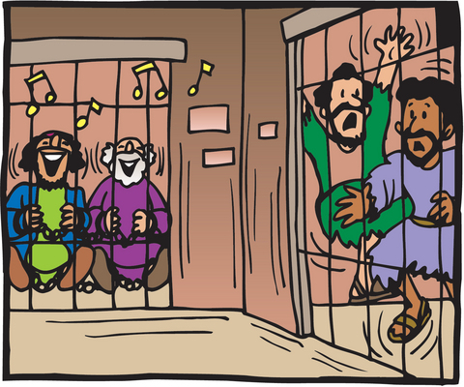
EEA Penalties Include
Up to 15 years in jail
MAX($500,000 fine or 2x value)
Forfeiture
Import-export
restrictions

Slide 17

First Amendment Issues
Opponents of corporate actions have revealed trade secrets to press
  Concerned or disgruntled
  employees
  Journalists or activists using
  social engineering (e.g.,
  Ciarelli)
Can corporations impose prior
restraint to prevent publication?
  Generally, no: 1st Amendment
  protects such publication
  absent compelling reasons to interfere
  May still prosecute for industrial espionage after the fact

Slide 18
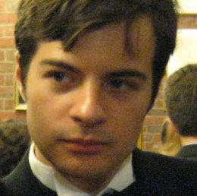

Apple Corp vs Bloggers (1)
Nicholas Ciarelli became fond of Apple MAC at age 6
At age 13, founded Think Secret Web site
  Focused on Apple products
  Popular venue for news, reviews, gossip & rumors
  Pen-name “Nick dePlume”
In late Dec 2004, Think Secret
previewed new products before
Apple ready to announce them
  Mac mini
  iPod Shuffle
  iLife ’05 & GarageBand 2
Lawsuit Jan 2005: Apple
Computer Inc v. Nick dePlume
See http://www.wired.com/wired/archive/13.05/apple.html

Slide 19


Apple vs Bloggers (2)
Also launched separate lawsuit vs other blogs
  v. Think Secret, PowerPage.org &
  AppleInsider
  Demanding identity of insiders who leaked info
Lawyer Terry Gross of Gross & Belsky took case
  Pro bono
  Demanded dismissal
  Labelled case a SLAPP (Strategic Lawsuit Against Public Participation)
  Denied that any significant trade secrets were revealed at all
See http://www.wired.com/news/mac/0,2125,66821,00.html

Slide 20

Apple vs Bloggers (3)
Mar 2005: EFF (Electronic Frontier Foundation, eff.org)
  Filed amicus curiae (friend of the court) brief in favor of defendants
  Argued online journalists
  should have same rights as
  traditional journalists
Mar 2005: CA Superior Court
judge James Kleinberg ruled
bloggers had no right to protect
sources
  “…an interested public is not the same as the public interest.”
  EFF warned “"Anyone who reports on companies or the trade press should be concerned about this ruling."
See http://news.bbc.co.uk/2/hi/technology/4348425.stm

Slide 21

DeCSS Trade Secret Dispute
1999: 15 year old Norwegian Jon Lech Johansen
  Studied DVD Software Player
  Determined how CSS anti-copy system worked
  Ascertained encryption keys to descramble CSS protection
  Posted DeCSS software on Internet
5 years of litigation involving DMCA;
issues:
  Reverse engineering,
  Injunctive relief
  Misappropriation
Acquitted (twice) in Norway in 2003
See Burgunder pp 230-234

Slide 22

Reverse Engineering
Defined in Computer Desktop Encyclopedia:
  To isolate the components of a completed system. When a chip is reverse engineered, all the individual circuits that make up the chip are identified. Source code can be reverse engineered into design models or specifications. Machine language can be reversed into assembly language (see disassembler).
Applicability to discussion of trade secrets
Ethical considerations
  State trade secret law
  (misappropriation
  prohibitions) v. acquisition
  of info through reverse
  engineering

Slide 23

International Trade Secret Protection
TRIPS agreement
  Agreement on Trade-Related Aspects of
  Intellectual Property Rights
  Members of the World Trade Organization
  (WTO) must protect “undisclosed
  information”
  Does not use trade secret term
  WTO members required to enforce their own trade secret laws with remedies
Issues
  Enforcing contractual obligations / confidentiality agreements
  Determining damages
  Durational periods – variation in time limits for maintaining secrecy of info
  Need to exercise caution with trade secrets overseas

Slide 24
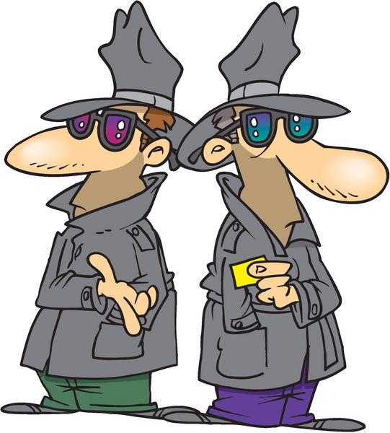
Industrial Espionage
Many cases available in IYIR database
Due to time limitations, will look only at 2 outstanding cases:
  Echelon
  Israeli Trojan Horse Keylogger
Finish with Chinese industrial espionage
IYIR: http://www.mekabay.com/iyir/index.htm

Slide 25
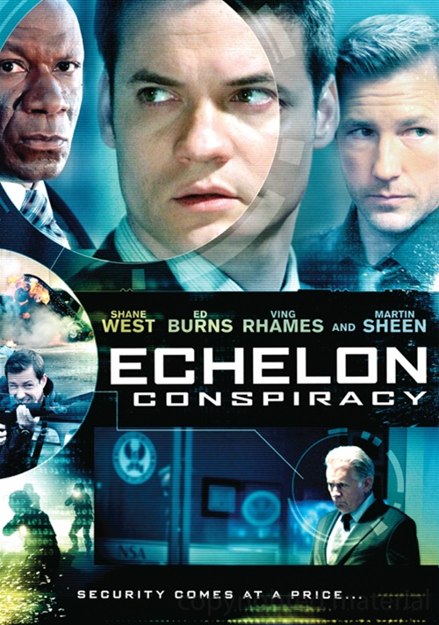
Echelon
EU Parliament attacks Echelon (2000.07)
Formed temporary committee to investigate spy network
Suspicions that Echelon used to intercept conversations of European businesses
Information might be given to competitors from Echelon operators
  US, Canada, Australia, New Zealand
In 2001.05, report recommends more use of encryption to defeat Echelon
Notes:
NewsScan, NY Times
http://www.nytimes.com/aponline/business/AP-EU-Echelon.html

Slide 26

Israeli Trojan Horse Keylogger
2005.05 Suspicions raised by keylogger software on PCs
  Author Amnon Jackont ound his MS on ‘Net
  Someone tried to steal money from his bank
  Tech found Trojan horse keylogger on computer
  Created by Michael Haephrati – ex-son-in-law
  Many companies found infected by same program – sent data to server in London
2006.03 Perpetrators sent to jail
  Michael Haephrati: 4 years
  Ruth Brier-Haephrati: 2 years

Slide 27

Industrial Espionage by PRC Agents
2001: Hai Lin, Kai Xu, & Yong-Qing Cheng
2001: Junsheng Wang
2002: Seismic Imaging SW Theft
2006: Fei Ye & Ming Zhong
2007: Chi Mak & Family
2009: US Electric Grid
2011: AMSC SCADA
2013: PRC Denies All

Slide 28

2001: Hai Lin, Kai Xu, & Yong-Qing Cheng
Chinese nationals
Arrested for stealing software from Lucent
Sold to Datang Telecom Technology Co. of Beijing
  Majority-owned by Govt of PRC
In 2002, charged with further thefts from 4 other US high-tech firms: Telenetworks, NetPlane Systems, Hughes Software Systems, & Ziatech.

Slide 29

2001: Junsheng Wang
Employed by PRC firm Bell Imaging Technology
Wife worked for Acuson Corp in California
Wang copied documents brought home by wife
Gave copies to Bell Imaging on trip to PRC
Convicted of theft of trade secrets

Slide 30
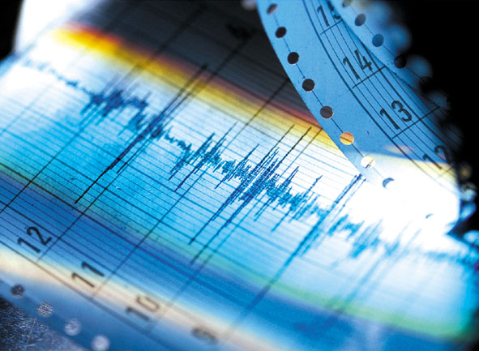
2002: Seismic Imaging SW Theft
Chinese programmer arrested
Stole software from 3DGeo
Transferred to China National Petroleum Corp (state-owned)
Jailed in Santa Clara

Slide 31

2006: Fei Ye & Ming Zhong
Pleaded guilty to economic espionage
On behalf of PRC
Stole trade secrets from
Sun Microsystems &
Transmeta Corp.
Designing competing
microprocessor using
stolen designs
Planned to share profits
with City of Hangzhou &
Province of Zhejiang
Employer’s firm funded through PRC National Technology Research & Development Program of China

Slide 32

2007: Chi Mak & Family
Chinese-born engineer
Admitted passing stolen submarine propulsion systems information to Chinese government
Wife, brother & several other relatives indicted
Brother & sister-in-law stopped at LA Intl Airport intending to fly to Hong Kong & Guangzhou, PRC
Luggage contained encrypted disks with stolen trade secrets

Slide 33

2009: US Electric Grid
Chinese, Russian & other spies have penetrated US electric grid
Installed rogue remote-control software
“"The Chinese have attempted to map our infrastructure, such as the electrical grid," said a senior intelligence official. "So have the Russians.“
Espionage pervasive across USA
Intrusions growing

Slide 34
2011: AMSC SCADA Code
June 2011: American Superconductor Corp (AMSC) technicians examined wind turbine in Gobi Desert (PRC)
Found that client, Sinovel
Wind Group, stole source
code for proprietary SCADA
software
Client stopped buying SW
from AMSC
  2/3 of AMSC’s $315M
  annual revenue
Company lost most of its
capitalization
  40% value in 1 day
  Ended with 83% stock loss by Sep 2011

Slide 35
2013: PRC Denies All Claims of Cyberespionage
“U.S. Presses Beijing on Corporate Espionage: White House Develops Strategy to Encourage China to Halt Alleged Cyberspying, but Faces Some Fundamental Obstacles”
  By Siobhan Gorman and Danny Yadron
  Updated June 7, 2013 10:01 p.m. ET
WASHINGTON—The Obama administration faces a major impediment in tackling Chinese cyberspying: It must convince the Chinese there's a key line between government spying and corporate spying.…
http://online.wsj.com/news/articles/SB10001424127887324069104578527323576340846

Slide 36
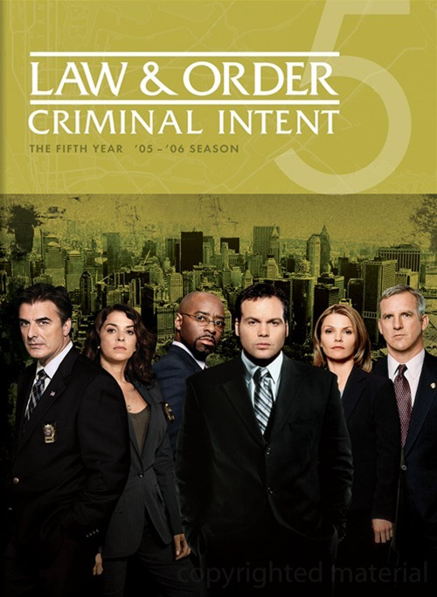
Law & Order
Criminal Intent
“Scared Crazy” – Year 5, Episode 9
Centers on trade secrets
  Pay attention to how company attempts to protect them
  Notice methods use to steal them
Secondary theme is consequences of psychological torture

Slide 37
Now go and study

