Slide 1
Copyright Protection for Computer Programs and Digital Media
CJ341/IA241 – Cyberlaw & Cybercrime
Lecture #13
M. E. Kabay, PhD, CISSP-ISSMP
School of Cybersecurity, Data Science & Computing
Norwich University

Slide 2
Topics
Copyright & Computer Programs
Digital Imaging
End-User License Agreements (EULAs)

Slide 3
Copyright & Computer Programs
©
Overview
Historical Snapshot
Proving Infringement
Expressions
Levels of Abstraction
Whelan v. Jaslow 1986
Lotus Development Corp v. Paperback Software Int’l 1990
Computer Associates Intl v. Altai 1992
Lotus Development Corp. v. Borland Int’l 1995
International Protection of Computer Programs

Slide 4
Copyright & Computer Programs: Overview
Extent of copyright protection for computer programs complicated and controversial
Computer programs:
Many “have all the earmarks of a creative literary-style document.” (Burgunder)
Integral part of an operational machine
Programmers want widest protections
Code covered, conceptual aspects, file structures, organization, user interface
Companies want limitations
Only literal code
Want to avoid market monopoly

Slide 5
Historical Snapshot (1)
Mid-1960s: uncertainty about copyright protection of computer programs
1976: Major revision of Copyright Act
Congress recognized it couldn’t address issues posed by computers to copyright policy
Created National Commission on New Technological Uses of Copyrighted Works (CONTU)
Charged with making recommendations about changes to encompass new technology
http://digital-law-online.info/CONTU/contu1.html

Slide 6
Historical Snapshot (2)
1978: CONTU* released report
Recommended copyright protection for computer programs
Protection should only extend to expression of computer programs
Report ambiguous in defining what aspects constitute expression
1980: Update of Copyright Act
Computer programs protected
Ambiguities remained
Courts left with determining protection parameters
___________ *CONTU = National Commission on New Technological Uses of Copyrighted Works

Slide 7
Proving Infringement
Requires showing:
Substantial similarity of the works and of the protectable* expression
Guiding Copyright Principles
Should provide incentives to develop and distribute works
Exclusivity
Should provide sufficient protection
______
* As spelled in US Code; sometimes spelled protectible elsewhere.

Slide 8
Expressions
Copyright disputes boil down to basic issue: distinguishing protectable expression from unprotectable ideas
Cannot protect content that is indispensable to convey an idea (Burgunder p. 314)
Otherwise 1st to discuss idea would lock down all further use of the idea
Example of court case involving expression in computer world: Apple v. Microsoft and HP (1989):
Core issue: scope of protectable expression (graphical use interface or GUI)

Slide 9
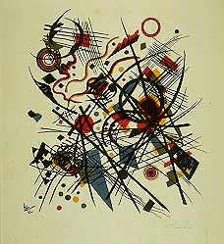
Levels of Abstraction
Multiple expressions test
Underlying principles of copyright guide
Alternative expressions
Distinction between ideas and expressions
Court decisions somewhat ad hoc, but attempt to reflect guiding copyright principles
Line may seem elusive
See extended discussion in Burgunder pp 309-317
Wassily Kandinsky
(Russian, 1866-1944)
Abstraction, 1922, Lithograph
Picture from Wesleyan Univ. Davison Art Center Web site
http://tinyurl.com/44hrfm

Slide 10
Whelan v. Jaslow 1986 (1)
First significant decision to address copyright protection for computer programs
Jaslow Lab hired Strohl Systems Group Inc to create a bookkeeping program
Ms Whelan (Strohl employee) developed Dentalab program in EDL
Whelan left employ of Strohl on friendly terms
Strohl assigned entire interest in Dentalab to Whelan
Whelan & Jaslow agreed Jaslow would market Dentalab for 35% commission
Jaslow developed Dentcom program in BASIC
Jaslow cancelled agreement w/ Whelan and independently marketed both programs
Whelan charged Jaslow with copyright infringement
Jaslow claimed ownership of Dentalab & denied copying code for Dentcom

Slide 11
Whelan v. Jaslow 1986 (2)
Court ruled Whelan owned the copyright
Found unlawful reproduction based on access and similarities
Jaslow had access to original code
Dentcom was virtually identical to Dentalab
File structures
Subroutine functions
Jaslow appealed to Appeals Court but decision in favor of Whelan was affirmed
Courts decided copyright issues by analogy to literary works: expression v. idea
Detailed structure of the program was part of the expression, not the idea of that program
Therefore subject to copyright restrictions
http://cases.justia.com/us-court-of-appeals/F2/797/1222/104748/

Slide 12
Lotus Development Corp v. Paperback Software Int’l 1990
Two competing application programs (spreadsheets and other functions): Lotus 1-2-3 and VP-Planner
Lotus sued Paperback Software, alleging unlawful copying of the 1-2-3 user interface
District Court
Computer programs are not entitled to an unlimited scope of copyright protection
BUT more similarities than differences
Paperback claimed that need for compatibility and industry standardization trumps expansive copyright protection
Court was not persuaded
Found infringement and ruled for plaintiff (Lotus)

Slide 13
Computer Associates Intl v. Altai 1992
CA created job-scheduling program and developed an operating system (OS) language
Altai hired a programmer who had worked on the CA project: developed component-compatibility program for Altai
Altai began marketing its own scheduling program
CA learned that Altai may have appropriated parts of its OS-compatibility program and sued Altai for IP infringement
Altai then REWROTE the software
District Court found Altai infringed in its first version of its new program (created with help of former CA programmer), but not in the re-write
CA appealed
Appeals Court affirmed decision in favor of defendant (Altai)
Result: case reduces the degree of copyright protection for computer programs

Slide 14
Lotus Development Corp. v. Borland Int’l 1995
Lotus 1-2-3 a pioneering PC spreadsheet program (like Microsoft Excel which came later)
Contained hundreds of commands, menus and submenus
Borland spent three years developing its Quattro program
Determined that compatibility with 1-2-3 was important
Did not copy any of Lotus’s code
District Court
Determined infringement by Borland of copyrightable expression (interface and key reader)
Borland appealed, claiming that the Lotus menu command hierarchy is not copyrightable under Section 102(b)
Appeals Court
Reversed district court decision
Found command hierarchy uncopyrightable and no infringement
Importance of standardization and compatibility noted

Slide 15
International Protection of Computer Programs
Developed countries in agreement
Want copyright laws to cover exact code
Controversy
Disagreement in US concerning extent to which copyright should protect computer programs
Duplicating software significant revenue source for some countries (e.g., China)
Reluctant to pass or enforce copyright protection laws
90% software piracy rates in some areas (e.g., Latin America, Asia)

Slide 16
International Protection (2)
1991: EU Directive
Harmonized copyright policies concerning computer programs among EU nations
Copyright protection extends to expression of a program (but not to underlying principles or ideas)
Owner or licensee can
Make back-up copy
Use program for intended purpose
Correct errors
May reverse analyze (aka reverse engineer) if necessary to achieve interoperability

Slide 17
International Protection (3)
1994: TRIPS (Agreement on Trade-Related Aspects of Intellectual Property Rights)
WTO member obligation to protect computer programs
Specifies copyright protects expressions, but not ideas, procedures or methods of operations
Authors have right to prohibit rentals of their work (common problem in 1980s)
Developed countries had until 2006 for compliance
Less-developed countries have until 2016 for some aspects of the treaty
http://www.wto.org/english/tratop_e/trips_e/trips_e.htm

Slide 18
Digital Imaging
Digital Imaging Overview
Digital Imaging Issues
Legal Issues
Moral Rights
Ethical Issues
Propaganda
Personal Issues
Hoffman v. Capital Cities
http://www.theufos.com/images/Extraterrestrial_Being.jpg
Permission granted by copyright owners for inclusion.

Slide 19
Digital Imaging Overview
Creation
Alteration (e.g., editing, re-editing)
Processing
Compression
Storage
Printing
Display

Slide 20
Digital Imaging Issues
Legal
Copyright
Fair Use
Evidentiary
Criminal
Moral Rights
Proper Attribution
Protect integrity of the work
Ethical
Personal
Which Came First - The Digital Camera or the Digital Camera Image?
Original Digital Art by Noel Carboni
See http://ncarboni.home.att.net/DigiLinks.html
Permission granted by author for inclusion here.

Slide 21
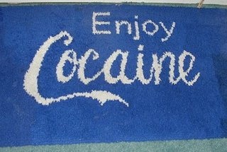
Legal Issues
Copyright
Originality
Digital sampling: using
Photographer: composer
Other Intellectual Property issues
E.g., Trademark reproduction, alteration
Evidentiary (to be discussed in upcoming lectures)
Chain of Custody
Authentication: pictures can lie
Criminal
Exploitation of Children – virtual child pornography (as previously discussed)

Slide 22
Moral Rights (1)
Rights of creators of copyrighted works
First recognized in France and Germany
Included in Berne Convention for the Protection of Literary and Artistic Works in 1886, (revised 1928 & 1986)
US signed convention in 1988
Still does not completely recognize moral rights as part of copyright law
Treats moral rights under defamation or unfair competition

Slide 23
Moral Rights (2)
Include
Attribution
Anonymous or pseudonymous publication
Integrity
No distortion or mutilation
Must not detract from artist's relationship with work
Even after it leaves the artist's possession or ownership
Distinct from economic rights
Apply even if artist has assigned rights to work
US Visual Artists Rights Act of 1990 (VARA) recognizes moral rights, but only applies to works of visual art.

Slide 24
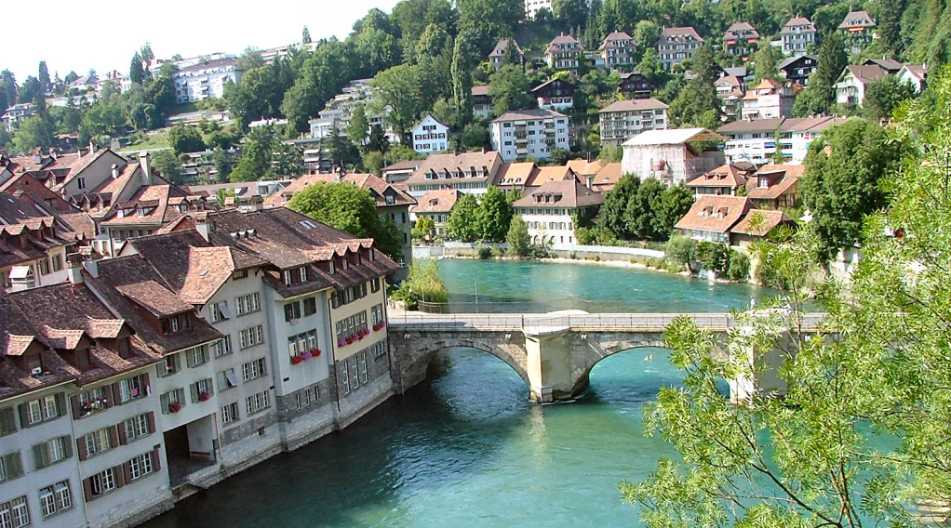
Moral Rights (3)
US adoption of Berne Convention
Moral rights addressed
1991 Amendment Copyright Act
Explicitly protects moral rights of author
“…a still photographic image produced for exhibition purposes only, existing in a single copy that is signed by the author, or in a limited edition of 200 copies or fewer that are signed and consecutively numbered.”

Slide 25
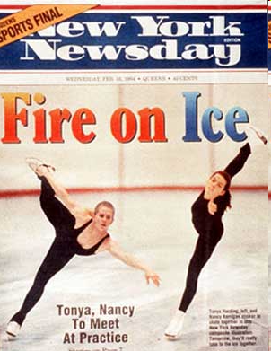
Ethical Issues
Image manipulation:
1994: New York Newsday cover photograph depicting Tonya Harding & Nancy Kerrigan skating next to each other when they hadn’t done so
DIGITAL FAKERY

Slide 26
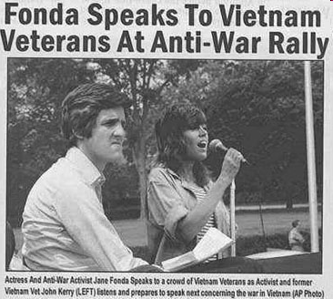
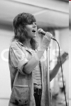
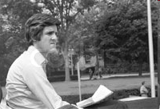
Propaganda
Swift Boat Veterans for Truth circulated picture supposedly of John Kerry at a rally with Jane Fonda in 1970s
Part of vicious smear campaign against Kerry
Photo was fake: it was a composite
+
http://hnn.us/roundup/entries/3592.html

Slide 27
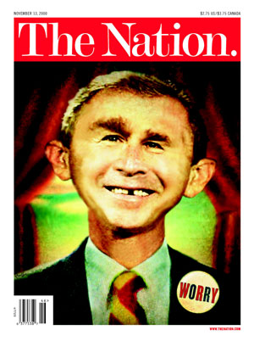
Personal Issues
Privacy Rights
Publicity Rights
Morphed pictures
Morphing software
Examples: Politician faces in experiments by social scientists
But can morph with unpopular figures for subliminal effects
http://www.washingtonpost.com/wp-dyn/content/article/2006/02/27/AR2006022701253.html

Slide 28
Hoffman v. Capital Cities (1)
1982: Dustin Hoffman cross-dresses in film Tootsie
1997: Los Angeles Magazine publishes picture of Dustin Hoffman’s head merged onto body of female model
Model wearing designer dress and shoes
Photo caption: “[DH] isn’t a drag in a butter-colored silk gown by Richard Tyler and Ralph Lauren Heels”
Hoffman’s lawyers argued it was a covert ad: named designers who advertised elsewhere in magazine & implied endorsement by DH
http://www.unc.edu/~unclng/hoffman.htm
http://www.fake-detective.com/faqs/legal-1.htm#Dustin

Slide 29
Hoffman v. Capital Cities (2)
Federal Trial Court (1999)
Ruled that image manipulation was violation of “right of publicity” granted to stars and other public figures
Exploited and robbed celebrities of dignity, professionalism and talent
Awarded DH $3M in compensatory and punitive damages
Appeals Court (2001)
Reversed decision
Held 1st Amendment rights trump publicity rights
Public figure
Magazine using likeness for social commentary
Magazine disclosed use of “digital magic”

Slide 30
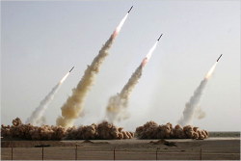
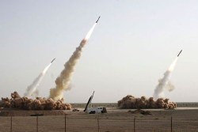
More Digital Fakery
See The Hoax Photo Database
http://www.museumofhoaxes.com/hoax/photo_database/
Countless examples of digitally-modified photos
Iranian press photo of 4 missiles launched July 9, 2008
Original photo showing only 3 missiles successfully launched

Slide 31
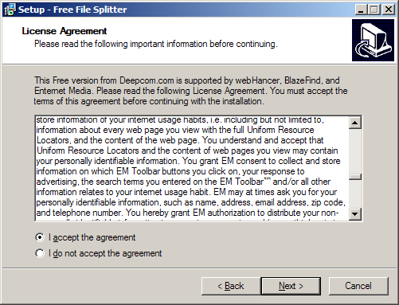
End-User License Agreements (EULAs)
Fundamental Principles of Contract Law
Uniform Commercial Code (UCC)
Statute of Frauds under Common Law
Uniform Computer Information Transactions Act (UCITA)
Digital Signatures

Slide 32
Fundamental Principles of Contract Law
Elements of a Contract*
Invalidating Agreements
Remedies for Breach of Contract
___________
*Legally enforceable agreement
http://www.law.cornell.edu/wex/index.php/Contracts

Slide 33
Elements of a Contract
Offer & acceptance
Communicated to both (or more) parties
Serious intent to establish binding agreement
Capacity
Right or authorization to engage in agreement
Mental status, age may affect capacity
Legality
Undertakings for illegal acts are unenforceable under law
Attorneys must be licensed in jurisdiction
Consideration
Some legally recognized value exchanged

Slide 34
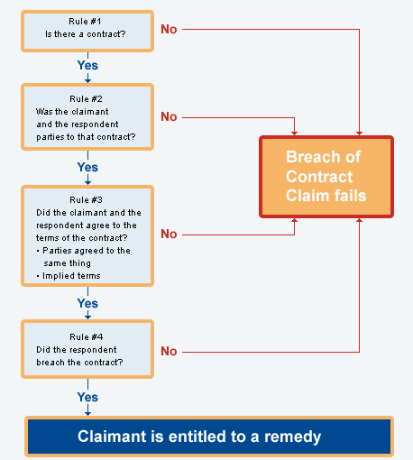
Invalidating Agreements
Contract may be voided due to
Undue influence – e.g., close relationship
Duress – threats, intimidation
Fraud – misrepresentation
In execution: signature under false pretenses
In inducement: lies
Mutual mistake of fact
Good-faith agreement
Both parties lacking essential information
http://www.justice.govt.nz/wht/images/boc-flow1.gif

Slide 35
Remedies for Breach of Contract
Common-law
Return to equivalent status for victim
Compensatory damages
Consequential damages
Incidental damages
Punitive damages upon intentional tort
Equitable remedies
Specific performance (e.g., unique asset)
Injunction barring specific harm
Reformation – modifying contract (rare)

Slide 36
Uniform Commercial Code
UCC framework (1952)
National Conference of Commissioners on Uniform State Laws (NCCUSL)
American Law Institute (ALI)
Article 2: Law of sales
Applies to sale of goods (not services)
Merchant/non-merchant distinction
Lack of essential terms
Good faith & fair dealing
Warranties

Slide 37
Merchant/Non-merchant Distinction
Under common law, acceptance had to be in terms identical to original offer
Article 2 of UCC allows acceptance to include additional terms UNLESS the new terms
Agree only to a subset of offer terms
Materially* change the offer
Are objected to by offeror in reasonable* time
_____________________
*red-flag words beloved by lawyers

Slide 38
Lack of Essential Terms
Common law precluded contract enforcement in absence of
Definition of contracting parties
Price
Quantity
Delivery dates. . . .
UCC Article 2 loosens requirements
Court may judge that parties intended to enter into contract
May fill in details (except quantity)
$
#

Slide 39
Good Faith & Fair Dealing
UCC Article 2 requires good faith
Honesty in fact and
Observance of reasonable commercial standards of fair-dealing
Also avoidance of unconscionability
Court can refuse to enforce terms that strike the court as shockingly unfair
E.g., small-print disclaimers, denial of rights of consumers
Small print disclaimers. Small print disclaimers. Small print disclaimers. Small print disclaimers. Small print disclaimers. Small print disclaimers. Small print disclaimers. Small print disclaimers. Small print disclaimers. Small print disclaimers. Small print disclaimers. Small print disclaimers. Small print disclaimers. Small print disclaimers. Small print disclaimers. Small print disclaimers. Small print disclaimers. Small print disclaimers. Small print disclaimers. Small print disclaimers.

Slide 40
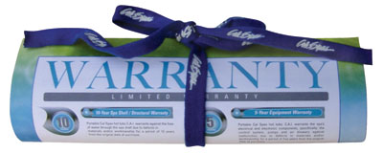
Warranties
Express warranties enforced under UCC Article 2
Affirmations of fact or promises by sellers
Description of goods
Samples, models (no bait and switch)
Implied warranties
Merchantability – fitness for intended use
Fitness for particular purpose – response to specific needs
Exclusion of warranty
Generally ignore disclaimers that are unreasonable

Slide 41
Warranties (cont’d)
Attempted exclusion of warranties of merchantability or fitness for specific purpose
Must be written and conspicuous
Courts have usually sided with consumer
Less protective of commercial buyers
Bears directly on shrink-wrap and click-wrap agreements
Brown v. SAP America case
Breach of contract
Court ruled that plaintiff could not claim fraud solely to invalidate limitation of liability

Slide 42
Requirements of a Writing: Statute of Frauds
Common law
UCC
Signature requirement
Electronic contracts and the UCC
Computer software as goods
Statute of Frauds and Perjuries (1677)
Written contract required for –
Promise to answer for debt
Terms greater than 1 year
Marriage terms
Sale of real property
Promise to pay estate debts
Sale of goods costing > $500
UCC Art. 2 §2-201:
Written contract required except –
Merchants – written confirmation
Specially-manufactured goods
Evidence in court admitting contract
Goods already paid for
Goods received and accepted

Slide 43
Requirements of a Writing (cont’d)
Signature requirement
Electronic contracts and the UCC
Computer software as goods
UCC covers goods
Includes leases of goods
Hardware definitely covered
Software license = lease?
Communications Group v . Warner Court ruled
that license was a
lease under terms of UCC
Therefore warranty enforceable
Signature serves for
Evidence
Ceremony
Approval
Efficiency and logistics

Slide 44
Uniform Computer Information Transactions Act
Historical background of UCITA
American Law Institute & Natl Conference Commissioners on Uniform State Laws
Attempt to clarify electronic contracts
Causing uproar
Conflict between vendors and customers
Consumer-protection groups up in arms
Passed only in MD & VA so far (2006.10)
Creeping through state legislatures (9 states had passed components as of 2006.10)
http://www.ucita.com/

Slide 45
General provisions of the UCITA
Exclusions
Financial services
Audio / visual programming
Movies, recordings
Compulsory license
Contract of employment for employees
UCC Articles 3-8
Scope
Computer information transaction =
Agreement to
Create, modify, transfer, license computer information* or rights
Includes support contract
*= information in electronic form from computers
Exclusions
Opting out of the Act: by mutual agreement
Formation of contract
Offer and acceptance
Contracts for ≥$5,000 enforceable
Authenticated record; or
License of ≤ 1 year; or
Performance / information accomplished / accepted; or
Admission in court

Slide 46
Warranties under the UCITA
Similar to terms of UCC Article 2
Express warranties
Implied warranties
Disclaimers – may not be enforceable unless
Conspicuous
Unambiguous
Breach of contract
Notice of breach
Response to request for information about defect
Remedies
Remedies include
Cancellation
Contractual remedies
Liquidated damages
Compensatory damages

Slide 47
Now go and study

