Slide 1
Trademarks & Domain Names
CJ341/IA241 – Cyberlaw & Cybercrime
Lecture #15
M. E. Kabay, PhD, CISSP-ISSMP
School of Cybersecurity, Data Science & Computing
Norwich University

Slide 2
Topics
Trademarks
Domain
Names
Cyber-
squatting
International
protection

Slide 3
Trademarks
Purpose
Definition and Types
Classes of Marks
Application and Exceptions to Grant
Nature of Protection
Relief for Violation
TM

Slide 4
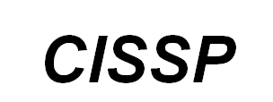
Examples of Marks

Slide 5
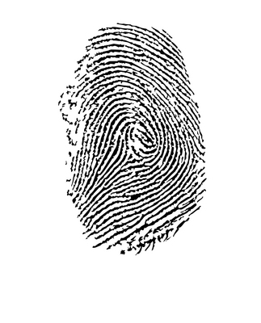
Purpose of Trademarks
Represent origin of goods or services
For the producer
Use symbol or other designation
Represent who makes goods or provides service
Reap financial rewards resulting from past quality
For the consumer
Allow quick recognition of goods or services as being from same manufacturer or provider
Prevent confusion and counterfeits

Slide 6
Definition and Types of Marks
Trademark
Word, name, symbol, device or combination
Used to distinguish goods from other similar goods
Service mark
Identifying and distinguishing services
Collective mark
TM or SM
Coöp, association, union, guild
Certification mark
Assertion of compliance with standards or origin by certifying organization

Slide 7
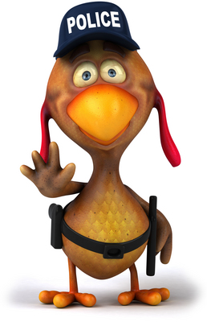
Trademark Policies
Co-exist at Federal and State levels
Grounded in unfair competition principles
“…unfair competition doctrines are aimed at preventing the unfair consequences that arise when competitors make it difficult for consumers to locate the goods they want” (Burgunder p.521).
Characteristics of unfair competition
Symbol or device (trademark) used by one company
Competitor uses symbol or device that is similar, potential causing confusion
Competitor knowingly, or should have known, about prior symbol or device use
Further economic objectives – i.e. efficiency

Slide 8
US Legal Protection of Trademarks: The Lanham Act
State Level:
Similar to federal protection, but with geographical limitations
Federal Level:
Trademark Protection Act of 1946 – a.k.a. the Lanham Act
Protects words, names, symbols, or devices used to distinguish the sources of goods or services
In 15 USC §1114 = §32 of Lanham Act
Use likely to
Cause confusion
Cause mistake
Civil law
Deceive
http://www.bitlaw.com/source/15usc/

Slide 9
Lanham Act – cont’d
15 USC §1125 = Lanham Act §43
Word, term, name, symbol, device, or combination
Likely to cause confusion, mistake or deception
Affiliation, connection, association with person
Origin, sponsorship, approval
Goods, services, commercial activities
Commercial promotion or advertising
Nature, characteristics, qualities
Geographical origin

Slide 10
Classes of Marks (1)
Fanciful
Invented words; e.g., Alera, Adario, Elantra
Arbitrary; e.g., Cougar, Pavillion
Immediate protection
Suggestive – ordinary words or combinations
Connotes quality, ingredient, characteristics but not substance; e.g., PestPatrol, SaferSite
Immediate protection

Slide 11
Classes of Marks (2)
Descriptive – ordinary words w/ secondary meaning – primary meaning is source
Yellow Pages, Blue Flame
Protection of secondary meaning
Fair use possible
Generic – class of product/service – no protection under Lanham Act
“You have mail,” “Instant messaging”
“E-mail,” “Web site,” “E-commerce”

Slide 12
Microsoft Corp. v. Lindows.com 2002
1995: PTO registered the name Windows for Microsoft
2001: Microsoft sued Lindows.com, a Linux-based operating system development and distribution company, claiming name infringed on the Windows registered trademark
Windows questioned as a Generic mark
Lindows.com claimed PTO erred in registering Windows because generic term describing windowing capability of graphical user interfaces prior to Microsoft’s first OS release
2002: Trial judge indicated generic term possibly improperly registered
Parties settled dispute; Lindows adopted new name
Note: Marks that become generic over time can lose protected status (e.g., “aspirin”)

Slide 13
Abercrombie & Fitch v. Hunting World 1976
A&F sued Hunting World, claiming infringement of its registered trademarks for the word “safari” on clothing
Hunting World claimed that the word is common
District Court
Determined “safari” generic
Could not distinguish A&F’s goods
Dismissed A&F’s complaint
Cancelled A&F’s registered “safari” trademarks
A&F appealed
Court of Appeals
Explained that there are four categories of trade protection terms
Found term “safari” to be generic with respect to some types of clothing, but not with others (e.g., boots)

Slide 14
Federal Registration
Registration provides notice to others of:
Registrant’s exclusive rights to use mark
Registration = Prima facie evidence of validity
Burden on challenger of mark
Once registered for >5 years, not possible to contest mark
Availability of enhanced remedies for trademark counterfeiting
TM
®
v

Slide 15
Application for Registered Trademark
Register TM with US Patent & Trademark Office (PTO)
Application
240,000 applications per year
Payment of fees
2010: fee = $850
http://www.uspto.gov/web/offices/ac/qs/ope/fee031913.htm#tm
Drawing of mark
Examination process
Approval, amendment, or denial
Appeal Process

Slide 16
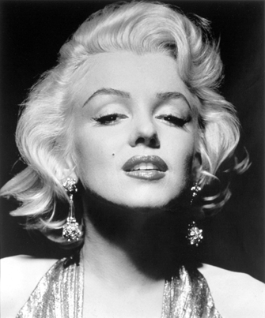
Exceptions to Grant of Trademark
Immoral, deceptive, scandalous
Falsely implies connection w/ person, institution, national symbol
Flag of US or other government entity
Name, portrait, signature of living person or deceased president of US (w/out permission)
Resembles existing mark
Mere description or surname
McDonald’s has sued many family firms established before fast-food chain started
Lost cases
Prof Kabay’s new trademark for his
course materials
– or not.

Slide 17
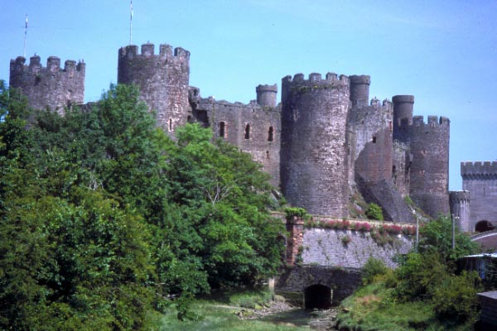
Nature of Protection for Trademarks
Prevent confusion by users
Factors considered by the courts
Similarity of marks
Similarity of goods
Relationship between parties offering goods
Classes of purchasers
Evidence of confusion
Defendant’s intent
Strength of plaintiff’s mark

Slide 18
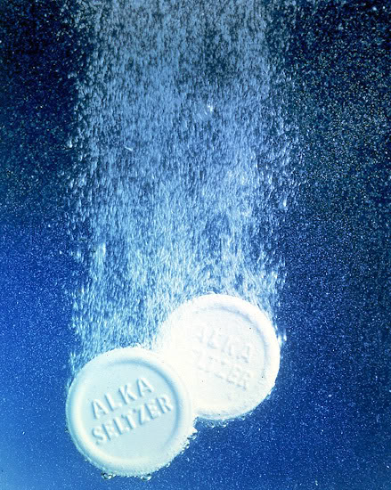
Relief for Violation of Trademarks
Injunction prohibiting continued violation
Seizure of goods and counterfeit marks
Recovery of plaintiff’s profits
Destruction of infringing goods and advertising
Recovery of actual damages incurred (loss of profits, goodwill)
Recovery of legal costs including attorney’s fees in some cases

Slide 19
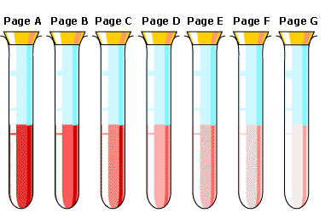
Dilution
Occurs when distinctive or well-known mark is used by another company for unrelated product or service
Confusion not main concern because of dissimilarity
E.g., Kodak paper and Kodak speakers
Federal Trademark Dilution Act (FTDA)
15 USC §1051
Law since 1996
Primary tool for dilution protection in US
(see also later in notes)

Slide 20
Checkpoint Systems Inc. vs Check Point Software Technologies
The companies
Checkpoint Systems provides anti-shoplifting equipment
Check Point Software provides firewalls
The claim
Checkpoint accused Check Point of infringing on its trademark
The ruling
Court refused to grant injunction
Argued there was no likelihood of confusion

Slide 21
Trademark Protection and Computers
Trademark principles apply in computer / technology context
E.g., protection available for shape and appearance of hardware (product design)
Apple Computer’s iMac
Design big hit
1999: Apple filed suit against Future Power, Inc. when it intended to sell a PC like iMac
Court issued a preliminary injunction

Slide 22
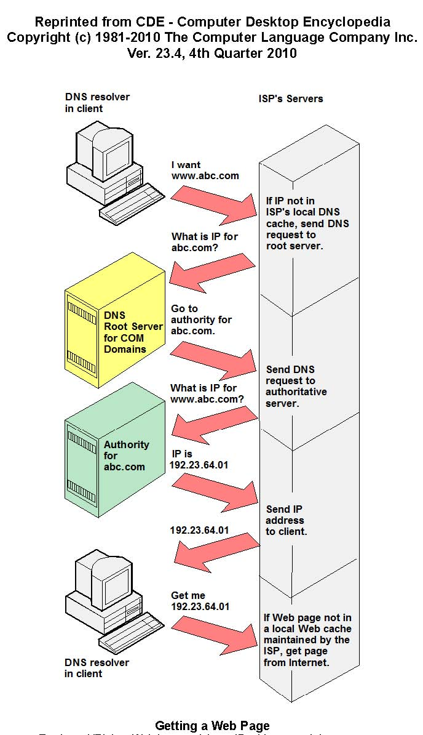
Domain Names
The Domain Name System (DNS)
Looking Up DNS Info
Dispute resolution
Hyperlinks
Cybersquatting Cases

Slide 23
The Domain Name System
Converts words (e.g., www.norwich.edu) into IP addresses (e.g., 192.149.109.153)
Early years – DARPA contract with USC
1992: NSFNET opened to .com users
Network Solutions Inc. became registrar for .com, .net, .org
1998: ICANN (Internet Corporation for Assigned Names and Numbers)
Established by US govt
Highly controversial – much political turmoil over actions, governance
http://www.icann.org/

Slide 24
Looking Up DNS Information (1)

Slide 25
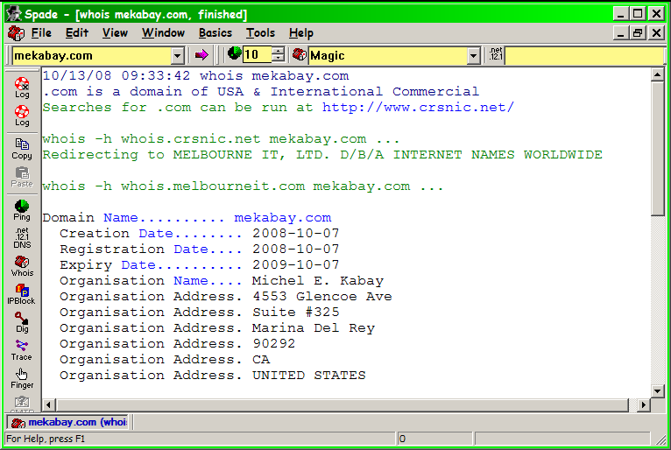
Looking Up DNS Information (2)
Home page:
http://samspade.org/
Download:
http://preview.samspade.org/ssw/download.html

Slide 26
Dispute Resolution
Early years: arbitrary decisions criticized by courts
New rules: complainant must show
Domain name same or confusingly similar to TM or SM
Registrant has no legitimate rights or interest to domain name
Registered and used in bad faith
Bad faith shown by primary purpose of registration
Extortion of money for name; or
Interference with complainant’s business; or
Deliberate attempt to attract visitors for commercial gain by causing confusion

Slide 27
Hyperlinks and Trademarks
Cannot legally use
Others’ trademarks or logos on a Web site without permission
Framing to bring another’s content directly into a page that appears to be created by another site
Others’ trademarks in invisible metatags
In underlying HTML
Metatags visible to search engines
Attempt to increase number of hits for page misappropriating trademark
E.g., one car company might include trademarks for cars of a competitor to draw traffic via GOOGLE searches
THIS IS A HYPOTHETICAL EXAMPLE!

Slide 28
Framing: TotalNews
1997.03 — RISKS, EDUPAGE
“Channels”
controlled by
TotalNews
Materials from
news source
Banner ad fees
paid to TotalNews
Notes:
From EDUPAGE:
NEWS LINK SITE SUED OVER HOT LINKS
A lawsuit filed in U.S. District Court in New York City accuses Phoenix-based TotalNews of "blatant acts of misappropriation, trademark dilution and infringement, willful copyright violations, and other related tortious acts." The plaintiffs, which include CNN, The Washington Post Co., Dow Jones, Times Mirror and Reuters, are upset that the hot links provided from TotalNews to their Web sites display their content framed by the TotalNews home page and its banner ads. Bruce Keller, an attorney for the plaintiffs calls totalnews.com "a parasitic Web site with no content of its own." However, TotalNews says it's simply providing PC users links to some 1,200 news sources, allowing viewers to compare information from each, and that if the case goes against them, the precedent will endanger the ability of Web site operators to provide hot links to other sites. "Hot links either do or don't violate trademarks. That's not new. Framing is new. And framing and selling ads is pretty damn new," says Keller. (Broadcasting & Cable 3 Mar 97)

Slide 29
Framing: TotalNews (cont’d)
News organizations claimed
Misappropriation
Entire commercial value of news
Reselling to others for TotalNews’ profit
Federal trademark infringement & dilution
Diluting distinctiveness
Causing confusion, deceiving customers
Copyright infringement
Violating several exclusive rights

Slide 30
Framing: TotalNews (cont’d)
Violation of advertising laws, deceptive practices & unfair competition
Mistaken impression of affiliation
Tortious interference with business relationships
Selling ads by making news available
Conclusion: case settled out of court
TotalNews would stop framing
Would link to news sites only with permission
See http://www.publaw.com/framing.html

Slide 31
Links: Ticketmaster vs Microsoft
1997.04 — Ticketmaster Group sues Microsoft
MS included hot links from Ticketmaster Web pages to Microsoft Web pages
No formal agreement granting permission for such links
Ticketmaster saw MS as deriving benefit from the linkage but bypassing Ticketmaster's advertising
Ticketmaster programmed Web pages to lead all Sidewalk users trying to follow unauthorized links to a dead end
Notes:
Groups Express Shock At Ticketmaster Move (05/01/97; 8:52 a.m. EDT) By Charlotte Dunlap, Computer Reseller News
HOLLYWOOD, Calif. -- Electronic governing bodies and civil liberties groups are shocked over Ticketmaster's move earlier this week to sue Microsoft for providing links from its local Internet directory sites to Ticketmaster's event pages.
At issue is Microsoft's creation of links within its Seattle Sidewalk online site. These links bypass Ticketmaster's home page and go directly into its event pages, thus bypassing advertisements located in preceding pages. Seattle Sidewalk "has 24 to 48 links to our site, which is annoying, but that's not the issue," said Alan Citron, senior vice president for multimedia with Ticketmaster. "Our position is, if they're going to build a page strictly around our content, we should share in the ad revenue."
Microsoft officials did not return calls for comment.
Internet-standards and social-issues bodies said links to other sites are the foundation from which the Web was created. Posting information to a public server implies others can provide links to it, these groups maintained. "Ticketmaster knew when they put up a Web page that's accessed to a public server that people can link to it, and it's an implied license," said Stanton McCandlish, program director at Electronic Frontier Foundation in San Francisco. "Microsoft can't make use of the materials, and there's no copy being made by Microsoft, but their pages just link to it -- that's how the Internet works. It's a URL, an address."
Dave Banisar, staff counsel with the Electronic Privacy Information Center in Washington, D.C., agreed. "There's a number of stupid suits like this going on around the world. What it all comes down to is they all missed the point of what the Web is supposed to be. It's designed for linking."
(Cont’d on next page)

Slide 32
Links: Gary Bernstein Sues Entire Web? (1998-09)
Hollywood photographer Gary Bernstein
Sued several Web operators for having links to sites containing pirated copies of his works
Included indirect links
links to site with links to sites. . . .
Contamination spread along Web links
from bad site to all those linked to it
presumably every Web site on planet
Los Angeles Federal District Court Judge Manuel A. Real dismissed indirect linkage
Bernstein withdrew entire suit
Notes:
New York Times 25 Sep 98 via EDUPAGE

Slide 33
Deep Linking
Many sites require registration for their materials
Provide sales leads
Statistics on users characteristics
Market research
Once you’ve signed up, get URL for White Paper (etc).
Is there a violation of IP laws or ethics in publishing the hidden URL?
Some Web sites have private (unpublished, unlinked) sections
What if someone publishes the link?

Slide 34
Federal Trademark Dilution Act of 1995 – 15 USC §1051
Prior to 1995, courts had to rule against plaintiff if no confusion could be shown
Thus radically different businesses could use existing trademarks without infringing the Lanham Act
But large companies with famous trademarks argued that frequent use diluted value of their marks
Congress passed TDA of 1995 to protect such plaintiffs even when no confusion likely

Slide 35
Cybersquatting
People register domain names related to trademarks or company names to
Make money (sell back to legit user)
For political purposes (embarrassment)
For fun / satire / mischief
Examples
{insert_name_here}sucks.com
Variant top-level domains
whitehouse.com used to be porn site
Variant mis-spellings
i →1, o → 0, etc.
Symbols near to each other on keyboard
Permission requested from Biplab Dey, Dolcera ITES, for use of image

Slide 36
Cybersquatting Cases Have Used Trademark Dilution Act
Many examples of parasites who register famous trademarks or people’s names as DNS entries
Hope to capitalize by extorting money to sell registration to legitimate users
Many victims have appealed under ICANN rules or gone to court for trademark dilution
Intermatic Inc. vs Toeppen an excellent example of case illuminating the issues
Defendant registered 240 domain names using famous company names and trademarks
Intermatic argued that Toeppen should not be able to block its use of its TM in domain name
Judge ruled in favor of plaintiff because of dilution

Slide 37
Panavision Int’l v. Toeppen 1996
Dennis Toeppen registered panavision.com
Site displayed views of Pana, Illinois
Panavision thereafter sought to create a website under its own name, but learned panavision.com was registered
Notified Toeppen
Toeppen demanded $13K for use of the domain name
Panavision refused to pay
Toeppen then registered panaflex.com
Panavision sued Toeppen for trademark infringement & dilution
Court found
Toeppen violated federal and state dilution laws
Enjoined Toeppen from continued violations
Key Point: Registering a famous mark as a domain name with the goal of cashing in on it violates dilution statutes.

Slide 38
Anticybersquatting Consumer Protection Act (ACPA) of 1999
15 USC §1129
Increasing complaints about cybersquatting
Bad faith use of TM, company name or person’s name defined clearly for domain names
Civil liability
Multiple criteria
Most significant: offer to sell or transfer domain name
For financial gain
Without prior use for real business
Registration of multiple similar infringing domain names
Statutory damages of $1,000-$100,000 per domain name
Applies to distinctive trademarks & famous names
Effective tool used for protection from domain-name related abuse
See Burgunder p 394 – factors for assessing bad faith under ACPA (Exhibit 11.1)

Slide 39
Uniform Dispute Resolution Policy (UDRP)
Adopted by ICANN in 1999
Gives trademark owners efficient way to deal with cybersquatting & other domain name abuse
Trademark owner can force a registrant to resolve a name dispute if presence of 3 elements:
DN is identical or confusingly similar to a TM or SM and complainant has rights to TM or SM
DM registrant has no rights or interests to DM
DM registered and used in bad faith
Dispute is submitted to dispute resolution provider

Slide 40
International Protection of Trademarks
Paris Convention for the Protection of Industrial Property (1883)
National treatment – same rules for all
Rights of priority for filing of registration
Similar rights of refusal of registration
Seizure of contraband / counterfeits
Agreement on Trade-Related Aspects of Intellectual Property Rights (TRIPS, 1994)
Includes TM protection
7-year terms of protection with unlimited renewals
Madrid Agreement & Protocol
56 nations (2006), but not US
After trademark filed in home country, business can file centrally with WIPO
Automatic extension of registration
See Burgunder p 465

Slide 41
Now go and study

