Slide 1
Legal Issues in Cybercrime Cases: IP Crimes
CJ341/IA241 – Cyberlaw & Cybercrime
Lecture #24
M. E. Kabay, PhD, CISSP-ISSMP
School of Cybersecurity, Data Science & Computing
Norwich University

Slide 2
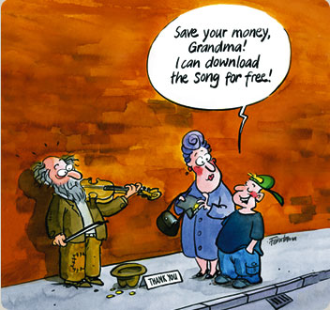
Copyright Review
Criminal copyright enforcement = federal function
Copyright violations codified in Titles 17 & 18 of USC.
Challenges presented by technology
17 USC § 506(a): key criminal statute
Any person who infringes a copyright willfully and for purposes of commercial advantage or private financial gain shall be punished as provided in section 2319 of title 18
Punishment by imprisonment, fine (18 USC 2319)
Base sentence 0-6 months
http://www.urheberrecht.ch/E/img/cartoon1.jpg
Copyright © Government of Switzerland
Used by kind permission of the Federal Institute of Intellectual Property

Slide 3
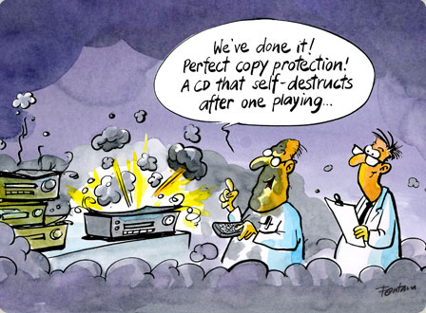
Elements of Copyright Infringement
Prosecution shows:
Existence of valid copyright
Infringement of the copyright by defendant
Defendant acted willfully, either
for purposes of:
commercial advantage or
private gain or
by the reproduction or distribution of one or more copies or phonorecords of 1 or more works during any 180-day period which have a retail value > $1,000
http://www.urheberrecht.ch/E/img/cartoon5.jpg
Copyright © Government of Switzerland. Used by kind permission of the Federal Institute of Intellectual Property

Slide 4
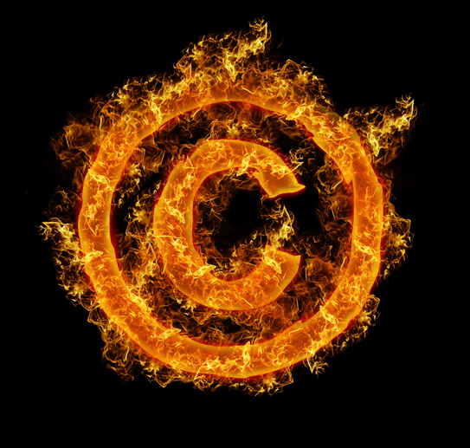
Defenses to Criminal Copyright Infringement
No valid copyright
Not registered
Note: Copyright registration not required at time of infringement
Fraud
Copyright registrant was not author
Gov’t must prove validity as element
"For him that doth ill and doth sin with this book, in retribution for what he has done, I send this curse, and for him that would alter this book: may he be annihilated by leprosy, and may his name be erased from the book of the living and may he join the Devil for all Eternity."
13th century book curse adapted from Eike von Repgow, «Sachsenspiegel.»
http://www.urheberrecht.ch/E/heute/duh10.php?m=5&s=1

Slide 5
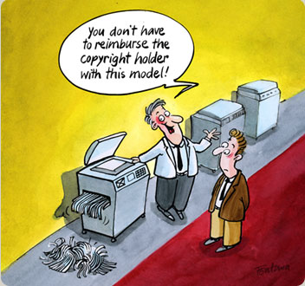
Authorized Use
Defeats willfulness element
Copyright Act does not define authorization
“Apparent authority” as possible defense
Good-faith belief copy permitted
http://www.urheberrecht.ch/E/img/cartoon3.jpg
Copyright © Government of Switzerland
Used by kind permission of the Federal Institute of Intellectual Property

Slide 6
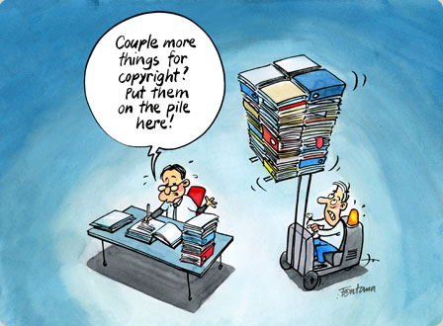
Statutory Exceptions – No Infringement
http://www.urheberrecht.ch/E/img/cartoon2.jpg
Copyright © Government of Switzerland
Used by kind permission of the Federal Institute of Intellectual Property
Reproduction of limited number of copies by libraries and archives
First Sale Doctrine
Fair Use Doctrine

Slide 7
First Sale Doctrine
Copyright Act §109 distinguishes between physical copy and intellectual property
Ownership of physical copy of work permits
Lending (not CD/DVDs)
Reselling
Disposing
Does not permit
Reproduction
Public display or performance (outside home)
Software, music, video sold by license
Original may be sold only if copies deleted
Cannot be rented out without special contracts with copyright owner
See http://www.copyright.com/ccc/viewPage.do?pageCode=cr10-n#saledoctrine

Slide 8
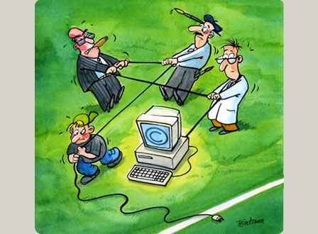
Fair Use Reviewed
4 factors considered to determine if use complies with Fair Use Doctrine:
Purpose and nature of use
Nature of the copyrighted work
Amount and substantiality of the portion used in relation to the copyrighted work as a whole
The effect of the use upon the potential market or the value of the work
http://www.urheberrecht.ch/E/img/cartoon4.jpg
Copyright © Government of Switzerland
Used by kind permission of the Federal Institute of Intellectual Property

Slide 9
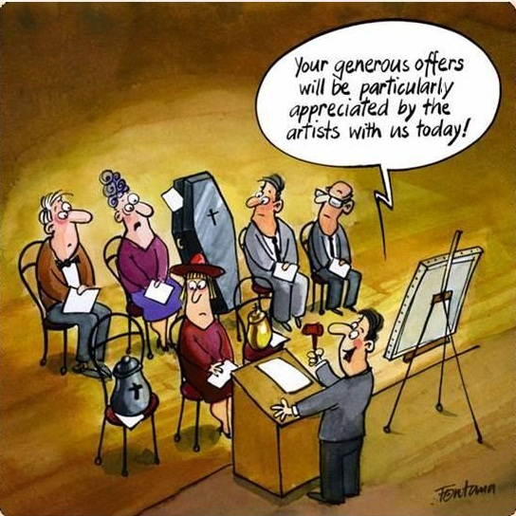
Copyright Misuse (1)
http://www.urheberrecht.ch/E/img/cartoon8.jpg
Copyright © Government of Switzerland
Used by kind permission of the Federal Institute of Intellectual Property
Courts tend to look to see whether copyright owner has acted against public policy
Defendant can claim owner is using copyright in manner that violates public policy
Renders copyright unenforceable
Used where owner attempts to extend rights beyond those granted under Copyright Act

Slide 10
Copyright Misuse (2)
Qad. Inc. v. ALN (1992)
Defendants copied part of Plaintiffs’ software
Raised the affirmative defense of misuse, claiming plaintiff’s had copied another company’s program and had improperly extended their ownership rights
Court allowed the defense and found against Plaintiff based on their misuse of copyright

Slide 11
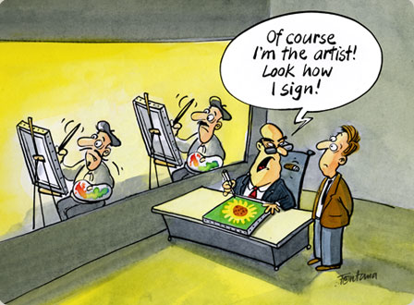
Counterfeit Labels
Trafficking in Counterfeit Labels or Computer Program Documentation or Packaging
18 USC 2318
Trafficking = transferring, transporting or disposing of the materials
Prohibits
Trafficking in counterfeit labels affixed or designed to be affixed to a phonorecord, a copy of a computer program, documentation or packaging of a computer program, motion picture or other audiovisual work; and
Trafficking in counterfeit documentation or packaging of a computer program
Fine + Imprisonment
http://www.urheberrecht.ch/E/img/cartoon7.jpg
Copyright © Government of Switzerland
Used by kind permission of the Federal Institute of Intellectual Property

Slide 12
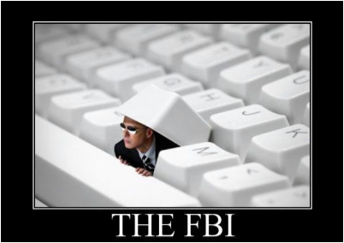
Counterfeit Anti-Counterfeit Labels (2007) [1]
Undercover investigation (2005)
FBI & Rapid Enforcement Allied Computer Team (REACT) Task Force
Operation Remaster
Federal search warrants at 13 locations in CA & TX
Seized contraband:
3 CD/DVD replicators
494,000 pirated music, software & movie disks
6,135 stampers to generate copies of disks (these are molds that create a copy in 3 seconds)
http://img.photobucket.com/albums/v103/tiptoe221/FBI.jpg
http://www.usdoj.gov/criminal/cybercrime/wenSent.htm

Slide 13
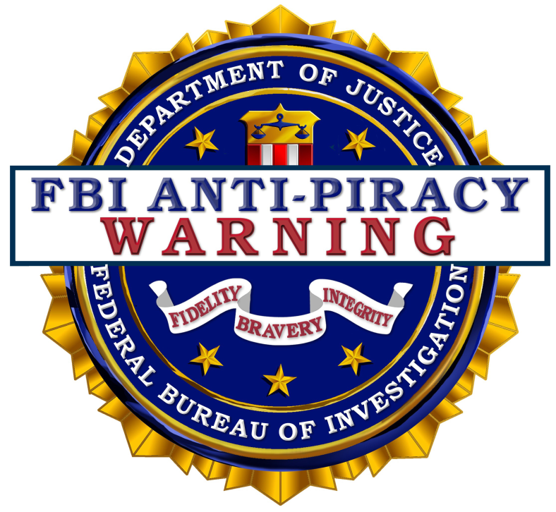
Counterfeit Anti-Counterfeit Labels (2007) [2]
Counterfeits included
Adobe Photoshop
Norton Antivirus
Music from many artists
Counterfeit labels with FBI Anti-Piracy Seal placed on the counterfeits!
San Jose, CA US Attorneys charged three defendants with massive piracy violations
Sentences
Yaobin Zhai (34): 37 months prison & $6.9M restitution
Ye Teng Wen (31) & Hao He (32): 37 months prison & $125K fines

Slide 14
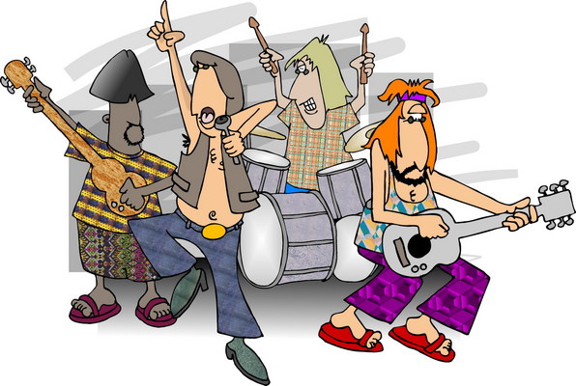
Live Performances
Unauthorized fixation of and trafficking in sound recordings and music videos of live performance
18 USC 2319(a) protects live performances
Criminalizes bootleg recordings of live performances
Up to $250K fines + 5 years imprisonment
Greater fines for repeat offenders

Slide 15
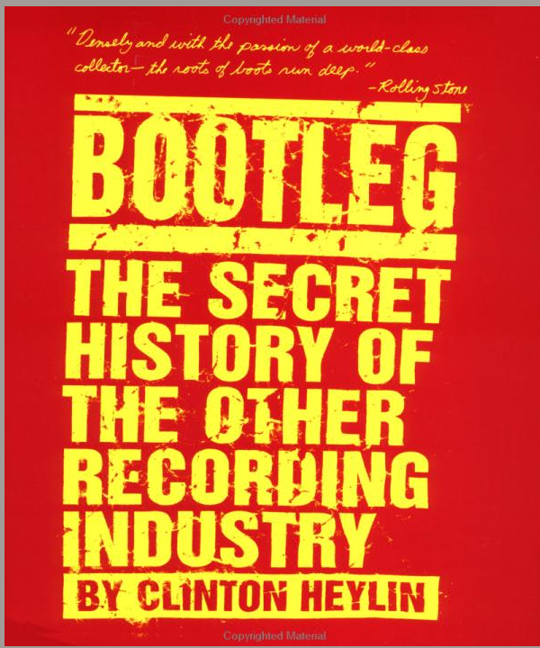
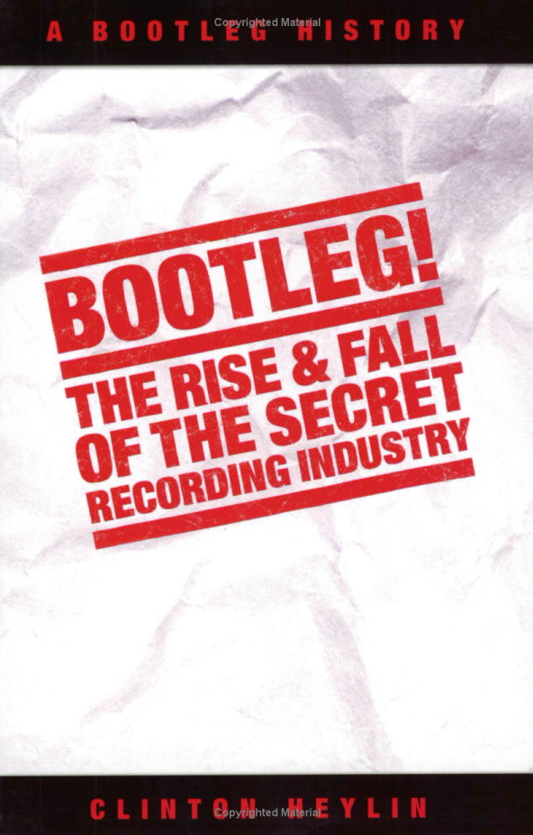
Bootleg Recordings [1]
(2004) ISBN 1-844-49151-X
(1996) ISBN 0-312-14289-7

Slide 16
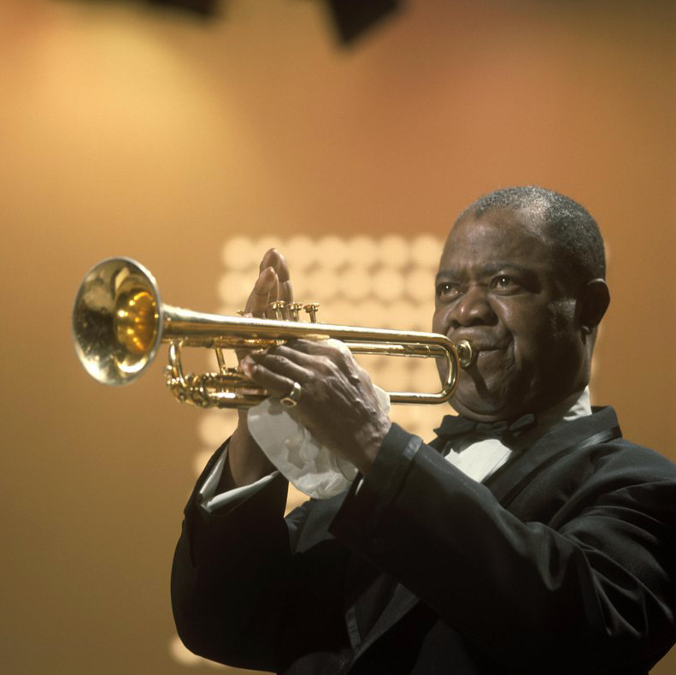
Bootleg Recordings [2]
Books by Heylin focus on rock music industry
Origins in Southern CA in 1969
Excerpts available on GOOGLE BOOKS http://books.google.com/ books?id=saWBw9ZG2cgC
But Louis Armstrong “gained his interest in tape recording after hearing bootleg recordings of his Carnegie Hall concert in 1947.” http://tinyurl.com/6ou52x
http://tinyurl.com/5ddek2

Slide 17
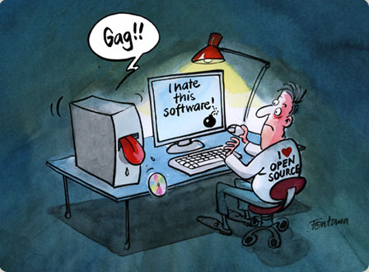
DMCA
Digital Millennium Copyright Act
Amended Copyright Act to address digital information and Internet
§1201
Prohibitions on circumvention of technological measures used to protect copyright systems
Fair use = defense
§1202
Protects against concealment of copyright infringement caused by tampering with CMI (copyright management information)
E.g., tampering with identification info
Up to $500K fine + imprisonment
Enhanced penalties for repeat offenders
http://www.urheberrecht.ch/E/img/cartoon9.jpg
Copyright © Government of Switzerland
Used by kind permission of the Federal Institute of Intellectual Property

Slide 18
Defenses to DMCA Violations
Constitutional challenges
U.S. v. Elcom (2002)
Defendant sold the Advanced eBook Processor, which permitted removal of use restrictions from Adobe Acrobat PDF files and files formatted for the eBook Reader
Defendant moved to dismiss on constitutional grounds, claiming DMCA violates First Amendment
Court found computer code is protected speech at some level, but that DMCA prohibits certain code related to function, not content, so no First Amendment fair use right and DMCA not overbroad
See http://digital-law-online.info/cases/62PQ2D1736.htm

Slide 19
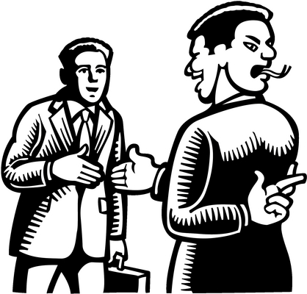
Copyright Removal & False Application
Removal of copyright notice or fraudulent use = criminal acts
Fines possible
Section 506(e) prohibits false representations on copyright application
Knowing violations = subject to fine
Key: knowledge – intent to knowingly supply erroneous info

Slide 20
Economic Espionage Act of 1996
Goal to protect info guarded by
“Reasonable” secrecy measures &
Maintain competitiveness of critical U.S. industries
Criminalizes theft of trade secrets
Previously, Trade Secrets Act dealt only with civil litigation

Slide 21
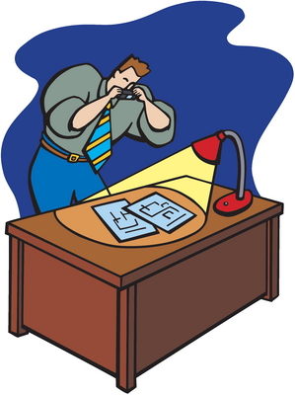
EEA Cases [1]
US v. Ho (1998).
Employee sent e-mail to competitor’s company requesting info relating to competitor’s technology
Employee arrested under terms of EEA
!?!

Slide 22
EEA Cases [2]
US v. Martin (2000).
Maine chemist and California scientist corresponded via e-mail
Chemist sent resume and confidential company info to scientist
Scientist prodded for more info
On chemist’s last day of work, mistakenly sent correspondence to her employer discussing confidential info she had sent to scientist
Scientist convicted for conspiracy to steal trade secrets

Slide 23
EEA Cont.
Insiders / Employees make up most cases
Situations where EEA red flag might go off
Company hires an employee who has intimate knowledge of former employer’s IP
Company buys a business that has employees who recently worked for competitors or other industry employers
Company uses consultants who have access to technical and marketing info
Do not allow employees to breach confidentiality agreements by asking improper questions

Slide 24
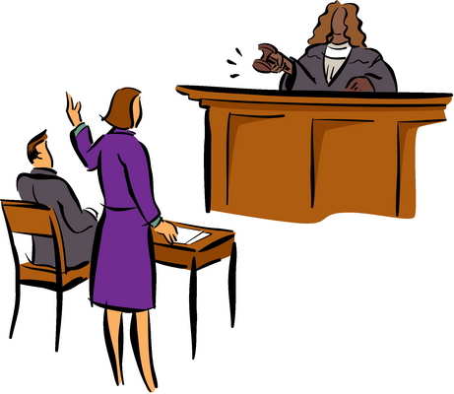
EEA Defenses
Parallel Development
Argue possession of a trade secret was derived through independent work
Reverse engineering
But beware DMCA violations
Must not disable technological barriers
General knowledge & skills
Strongest argument – challenges patent or supports no violation trade secrets
First Amendment rights
Bizarre idea!

Slide 25
Now go and study

