Slide 1
First Amendment Issues: Anonymity & Encryption
CJ341 – Cyberlaw & Cybercrime
Lecture #26
M. E. Kabay, PhD, CISSP-ISSMP
mailto:mekabay@gmail.com
V: 802.479.7937
Assoc Prof Information Assurance
School of Business & Management

Slide 2
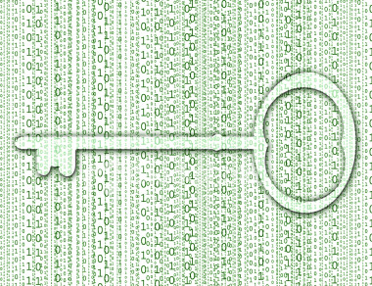
Topics
Contrary to syllabus,
there is no discussion of
entrapment in this lecture
Anonymity and Privacy
Privacy and Guilt
A Modest Proposal
The Madness of King George
Fourth Amendment
Anonymity
First Amendment Defenses & Computers
Cryptography Exports
Key Escrow
ICE Seizures
Wassenaar Arrangement
With some slides kindly provided
by Prof Robert Guess, MSIA
from Tidewater Community College

Slide 3
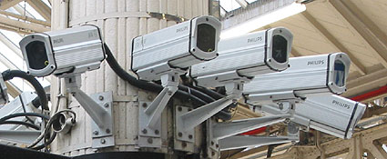
Anonymity and
Privacy
Sun CEO Scott McNeely caused a furor when he stated “You have zero privacy anyway. Get over it .”
25 Million Surveillance Cameras are in use worldwide.
Houston Chief of Police Harold Hurtt
  Called for placing surveillance cameras in public areas and private homes
  He said “I know a lot of people are concerned about Big Brother, but my response to that is, if you are not doing anything wrong, why should you worry about it?”
CLASS DISCUSSION:
How would you answer that?
Used by gracious permission
of Prof Robert Guess, MSIA
Tidewater Community College
Notes:
Quis custodiet ipsos custodes? – Juvenal
Virginia Beach installed facial recognition systems in 2002 to catch wanted criminals – 0 arrests in 4 years

Slide 4

On Privacy and Guilt
The issue is not whether someone desiring privacy has done anything wrong:
The issue is whether those
invading privacy are doing
something wrong.
  FBI Director J. Edgar Hoover
  detested civil rights workers
  and ordered 24-hour
  surveillance at taxpayer
  expense based entirely on
  his dislike of their politics *
  President Richard M. Nixon
  ordered illegal surveillance
  of his political “enemies” by
  the FBI and the Secret Service at taxpayer expense
  * http://www.icdc.com/~paulwolf/cointelpro/churchfinalreportIIIb.htm
  ** http://watergate.info/impeachment/impeachment-articles.shtml

Slide 5
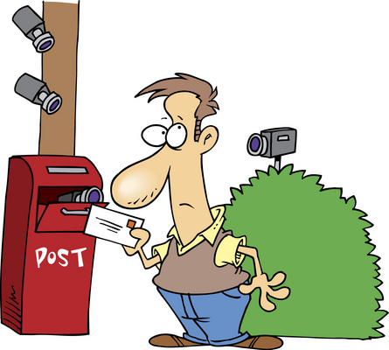
A Modest
Proposal
One possible answer to
the privacy dilemma:
  Eliminate privacy
  (governmental,
  corporate, and
  individual) and
  Create a completely
  open society
Criminal hackers chant “Information Wants to be Free” (well, for everyone else’s information)
Everyone should know everything about everyone
CLASS DISCUSSION:
Is that a wise course of action?
Imagine the consequences
Used by gracious permission
of Prof Robert Guess, MSIA
Tidewater Community College

Slide 6
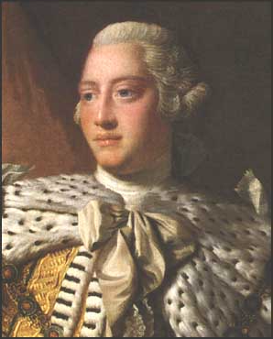
The Madness of King George
American Colonists engaged in barter and trade to avoid paying taxes to the Crown
In response, King George III issued “Writs of Assistance” to Colonial Governors
This power was widely abused for wholesale arrests, searches, and seizures
The founders of the United States of America deliberately decided to include constitutional protection from such governmental abuse
Used by gracious permission
of Prof Robert Guess, MSIA
Tidewater Community College
Notes:
The Founders foresaw in a small way, the threat of Big Brother… but they didn’t foresee all of his “little brothers”.
“A Man’s home is his castle” is a famous slogan of English common law. Lawrence M. Friedman of Stanford Law maintains that when enunciated, only the wealthy enjoyed this right. The poor enjoyed no common law right to privacy.
http://caselaw.lp.findlaw.com/cgi-bin/getcase.pl?court=us&vol=277&invol=438
[1] Killian, J and Costello,G. The Constitution of the United States of America: Analysis and Interpretation Congressional Research Service.

Slide 7
The Fourth Amendment to the US Constitution (again)
The right of the people to be secure in their persons, houses, papers, and effects, against unreasonable searches and seizures, shall not be violated, and no Warrants shall issue, but upon probable cause, supported by Oath or affirmation, and particularly describing the place to be searched, and the persons or things to be seized.
Notes:
What form do “papers” generally take in the present day?
Things get really difficult in business transactions – Who owns the papers?
What constitutes “effects” in the digital domain?
Is appearance in log files an “effect”?

Slide 8
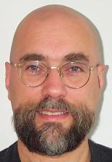
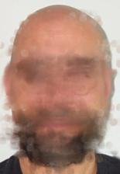
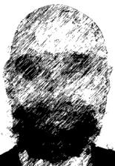
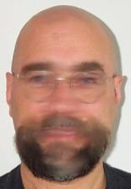
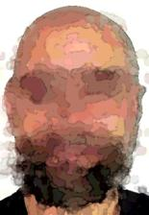
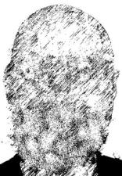
Anonymity
Major challenges to criminal law
  Ability to exist anonymously in cyberspace
  Identity & pseudonymity
    Are these people really who they claim to be?
  Technology
    E.g., anonymous remailers
    Ability of LE/legislators/gov’t/attorneys to keep pace with technology

Slide 9

Ban Anonymity?
Would a ban on Internet anonymity reduce crime?
See http://www.p2pnet.net/story/10336
  Brazilian politician called for ban on anonymity in 2006
  His proposed bill, if made into law, would have made it a crime for anyone to anonymously send an email, join a chat, write a blog, download content, disseminate virus or Trojans, and access banks or networks without proper authorization
Do you think this is a good idea for citizens of
  China?
  the USA?
Why or why not?

Slide 10

Circumventing Anonymity
Users are not always as “anonymous” as they think
  Social network users sometimes believe they are in a private space
    Reveal confidential information
    Show pictures of crimes (e.g., underage drinking of alcohol, consumption illegal drugs)
    Attack others in cyberbullying
  But most social networks allow open access
    School administrators
    Potential employers
Technology
  Tracking programs
  Forensic tools
Interesting article (April 2008):
http://tinyurl.com/5g6xox

Slide 11

First Amendment Defenses & Computers
First Amendment of US Constitution (again)
  Congress shall make no law respecting an establishment of religion, or prohibiting the free exercise thereof; or abridging the freedom of speech, or of the press; or the right of the people peaceably to assemble, and to petition the Government for a redress of grievances.
Citing 1st Amendment principles, attorneys have tried to argue that certain computer-related activities are protected
  Computer programs in general
  Viruses
  Encryption

Slide 12
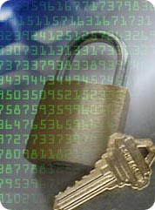
Computer Programs & Cryptography
Not easily lumped into protected speech category
Gov’t usually can’t prevent creation of code or dissemination
  Limitations can exist and be enforced if
  necessary to protect human welfare, but not easy to do so
In criminal cases, no bright-line rule about characterizing computer programs & conduct as protected
  E.g., US v. Mendelsohn, no valid first amendment claim where computer program was only directed to committing a crime, and not directed to any ideas or consequences
  In other cases, defendant’s conduct could be deemed protected expression
  But 1st amendment does not protect deeds, especially if they damage property or infringe rights

Slide 13

Cryptography and the Law of Unintended Consequences
People are afraid of
  Identity theft
  Computer intrusions
  Illegal / illicit surveillance
  Other fraud and abuse
A side-effect is the increasing use of cryptographic protocols
Cryptography is a two-edged sword
  A benefit when you employ it
  A harm when your opponent employs it
Used by gracious permission
of Prof Robert Guess, MSIA
Tidewater Community College

Slide 14
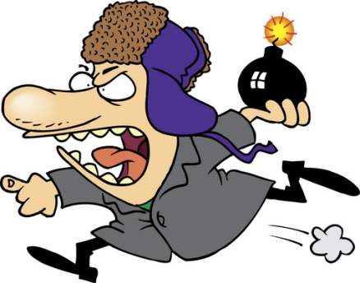
Cryptoanarchy
Cryptoanarchy: “the proliferation of
cryptography that provides the benefits
of confidentiality protection but does
nothing about its harms” (Denning)
This view led to the Clipper Chip fiasco (see below)
  Failure to provide crypto keys in Britain ~2-5 yr sentence
  France requires registration of crypto keys
But crypto not a major problem for LE because
  Strong crypto algorithm built on a weak platform (OS) or poorly written may be weak and subject to penetration
  Progress in cryptanalysis makes crypto less of a problem for LE
  Massively parallel applications like AccessData DNA help cryptanalysis (see EFF projects on DES)
Many argue that to criminalize crypto would be an INFOSEC disaster
Used by gracious permission
of Prof Robert Guess, MSIA
Tidewater Community College

Slide 15
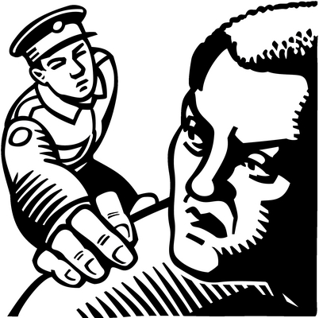
US Legal Status of Encryption
The ITAR
The Zimmerman Case
The Clipper Chip & Key
Escrow
The Bernstein Case
The EAR
ICE Seizures
Wassenaar Arrangement

Slide 16
The ITAR
International Traffic in Arms Regulations
Administered by Department of State
Until 1996, severely restricted export of cryptographic hardware and software as munitions
Constant protests from cryptographers and companies
  Nonsensical restriction
  Interference with trade
  Putting US suppliers at disadvantage

Slide 17
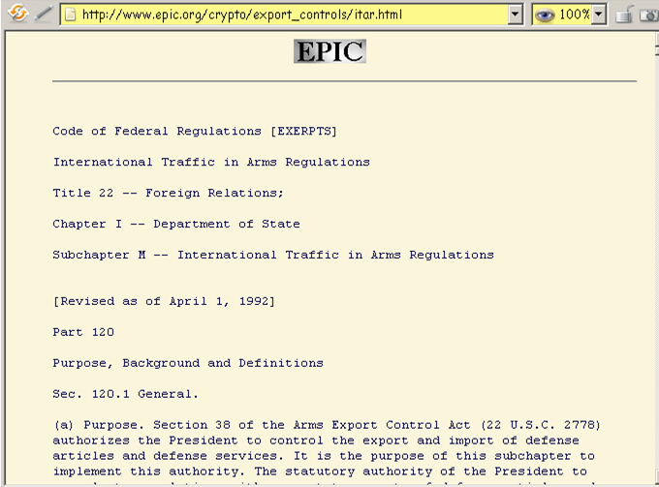
(ITAR)

Slide 18
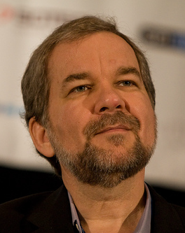
The Zimmermann Case
Phil Zimmermann created PGP* in early 1990s
Code was freely available
Someone posted code to BBS overseas
US government accused Zimmermann of violating the ITAR
World-wide protests
Phil Zimmermann Defense Fund
Eventually dropped the prosecution
*PGP = Pretty Good Privacy (named after
Ralph’s Pretty Good Grocery Store from Lake Woebegone)

Slide 19

The EAR
Export Administration Regulations
Administered by Department of Commerce
Encryption shifted from ITAR to EAR in 1996
Welcome change – liberalized regulations
Updated 2008-10-03: see http://www.bis.doc.gov/encryption/default.htm
  See next slide
http://www.access.gpo.gov/bis/ear/ear_data.html

Slide 20
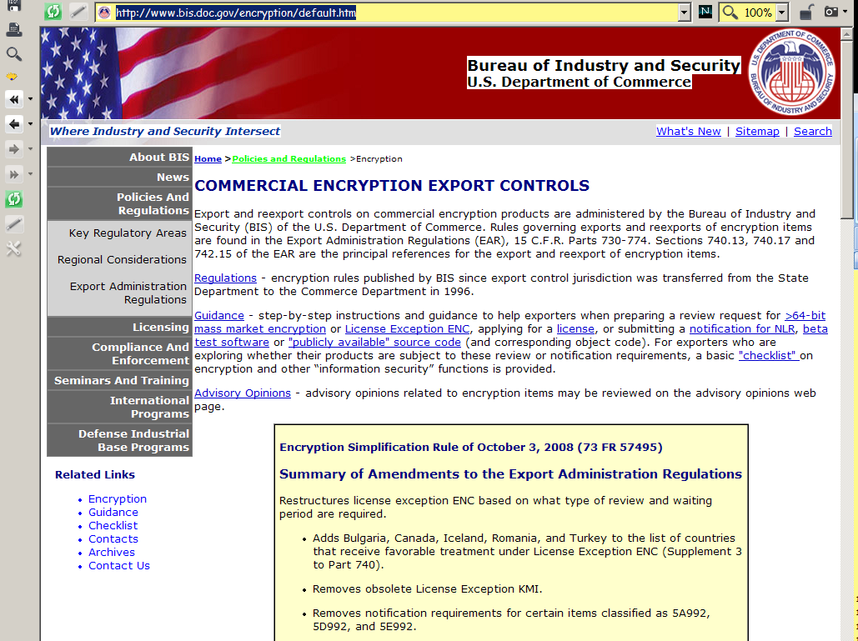
EAR Updated 2008
(Much more
below)

Slide 21

Cryptographic Regulations
NSA / Department of Commerce study
found that regulation had “a negative
effect on US competitiveness”
No domestic limitation on use or sale
Bureau of Export Administration (BXA)
License required for export of strong
crypto
No export to Cuba, Iran, Iraq*, Libya, North Korea, Sudan, and Syria
Code as Speech - Bernstein V US State Dept (next slide)
Used by gracious permission
of Prof Robert Guess, MSIA
Tidewater Community College
Notes:
“A STUDY OF THE INTERNATIONAL MARKET FOR COMPUTER SOFTWARE WITH ENCRYPTION” Prepared by the US Department of Commerce and the National Security Agency for the Interagency Working Group on Encryption and Telecommunications Policy

Slide 22
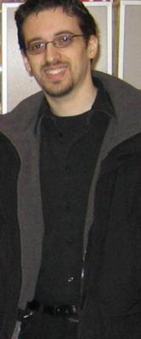
Bernstein v. US State Dept
  UC Berkeley student Daniel Bernstein
  wanted to post Snuffle encryption
  technology online
    Gov’t feared spread of technology
    Act enacted restricting export
  Bernstein challenged Act, claiming source code for computer cryptography program was protected under 1st Amendment
  Court found code = language, which = speech
    Gov’t could not restrict dissemination (disovulation??)
  Case rendered moot when gov’t switched to EAR instead of ITAR – Bernstein lost standing in court
Used by gracious permission
of Prof Robert Guess, MSIA
Tidewater Community College

Slide 23
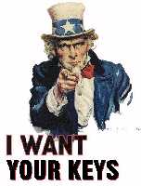
Key Escrow
When users encrypt critical data, must have way of decrypting
  User leaves
  User becomes non-cooperative
  (or dies)
Can store versions of key or
alternate keys
  Public Key Cryptosystem (PKC)
  allows encryption to multiple
  public keys
  Any owner of corresponding
  private key can decrypt the
  ciphertext
Modern cryptographic products (e.g., PGP) offer escrow functions for corporate users

Slide 24
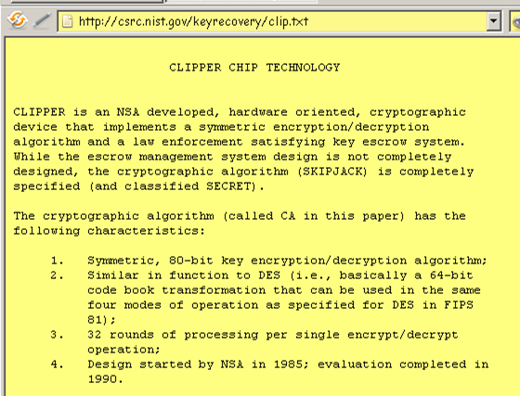
(Clipper Chip)

Slide 25
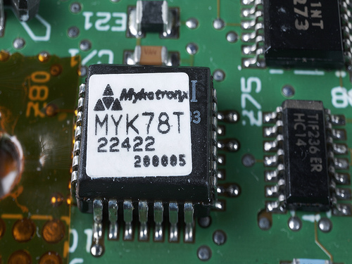
Clipper Chip & Key Escrow (1993)
Encryption had been domain of military (esp NSA) for decades
By early 1990s, personal computers made enough computational power available for general use by the public
Pretty Good Privacy implemented PKC
April 1993: Clinton administration proposed Clipper Chip
  Phones, fax, modems to
  be equipped with special
  chip (Clipper) to
  implement SKIPJACK
  algorithm
  Government would access
  LEAF (Law Enforcement
  Access Field) to decrypt

Slide 26


Clipper Chip (cont’d)
Reaction overwhelmingly negative
  Secret algorithms contemptible
    Details of the Clipper Chip were found thrown out in trash of manufacturer
    Committee of experts eventually given access to the code; pronounced OK
  Proposal would be meaningful only if other encryption were made illegal
    “Mandatory key escrow”
  Key escrow proposal said to be open to abuse
    But required collusion of people in 2 separate agencies of US government
Proposal finally abandoned in 2000

Slide 27
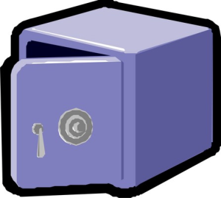
SAFE Act of 1997 (failed)
SAFE Act (Security and Freedom through Encryption) of 1997
Attempted amendment to 18 USC by adding new Chapter 123 with
  §2801. Definitions
  §2802. Freedom to use encryption
  §2803. Freedom to sell encryption
  §2804. Prohibition on mandatory key escrow
  §2805. Unlawful use of encryption in furtherance of a criminal act
Failed to pass into law
Currently, there are no restrictions whatever on the use of encryption inside the USA

Slide 28

US ICE Seizures: Boucher
Dec 2006: Sebastian Boucher
  Canadian citizen
  Legal resident of USA
  Crossed US border at Derby
  Line, VT
US ICE (Immigration & Customs
Enforcement)
  Inspected computer with
  permission
  Found adult pornography
  Then found some child pornography on Z: drive
  Z: drive encrypted using PGP disk encryption
  (cont’d on following slide)

Slide 29
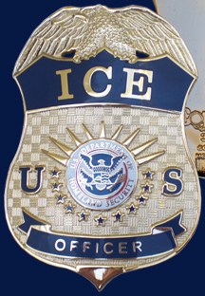
US ICE and Encryption [2]
2007: Grand Jury issues subpoena
  Required Boucher to divulge decryption key for Z: drive
  Judge Jerome J. Niedermeier then
  overturned subpoena on 5th
  Amendment grounds against self-
  incrimination
Issues:
  Forcing revelation of information held
  in mind of accused is protected by 5th
  Amendment.
  But there is case law where self-incrimination protection forfeited by permission for search
  What about
    National security?
    Corporate info?
See article by John Curran of Associated Press about case: http://tinyurl.com/668v2u
Articles by Prof Kabay about implications of case: http://tinyurl.com/5cs8yt http://tinyurl.com/68keob http://tinyurl.com/6g2ly5
Blog by Debbie Schlussel: http://tinyurl.com/2hfopx

Slide 30
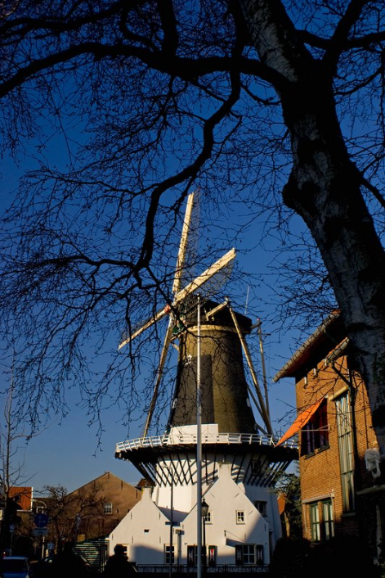
Wassenaar Arrangement
Wassenaar Arrangement on
Export Controls for Conventional
Arms and Dual-Use Goods and
Technologies
http://www.wassenaar.org/
  Named after town in
  Netherlands
  Established in 1995 by 28
  countries
  Follow-up to the Coordinating
  Committee for Multilateral
  Export Controls (COCOM)
    Intended to prevent export
    of encryption to “dangerous”
    countries (Soviet bloc)
  Completed 1998
Provides framework to be implemented by signatory countries

Slide 31
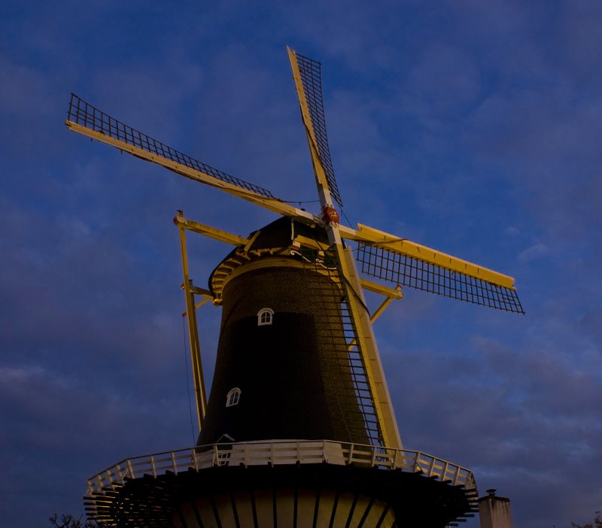
Wassenaar (cont’d)
Liberalized restrictions on encryption
No restrictions on export of encryption products for personal use
No restrictions on Internet publishing of encryption algorithms
Public domain encryption
software freely exportable

Slide 32
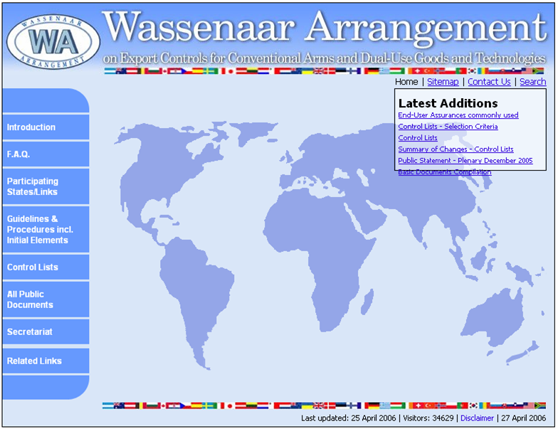
(Wassenaar)

Slide 33
DISCUSSION

