Slide 1
Data Modeling

Slide 2
Outline
Database Development Process
Entity-Relationship Model
Entities, Fields & Records, Oh My!
Special Entity Characteristics
Relationships
Data Modeling Steps
Model Defined By…
Collect Details
Interview
Nouns & Verbs
Evidence
Collate Draft Entities
Data Modeling Notation
Entities
Relationships
Cardinalities
Meaning
Business Rules
Cardinality Min & Max
Data Modeling Draft2
ERD Steps
Database Normalization
Database Design, In Brief
Everything you need to understand the basic concepts and processes

Slide 3
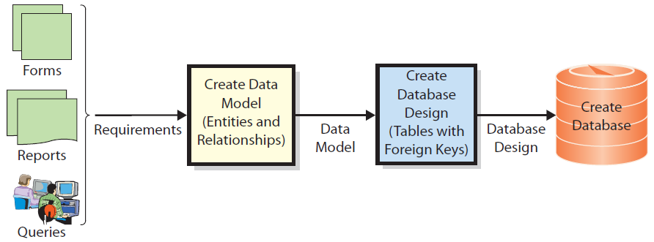
Database Development Process
Before building a database, developers construct a conceptual representation of database data called a data model to describe the data and relationships to be stored in database.

Slide 4
Database Development Process
Ideally the data model should be based on user and organizational requirements, discovered through interviews, examination of routinely used forms, reports, routine questions that arise…even user behavior.

Slide 5
The Entity-Relationship Data Model?
The most common method for constructing data models is the Entity-Relationship (E-R) data model
Developers use it to describe the content of a data model by defining entities that will be stored in database and relationships among those entities
Unified Modeling Language (UML) is another less popular tool for data modeling
Although purists will argue the philosophical fine points, an Entity is just a table that represents some thing of interest to someone.

Slide 6
Entities - Tables
Some thing users want to track
(represented as a table)
Examples: Contract, Sale, Customer, Salesperson, and Item
Person – Customer; Salesperson
Event – Sale
Thing, real or conceptual – Item; Contract

Slide 7
Entity Characteristics - Columns
Fields or Attributes
(represented as table columns)
Describe characteristics of an entity.
Examples: order attributes are OrderNumber, OrderDate, SubTotal, Tax, Total, and so forth.
In addition to specific things being of interest, specific attributes or characteristics of those things are of interest.

Slide 8
Entity Instances – Records (Rows)
Records or Instances
(represented as table rows)
The collection of values stored in all the columns across a single row in a table represents one instance or occurrence of the type of entity the table represents
A row (record) in a table intersects all the columns (characteristics) of that entity type. The values in those cells describe one instance of the entity

Slide 9
Special Entity Characteristics
Key Field (unique identifier)
Each instance (row) of an entity (table) needs to be uniquely identifiable.
One or more table fields (entity characteristics or attributes) must have values that are unique per row. That value never repeats w/in the table!
This field or fields is a KEY (or primary key)
Other non-key field values can repeat
To uniquely identify each instance of an entity (row in a table) there must be a field (or combination of fields) the value(s) of which occur(s) for one and only one row

Slide 10
Special Entity Characteristics
Foreign Key
An attribute (or group of attributes) whose value is associated with one and only one instance (row) in another entity (table).
Note a foreign key is simply the key of one entity used in another for the purpose of logical association (“relationships”).
Foreign key fields can contain duplicate values since their rows may all be associated w/one record in another entity
To be able to associate (relate) two tables, the key field or fields must be used as a foreign key in the other

Slide 11
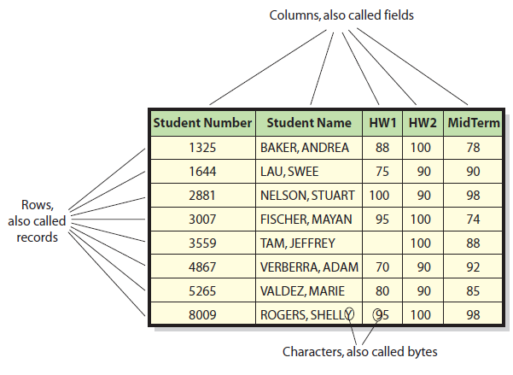
Table, Fields, Records & Values
Values or details about the thing the record represents
Which field is the KEY?

Slide 12
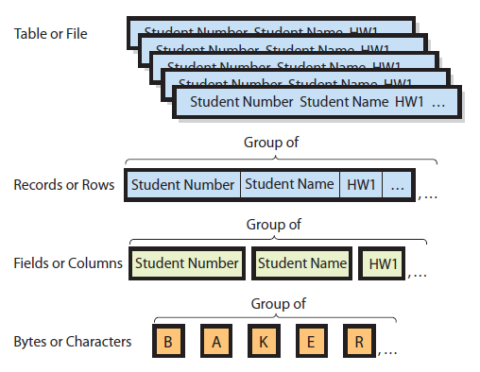
Hierarchy of Data Elements
Student table then is related to another structured table, such as Advisor, Class, etc.
The characters designate or form values, and those populate the row-column intersections of a given record.

Slide 13
Entity Example – Tables
Products Table from Northwind.mdb
Quantity Per Unit – a characteristic of interest for each Product
Products – a table of data (details) of interest to the business about instances of one type of thing
Each row is a record or an instance of a Product
“36 boxes”, the value for the Quantity Per Unit attribute of the fifth instance (record) in the Products table
Which field is the KEY?

Slide 14
Data Modeling Steps
The model is defined by the objectives of the organization and the details needed by the user to meet these objectives. To determine the Entities…
Collect details from the client
Meet with them. Interview them. Examine existing evidence. Observe their actions.

Slide 15
Data Modeling Steps - Interview
Collect details from the client
Meet with them. Interview them.
Discuss what they do, what they deal with, what they need to know the details of to do their jobs, what they do with the details and why?

Slide 16
Data Modeling Steps – Interview
Collect details from the client
Be alert for their use of nouns and verbs
Record them/list them all in any order
Nouns signal a possible entity in the data model for their slice of reality.
Verbs signal a possible entity relationship

Slide 17
Data Modeling Steps – Evidence
Collect details from the client
Examine documents they use and produce
Reports, faxes, charts, forms, queries, etc.
It might be worth shadowing them to watch what they do, note what documents they use, who they interact with, what they say, what types of actions they take, etc.

Slide 18
Data Modeling Steps – Draft Entities
Collect details from the client
From your lists, collate similar nouns (candidate entities)
Example From Class: Professors, Faculty, Adjuncts, Grad Students…all may be teachers
Does the person needing data about them do anything different w/it for one versus another? If not, maybe a general noun like “Instructor” would be OK, and any remaining characteristics on which they differ could be YES/NO fields in the table.

Slide 19
Data Modeling Notation
Once you have a final list of candidate entities, build draft high-level model
To complete your abstract, high-level data model for your organizations, you must use specific notation that simplifies what the model represents:
Entities and their characteristics
Relationships
Relationship minimums and maximums
Relationship meanings

Slide 20
Notation - Entities
Box w/Singular Entity Title above
Key Field in rectangle at top of box
Fields/Characteristics (incl. foreign keys) in main box
Foreign keys identified with “(fk)”
Student
Part
A#
Part_Number
Entity Title
Fname
Minitial
Lname
Description
Reorder Point
SupplierID (fk)
Characteristics
Foreign Key

Slide 21
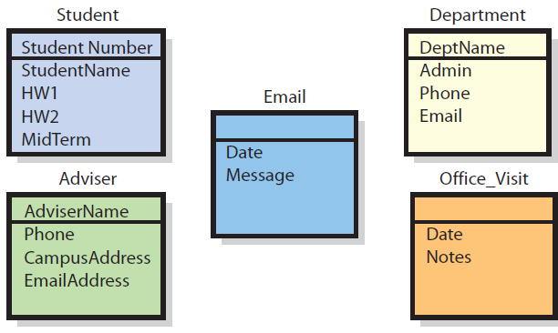
Entity Examples: Student Data Model

Slide 22
Notation – Relationships
What are the relationships between entities? (check your notes from before and look for verbs linking entity nouns)
Relationships between two entities are usually depicted by a line between the entities.

Slide 23
Notation – Cardinalities
Relationship Cardinalities – Minimum and maximum limits at either side of a relationship between entities, written or depicted symbolically, logically or numerically
Logical
Notation
Numerical
Notation
1:N
N:M
(1,50)
(25,50)
Symbolic: Crow’s Feet

Slide 24
Notation – Meanings
Relationships meanings between two entities are described by a verb or verb phrase that often simplifies the association (takes; is initiated by; has a)
A Student takes/attends/has Instructors
An Instructor teaches classes
A class has sections
Some model notations require a text description of the relationship meaning
Some put a diamond in line w/the relationship and include a verb or phrase describing the relationship.

Slide 25
Relationship Meanings
1:N or (1,n) = one-to-many relationship
One department can have many advisers
One adviser has at most one department.
1:N
N:M
N:M or (n,m) = many-to-many relationships
One adviser can have many students
One student can have many advisers.

Slide 26
Relationships ~ Business Rules
Because we are modeling organizational interest and use of data the relationships and cardinalities effectively represent business rules between entities.
That students may not have multiple advisers is obviously not a physical law or rule according to nature, physics, or the legal system (though a relationship could be determined in such a way).
Discovering such rules is part of the process of eliciting the model(s) from database users
1:N
N:M

Slide 27
Notation – Cardinality Min/Max
“Crow’s Foot” Symbols
Minimums (nearest to relationship center)
Zero (oval)
One (vertical bar)
Maximums (nearest to entity)
One (vertical bar)
Many (crow’s foot)
Combined Meanings:
Zero to many: OK to have none; no upper limit
One to many: No fewer than one; no upper limit
Zero to one: OK to have none; max of one
One and only one: exactly one
1
2
3
4
Notes:
Stopped here, day two, Sxn A

Slide 28
Examples – Cardinality Min/Max
Minimum cardinality—minimum number of entities that can be involved in a relationship.
Small oval: the table need not have an instance of that entity
Vertical bar: at least one entity of that type is required.
Maximum cardinality—maximum number of entities that can be involved in a relationship
Single line or no symbol: no more than one
“Crow’s Foot”: an unspecified max of “many”
Notes:
Stopped here w/SXN B, day 2

Slide 29
Data Modeling Steps – Draft Model₂
From your entity list, start with a central event
Add another entity such as a related person or thing
What is the relationship between them? (check your notes and look for the verb linking entity nouns or come up with one yourself)
What are the cardinalities?
Maximums? (Note any N:M relationships as you’ll have to come back to these, but don’t attempt to fix them yet)
Minimums?
What are likely (primary) key identifiers for each?
Add another entity and repeat for all entities!
Attend the in-class practice sessions, refer to your notes from those classes, and practice this process yourself to get a better feel for it

Slide 30
Data Modeling Steps - ERD
Until now we’ve focused on high level modeling
In ERD modeling you have to express the model so it could be represented by 2D tables in a database
This requires you “fix” all the N:M relationships
You will also identify and include a more detailed list of attributes (columns, characteristics) for each entity

Slide 31
Data Modeling Steps – ERD
Data Integrity Problems – N:M relationships
Convert every N:M relationship
Create an intersection table between the two entities involved
If possible use a name for the intersection table that is meaningful to the user; if not, aim for one that is meaningful in general
Each entity points toward the intersection table with a one-to-many relationship
Primary key of intersection table is likely both foreign key fields of the two original entities.
Revisit and establish minimum cardinalities again; likely the same

Slide 32
Data Modeling Steps - ERD
Data Integrity Problems – N:M relationships
Example: Student←→Class Section
One student can have one to many sections; one section can have one to many students
Create intersection table (Student-Section?...) w/studentID and sectionCRN fields as foreign keys; use both together as key
One student can be a part of many student section line items
One student-section line item can have one and only one student
Etc.

Slide 33
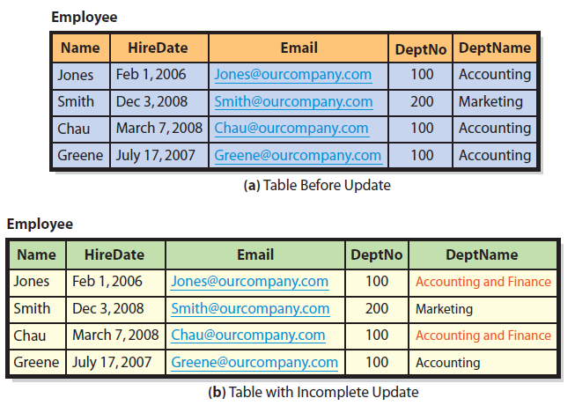
Database Normalization
Data Tables & Independent Themes. Poorly structured tables mix two or more independent themes. Here, it’s employees and departments.
Acctg
Acctg

Slide 34
Data Integrity Problems
In previous figure, Dept. 100 is both “Accounting and Finance” and “Acctng.” Which is correct?
Duplicate data can cause Data Integrity Problems
A table with data integrity problems will produce incorrect results and inconsistent information.
Users lose confidence in data & system
System, data problems & reputations become serious burden to the organization.

Slide 35
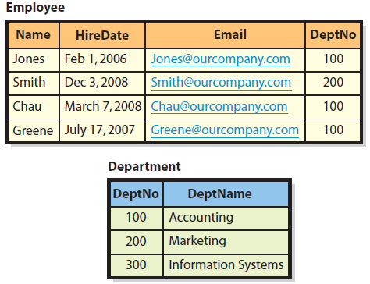
Normalizing for Data Integrity
Transforming a table to remove duplicate data and other problems is called normalizing it
To correct the problem
Split table into 2 single-themed tables
Employee
Department
Keep DeptNo identifier w/Employee
It is a foreign key. Enables relationships to the table where we store all the details about the 2nd theme – the department.
Use DeptNo as foreign key elsewhere
Changes/entries to department table then only need to be written once.
Foreign
Key
Field
(Primary)
Key
Field

Slide 36
Summary of Normalization
General goal of normalization is to construct tables such that every table has a single topic or theme
Database practitioners classify different table problem types into various “normal forms”
Normalization only one criterion for evaluating database design.
For example, normalized tables reduce duplicate data but can be slower to process.
Database designers sometimes opt for non-normalized tables to speed processing.
“Best” design depends on user processing requirements.

Slide 37
Database Design – In Brief
The process of developing a data model and converting it into tables, relationships, and data constraints.
Database design team
Elicits and develops model w/users assistance
Transforms entities into tables
Elicit required values (fields) for each relation
Normalizes tables as necessary
Expresses relationships by defining keys and foreign keys.
Adds tables to deal w/N:M relationships

Slide 38
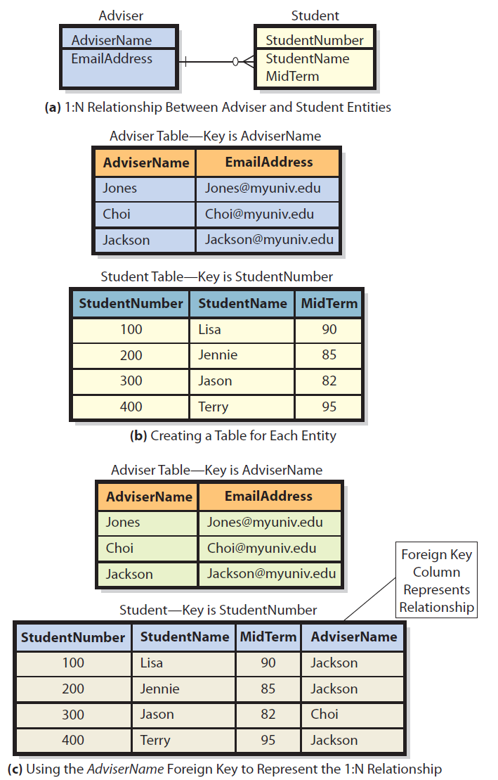
Representing a One-to-Many (1:N) Relationship

Slide 39
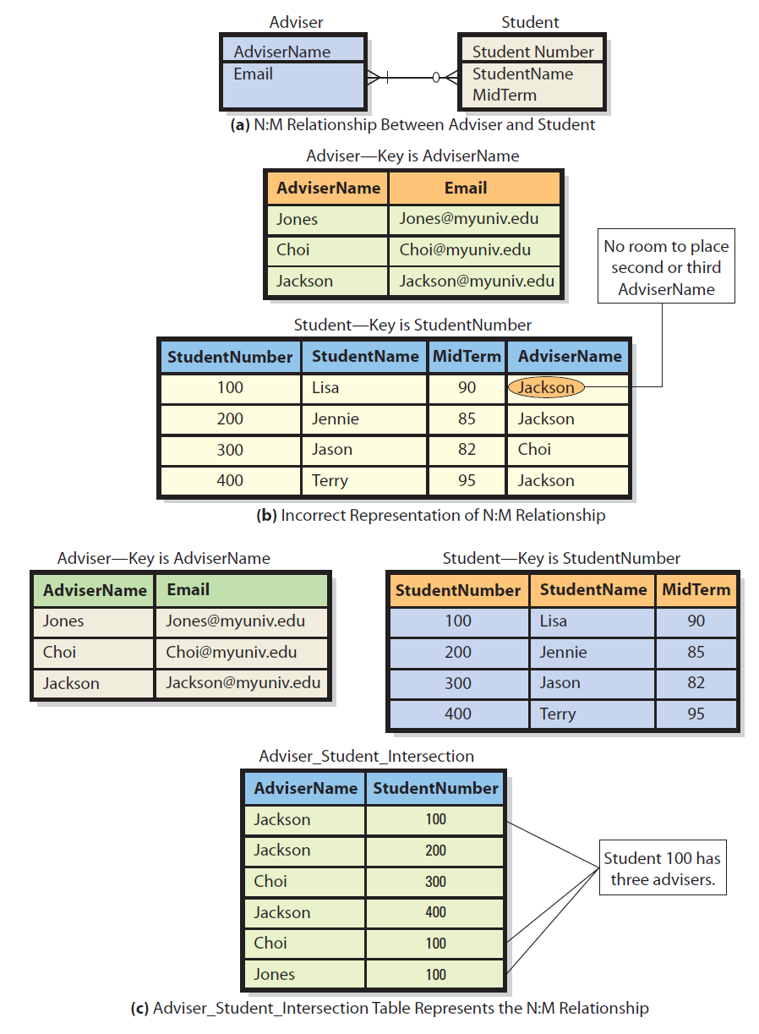
Representing a Many-to-Many (M:N) Relationship

Slide 40
Summary – Users’ Role
User review of the data model is crucial.
Be sure it accurately reflects users’ view of the business.
Users are the final judges of:
What data the database should contain,
How tables should be related.
Easiest time to change database structure is during data modeling stage.
Mistakes now will come back to haunt you later
Changing a data model relationship is simply a matter of changing notation. Changing it after the database is finished and data has been collected is not simple at all.
Expert help can be invaluable, but shouldn’t dictate database contents or table relationships. Users must be involved.

Slide 41
Guide: No, Thanks, I’ll Use a Spreadsheet
Databases take time to build.
Moderate-to-steep Learning Curve
Complicated to operate
May require use of multiple applications
Need IS people to create it and keep it running
Will share data that you may not want to expose
Spreadsheets may be a better option in some cases.
However, can create data, info “islands”

Slide 42
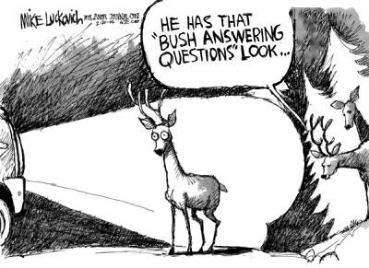
He has that “studying data modeling” look in his eyes…
…with apologies to Mike Luckovich!

