Slide 1
Staying Safe Online
Montpelier Senior Center
Week #1 – Mon 5 Jan 2026
Protecting Against Fraud (Part 1)
M. E. Kabay, PhD
Emeritus Professor – BSc & MSc Cybersecurity Programs
Norwich University
https://tinyurl.com/3b6p3h8s
Notes:
M. E. Kabay, PhD, CISSP

Slide 2
Topics
Spam
  Unsolicited email
Phishing
  Tricking victims into revealing info or downloading malware
Trojans
  Malware downloads
Advance-fee fraud
Refund scams
Blackmail

Slide 3
What is Spam?
Unsolicited email
  Recipient never asked for or permitted emails from the sender
  Estimated volume:
    160 billion spam emails per DAY worldwide
    ~46% of world total of 347 billion emails/day
Fraud rampant in spam
  ~600 million victims worldwide/year
  Losses ~$1 trillion worldwide/year
Dangers
  Cluttering inbox – can lose track of legitimate email
  Naïve recipients click on links – harmful materials
  False identification tricks victims into thinking they are responding to legitimate services (government, technical support, software licenses….)

Slide 4

Origins of the Term “spam”
Monty Python 1970 – The Spam Sketch
https://tinyurl.com/4r55f7ry
[Hormel Corporation politely requests that their food-like product be referred to as “SPAM.”]

Slide 5
The US CAN-SPAM Act
CAN-SPAM Act of 2003 [15 U.S.C. § 7704(a)]
Accurate header showing origin of email
Non-deceptive subject line
Clear indication of advertisement or fund-raising
Working return e-mail address
Easy opt-out link to work within 10 days
No further spam after opt-out
Valid physical postal address for sender
Penalties can include
  Fines up to $250 per email
  Penalties up to U$2 million
  Possible imprisonment
May report abuse to Federal Trade Commission
  https://reportfraud.ftc.gov/

Slide 6
Phishing (1)
Goal: obtain personal information for further fraud
Methods
  Fake websites (imitating real ones)
  Tricking victims into revealing secret info
    User ID (e.g., email, banks, gov’t sites
    Passwords
    Social-Security ID
    Bank info
KEY POINT: ALWAYS HOVER POINTER OVER A LINK TO SEE WHERE IT IS GOING! If link for your bank goes to a Russian (.ru) site, IT ISN’T REAL!!!
Up-to-date established antimalware products; e.g., (not an exclusive list)
  BitDefender
  Norton AntiVirus
  Windows Defender
  McAfee Antivirus

Slide 7
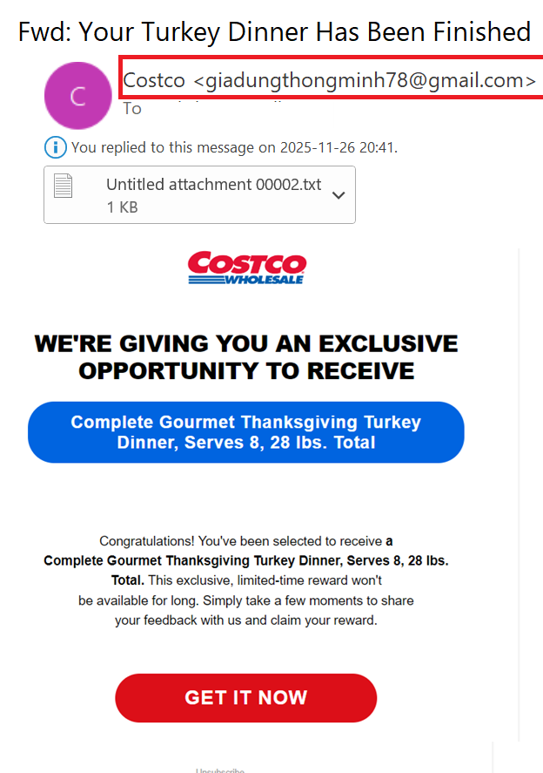

Phishing (2)
Check the origination address of ALL emails, especially those claiming to be from a company.
DO NOT OPEN ATTACHMENTS
The real example here is from an idiot who used GMAIL!! LOL!

Slide 8
Advance-fee Fraud
AKA “Nigerian 419 Scam”
Criminals announce huge payment (often $millions)
  “Government payment”
  “Legal payment from class-action lawsuit”
  Nonexistent “lottery winning” (without participation!)
  “Donation from a dying millionaire” (often a “widow”)
Victims supply detailed info
  Name, address, phone number, bank account (!)
Criminals request payment (e.g., $150) through a commercial cash card
  Walgreens
  Staples
  Amazon
  Etc.
Steal the money

Slide 9
Refund Scams
Emails or phone calls about non-existent payments
  Caller or email pretend to be from a company
  Often send millions of messages
    May have nothing to do with potential victims’ actual software or purchases
E.g., Email or phone message
  “You have been billed $429 for one year of your McAfee antivirus” (which the victim does not use)
  “If this information is wrong, phone XXX-XXX-XXXX
Criminal apologizes & asks to access bank account
  Victim (e.g., my 90-year-old aunt) agrees to let criminal install remote-access software to “see bank account”
  Steals details of banking account & logon & password
Pretends to refund 10x fake amount & whines about it
Victim authorizes wire transfer for non-existent payment
I stopped the theft of $30,000 from aunt’s account!

Slide 10
Threats of Prosecution
“FBI” or “State Police” or “IRS”
  Email with phone number to call
  Phone call with threats from “official”
  Text message with link or phone # to call
“You are being charged with XYZ crime”
  “Must pay $ (often thousands) to avoid prosecution”
That’s not how law-enforcement works!
  LEO do not warn suspects of arrest!
  Justice system does not ask for money to avoid trials!
Block the emails and block phone calls from #
Swear at the phone callers & hang up

Slide 11
Blackmail
Typical script by email or phone:
  “I’ve been watching you for a month using a virus I installed on your computer.”
  “I have recorded you doing {bad things list}”
  “Unless you pay me {large amount of money} I will post the videos online and arrange {bad consequences}”
Typically threats involve something sexual
But what kind of idiot pays a criminal NOT to do something?
What could possibly stop an endless series of demands??

Slide 12
Unwanted Phone Calls
Our phone #s can be widely distributed
US established DO NOT CALL (DNC) LIST
  Irresponsible companies and criminals have been collecting those DNC #s for spam calls
Install inexpensive call-blocking software; e.g.,
  Android: Should I Answer?
  Apple iOS: Robokillerheaders
These products share info from users
  Can update manually or automatically
  Work well!

Slide 13
Advice Summary
Install established anti-malware products on computers and phones
Never click on an unfamiliar link on Web or in Email without seeing where it is actually going online
Don’t respond to unexpected emails or phone calls
  Look up the real contact info yourself
Never let a caller install software to control your system
Never agree to let anyone “deposit money” to your bank account
Never agree to pay money for a gift or prize
Never respond to email, text or phone threats
Never respond to online claims that a government agency is going to fine you or send you to jail
Never respond to supposed blackmail threats

Slide 14

OK, STAY SAFE!

