Slide 1
Staying Safe Online Montpelier Senior Center
Week 3
Using the Web Safely
M. E. Kabay, PhD
Emeritus Professor – BSc & MSc Cybersecurity Programs
Norwich University
https://tinyurl.com/3b6p3h8s

Slide 2
Topics
Check the Link
Download Carefully
Avoid Public WiFi
Passwords
Two-factor Authentication
Be Shy – Restrict PII
Antivirus/Firewall Software
Log Off When Finished
Update System & Software
Backups

Slide 3
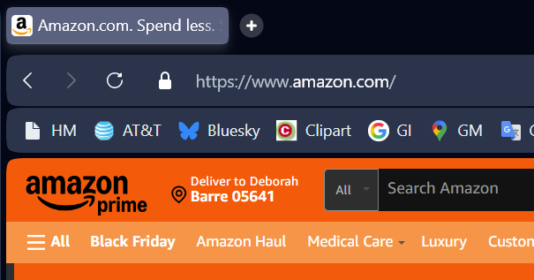
Check the Link (1)
Easy to see when you use browser:

Slide 4
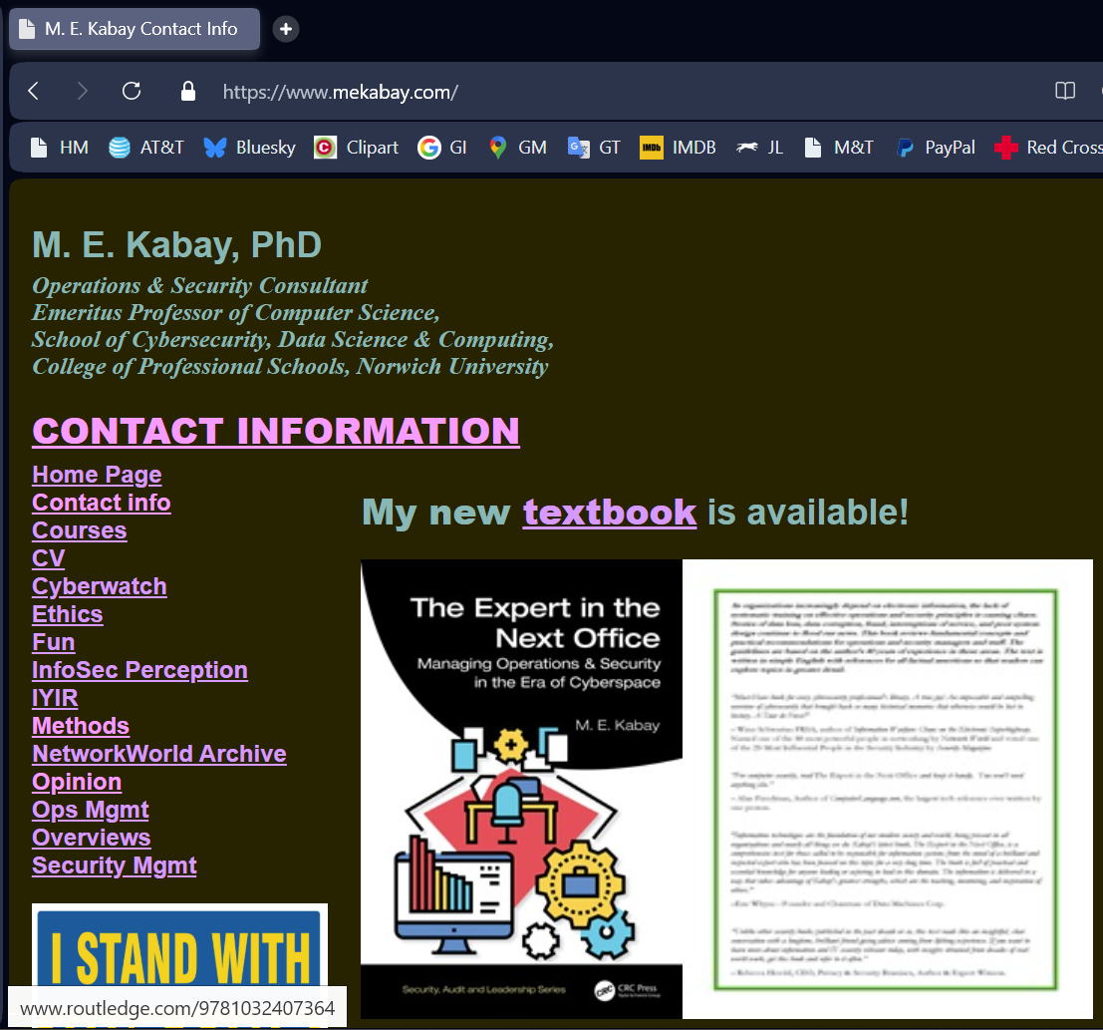

Check the Link (2)
Important to check in page
Howevering the cursor over the link brings up the actual link at the bottom of the page (in this browser).
ROUTLEDGE is the publisher of the textbook.
If one doesn’t know that, it is wise to look up the name before clicking on the link to be sure it’s safe.

Slide 5
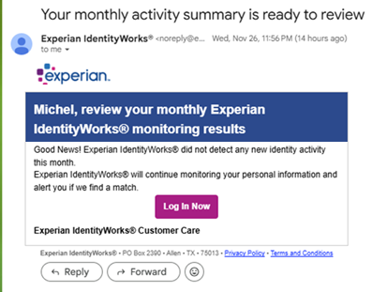


Check the Link (3)
This was actually a legitimate email, not phishing.
It simply illustrates that hovering the cursor over ANY link in email or on a Web page brings up the actual link.
In this case, the company uses a third-party emailing service. I checked and it’s OK.
Particularly important in email

Slide 6
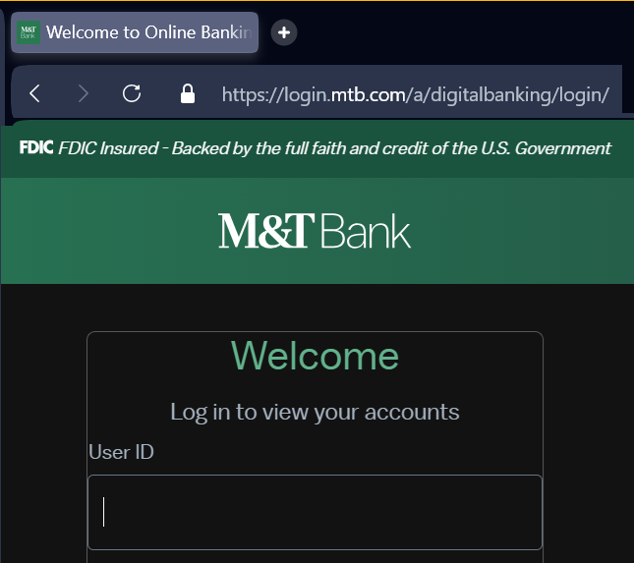
Download Carefully (1)
If you are logged into a site you normally use, you can download files safely
E.g., banking, credit-card, medical systems

Slide 7
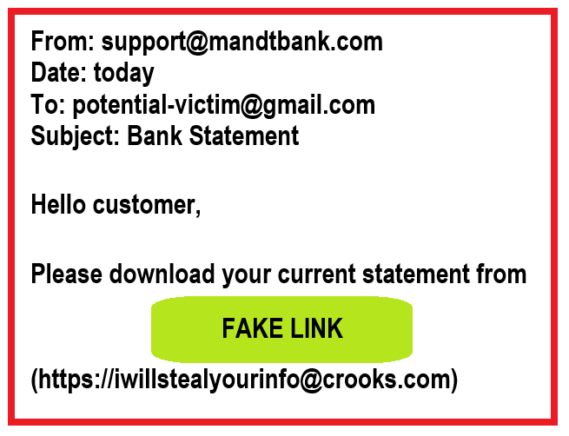
Download Carefully (2)
Do not download ANYTHING from strangers
Not from emails from random sender
Not unexpected email from supposedly safe organization or person
Contact the organization yourself to download information

Slide 8
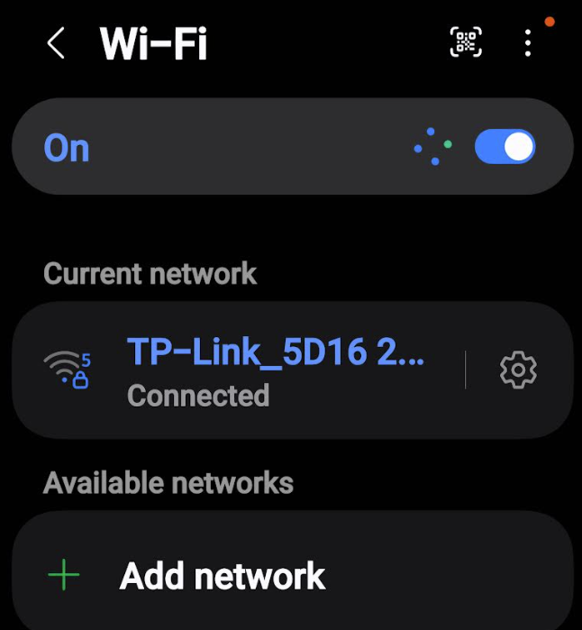
Avoid Public WiFi
WiFi available at hotels, restaurants, offices….
Easy to link phones, tablets, laptops
Be CAREFUL!
May be unsafe
Can allow criminals to log onto network
Easier to steal passwords, insert malware on users’ info
USE FOR PUBLIC SITES, NOT SECURE SITES

Slide 9
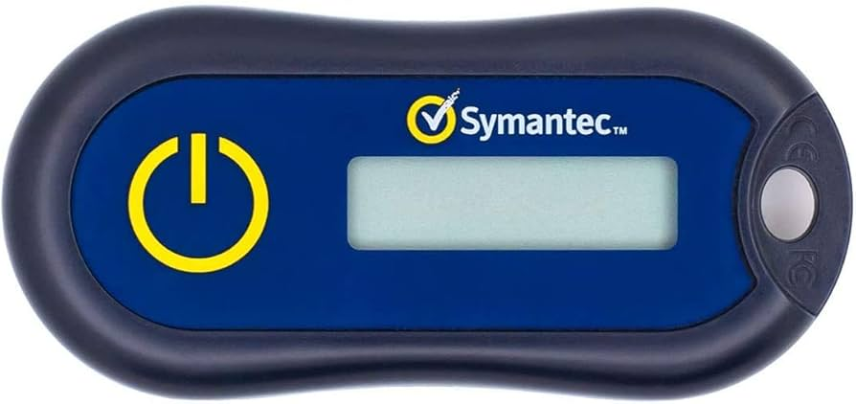
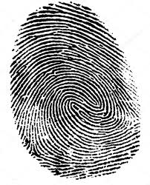

Passwords (1)
Passwords are ONE authentication method to prove that the identification is correct
What you know that others don’t know
Passwords
What you have that others don’t have
Tokens (e.g., physical keys)
What you are that others aren’t
Biometrics (face, fingerprint)
What you do that others do differently
Voice
Signature dynamics

Slide 10
Passwords (2)
Do not use publicly-available info for passwords!
Birthday
Partner’s name
Mailing address
Pet’s name
Mix letters, numbers, symbols
Store passwords securely
OUTLOOK “private” contact entry
Password safes/managers – programs store passwords using encryption

Slide 11
Passwords (3)
If you have to write passwords down on paper, store the paper securely! (e.g., a combination safe)
Password safes or managers are reliable
Your browser may have that feature
Store userIDs & passwords for all the different logons
Use a password & strong encryption to prevent disclosure to hackers (as long as they don’t have access to your device!)
Windows, Apple, Android, iOS systems
Bitwarden
1Password

Slide 12
Two-factor Authentication
Example from normal life
Receive a phone call on your cell phone
See number calling you (factor 1) and recognize the voice of the caller (factor 2)
Often must provide a code sent to your phone
Unique for specific login
Expires quickly (e.g., 10 minutes)
Other systems – usually password +
Physical token
Biometric data

Slide 13
Be Shy – Restrict PII
DO NOT PROVIDE SOCIAL-SECURITY NUMBERS CASUALLY
Only when YOU have logged in to site or service YOURSELF
Legitimate requests for SSN
Financial institutions (for tax purposes)
Employers
Credit-reporting
Background checks
Insurance companies
Other organizations may ASK but you may DECLINE

Slide 14
Antivirus/Firewall Software (1)
Antivirus (“antimalware”) protects against illegal software
Malware can modify/steal data & block access
Viruses are self-replicating
Remote-access Trojans provide control by hackers
Firewalls usually integrated into security software
Control access from external sources
Prevent infiltration of target systems

Slide 15
Antivirus/Firewall Software (2)
For Windows systems (including Android phones)
Bitdefender Total Security
Highly regarded
Anti-phishing
Anti-fraud
Anti-ransomware
Password manager
Norton 360 Deluxe
McAfee Total Protection
Avast One

Slide 16
Antivirus/Firewall Software (3)
Intego Mac Internet Security X9
Bitdefender Premium Security for Mac
Aka “Bitdefender Antivirus for Mac”
Norton 360 Deluxe for Mac
Avast Premium Security for Mac

Slide 17
Log Off When Finished
Do not leave system logged on (active) when you leave it
Must not allow anyone to access system simply by using your existing session
Applies even to home systems
Intruder could cause damage or steal info
Children could misuse system
Access dangerous sites (porn, abuse)
Some kids have charged $thousands online using parents or grandparents’ access to AMAZON etc.

Slide 18
Check Children’s Systems
Watch for access to online stores!
Guardian 3 Mar 2025:
8 year-old in Britain with iPhone
Accidentally had automatic access to parents’ HSBC debit card
Spent equivalent of $11,000
270 payments in 3 months
Parents did not notice
No alerts from banks or Apple
Thought the charges were like in a game
https://www.theguardian.com/money/2025/mar/03/our-eight-year-old-daughter-spent-over-8500-on-the-apple-app-store

Slide 19
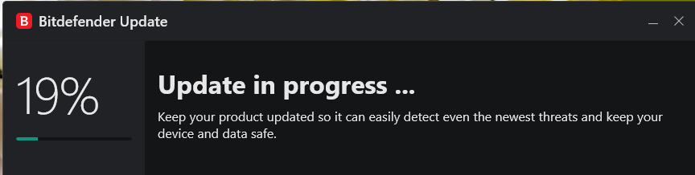
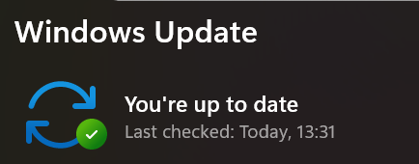
Update System & Software
Allow your antimalware & operating system to update automatically
And can initiate update on demand

Slide 20
Backups (1)
Keep copies of your data on EXTERNAL resources
Cloud storage (copies sent online to servers)
Microsoft Office 365
Backblaze (Windows & Mac)
IDrive for Mac
Physical USB drives
3TB (=3,000 GB = 3,000,000 KB) cost ~$100
Backup software
Windows:
WinZip (compresses modified files),
ViceVersa Pro (updates backup drive)
Mac: TimeMachine (built-in), Carbon Copy Cloner

Slide 21
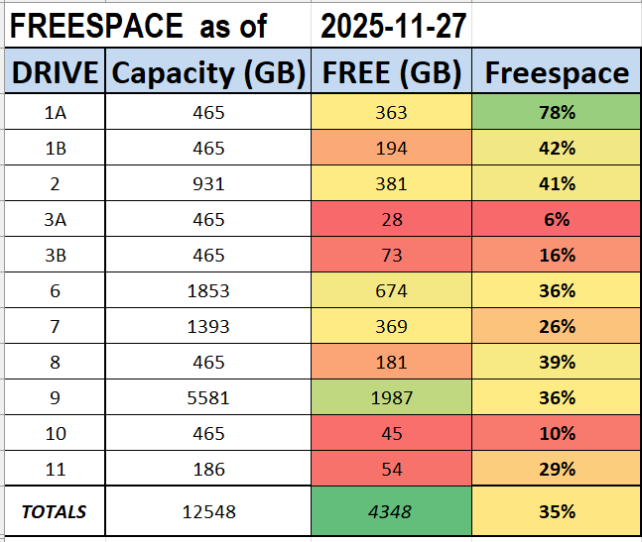
Backups (2)
Mich was in charge of operations centers in 1980s (Hewlett-Packard, Mathema Inc)
Earned a living in operations-management consulting
Industry
Government
Education
Therefore a bit fanatic about backups!

Slide 22

OK, STAY SAFE!

