Slide 1
Staying Safe Online Montpelier Senior Center
Week #4
Social Media
M. E. Kabay, PhD
Emeritus Professor – BSc & MSc Cybersecurity Programs
Norwich University
https://tinyurl.com/3b6p3h8s

Slide 2
Topics
Social-Media History
The Profit Mechanism: Advertising & Profiling
Cambridge Analytica Case
DISINFO via Social Media
Trolling & Cyberbullying
Privacy Issues
Political Implications
Censorship
Return of Intermediation
Surveillance
Identity Theft using Social Media
Facebook Settings

Slide 3
Social-Media History
Cave art (40,000 BCE)
Graffiti (13,000 BCE)
Cork Bulletin boards (1801)
Electronic systems (1970s ff)
CompuServe (1969)
PLATO (1970s)
USENET (1980)
IRC (1980s)
Blogs (1990s)
AIM (1997)
LinkedIn (2002)
MySpace (2003)
Facebook (2004)
Twitter (2006)
Weibo (2007)

Slide 4
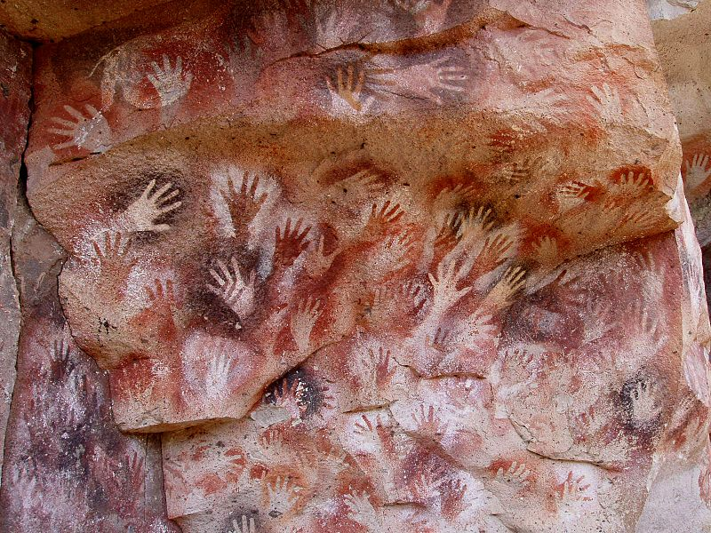
Cave art (40,000 BCE)
Cave of Hands
(13,000 BCE)

Slide 5
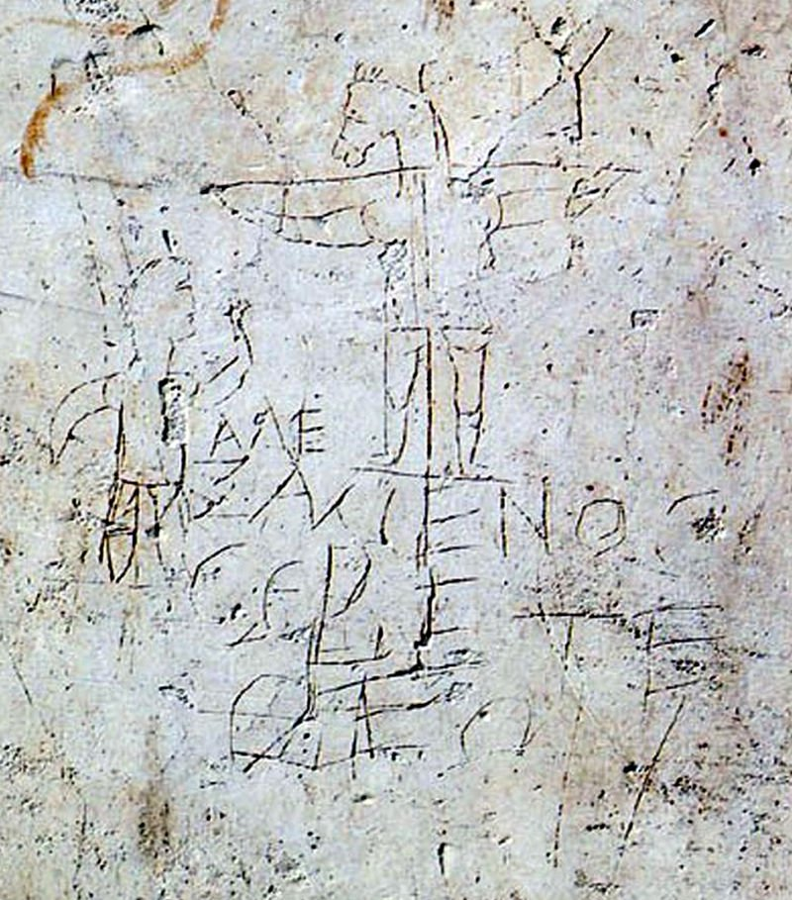
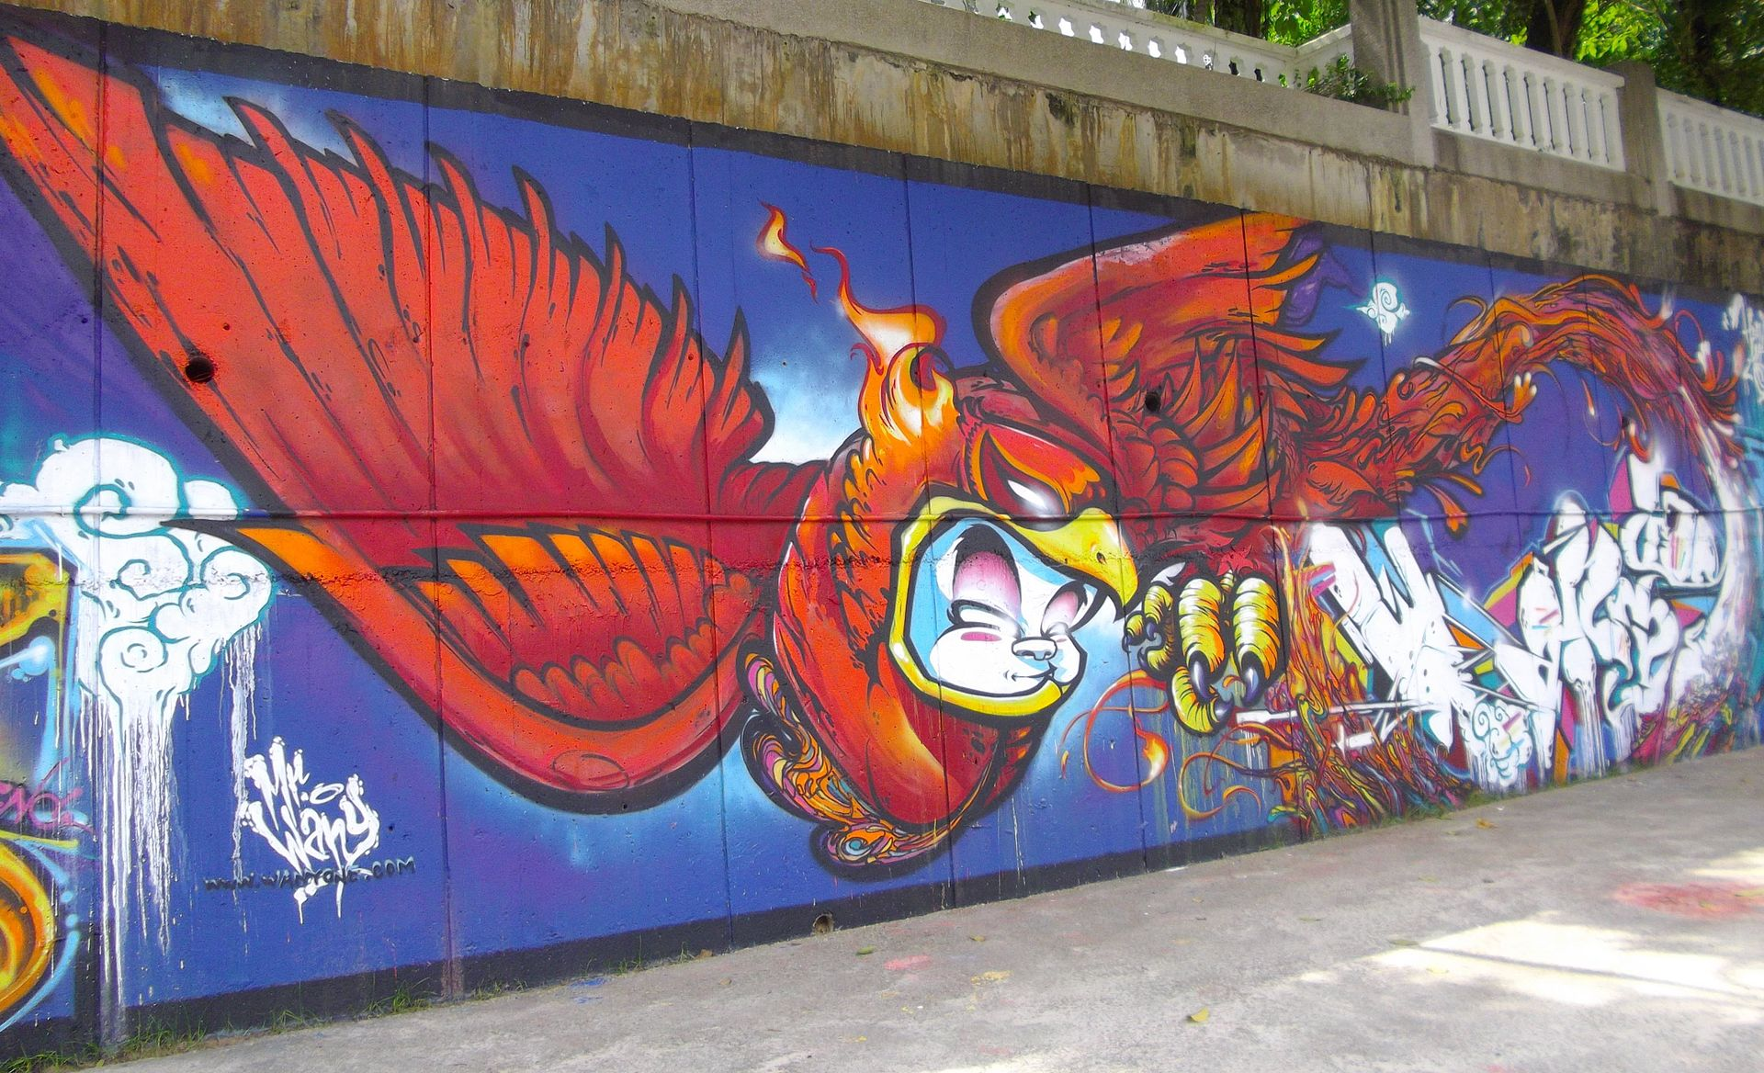
Graffiti (13,000 BCE)
Alexamenos Graffito
(200 CE)
Graffiti art in Kuala Lumpur, Malaysia

Slide 6
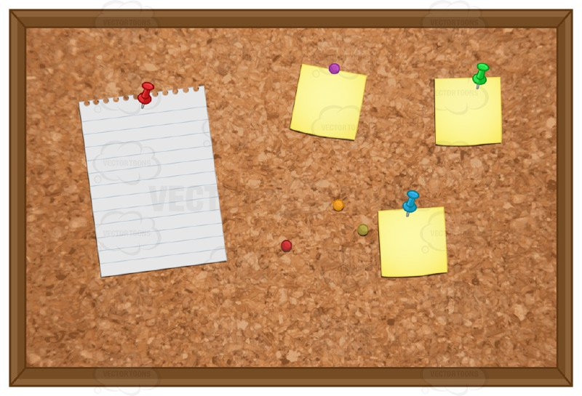
Cork Bulletin boards (1801)

Slide 7
Social Media Today
Computer-mediated technologies
Facilitate
creation & sharing of information,
ideas,
career interests and
other forms of expression via virtual communities and networks
User-generated content
Text posts, comments
Digital photos & videos
Results of artificial intelligence (AI)
https://en.wikipedia.org/wiki/Social_media

Slide 8
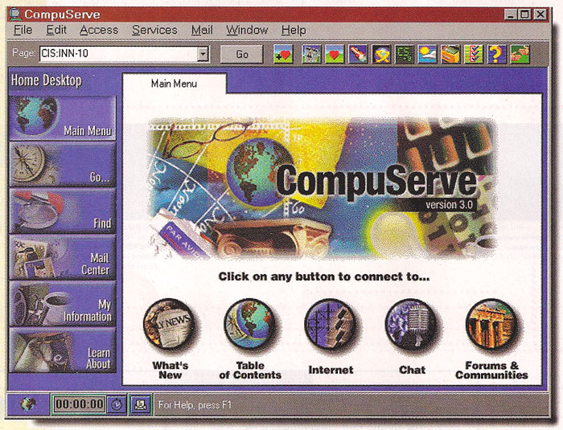
CompuServe (closed 2009)

Slide 9
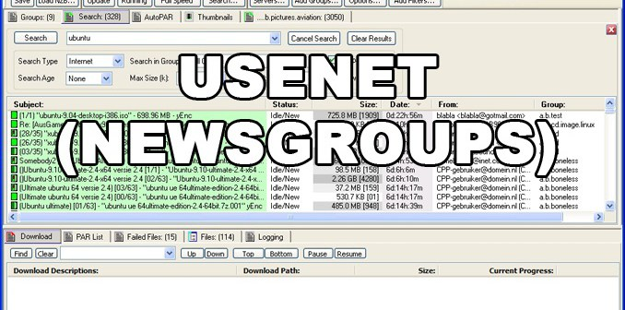
USENET Started in 1979
USENET Satire example: alt.sex.bestiality.hamster.duct-tape

Slide 10
USENET
~120,000 newsgroups currently active
Many millions posts/year
Unknown # users – but likely in millions
Articles typically available online more than 20 years
Popular among privacy geeks
Lots of highly technical discussion groups

Slide 11
Blogs on Variety of Media
Originally “weblogs” but now on any medium
Diary-like “posts” w/ most recent first
~440M bloggers worldwide
Becoming highly focused
Lots of illustrations and videos (e.g., on YouTube)
Increasing amount of AI-generated materials
Earning money
Advertising own or others’ products
Some bloggers earn >$millions
Ariana Huffington: $250,000,000/year
Huffington Post – news discussions
Engadget (tech) – $50,000,000/year

Slide 12
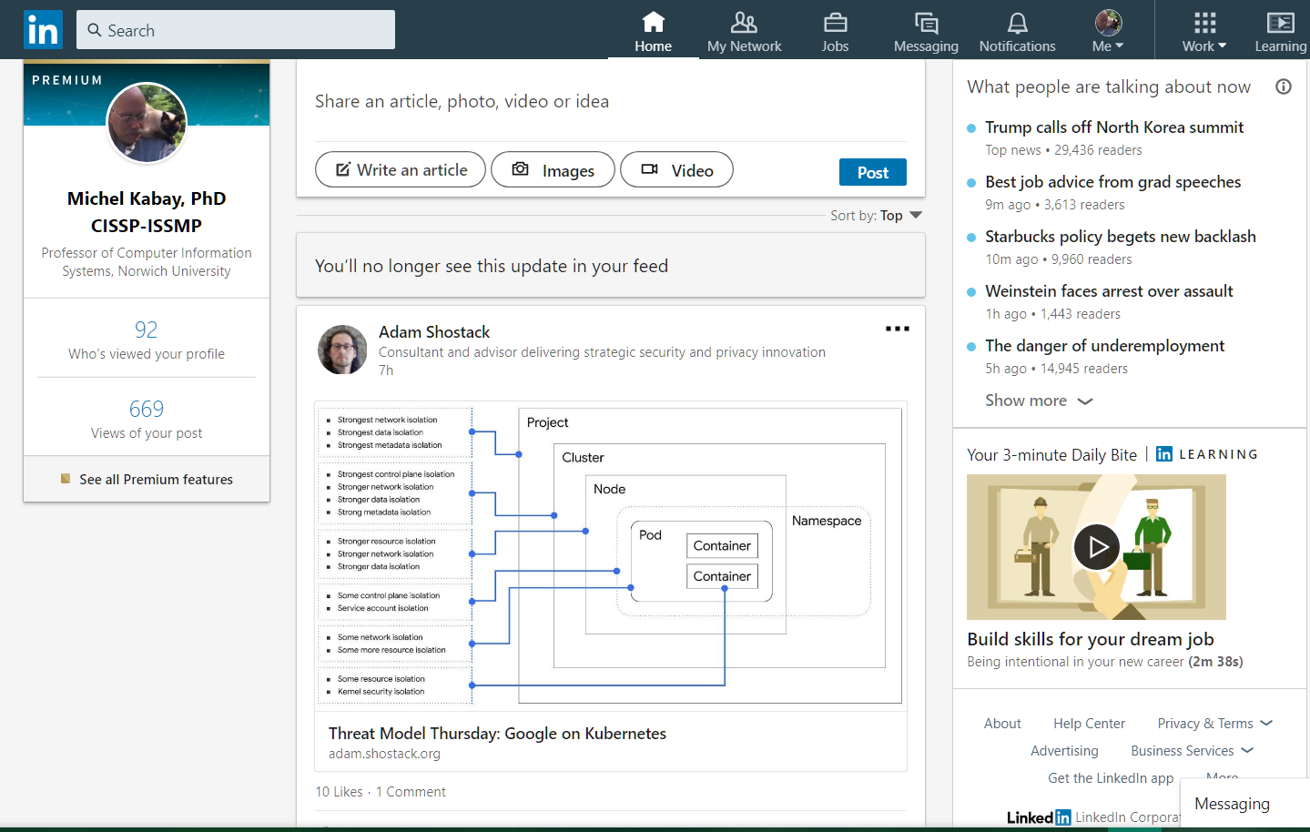
LinkedIn (1.1B users 2025)
Free
Premium
$30/mo to $170/mo depending on features

Slide 13

Twitter – now “X”
Widely used mechanism for broadcasting information and opinions
Bought by Elon Musk in 2022
Renamed it to X
557 million users in 2025
Anyone can read “tweets”
Must register to post free tweets
X Premium costs U$84/year
Max 280 characters/tweet for free
But “X Premium” can post 25,000 characters/post

Slide 14
Weibo (578M users 2025)
Generic term 微博 means “microblog.”
Most popular: Weibo.com for Sina Weibo
Others: Alibaba, Baidu, Ctrip, JD.com, QQ, YY, WeChat, Tmall, Taobao
140 Chinese characters code for more info than 280 letters via X
Sina Weibo – most used
Strictly monitored by Chinese government (see later under “Censorship”)

Slide 15
DISINFO via Social Media
DISINFO = disinformation = deliberately incorrect information or false rumors
Methods for spreading DISINFO
Selective censorship (e.g., China)
Hacking/leaking (e.g., DNC email hack)
Tricking search algorithms (e.g., padding sites with thousands of invisible links to target to raise its profile in GOOGLE search)
Bots (from “robots”): automated fake users to spread false information
Trolls: humans who deliberately post lies and accusations to generate controversy

Slide 16
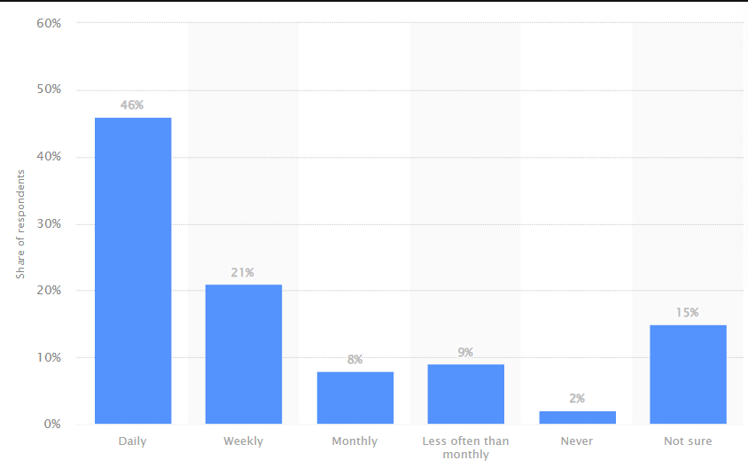
Effectiveness of DISINFO
2025: false news online
60%
50%
40%
30%
20%
10%
0%
Frequency of seeing false or misleading information online among adults in the United States as of May 2025
https://www.statista.com/statistics/1462054/false-news-consumption-frequency-us/
DAILY WEEKLY MONTHLY <MONTHLY NEVER UNSURE

Slide 17
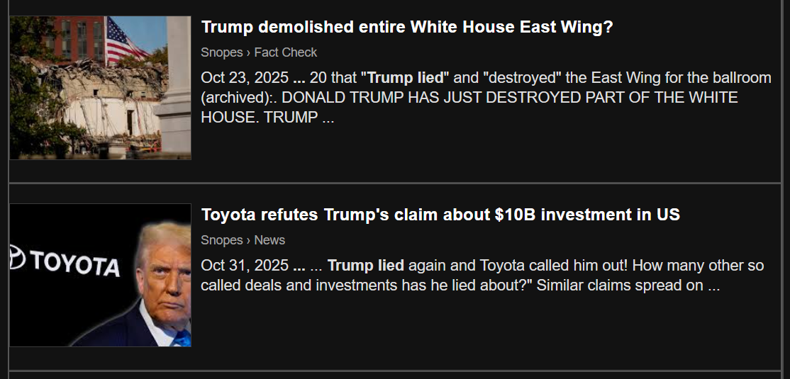
Checking Validity of “News”
The more shocking the “news,” the more important to CHECK ITS VALIDITY
Valuable site: SNOPES.COM https://www.snopes.com/

Slide 18
Trolling & Cyberbullying
Trolls
Deliberately foment discord
Post off-topic comments
Insults, abuse, threats
Cyberbullies
Target specific individuals or groups
Post sneers, insults, & lies
Can include threats of harm
May post doctored photographs
Often directed at women
Can report threats to social-media or to police

Slide 19
Privacy & Control Issues
Confidentiality
Limits on who sees what about whom
Control
Degree to which confidentiality can be maintained
Classic failure of privacy
Young people send nude or otherwise embarrassing pictures to a few supposed friends
But recipients have complete control
Sender does not limit whether recipient(s) share sender’s info with others w/out permission
E.g., nude photos can spread through the Internet like cancer

Slide 20

Political Implications
Sharing information can challenge dictatorships
“Arab Spring” demonstrated power of uncontrolled communications via smart phones
Possible to
Distribute recordings challenging govt lies
Plan & announce meetings, rallies
Terrifies dictators – they shut down networks
Increasingly important in 2026
Resisting rise of Fascism from federal govt

Slide 21
Censorship
1st Amendment of US Constitution
Controls government suppression of information
No restriction on suppression by private individuals or organizations
Most other nations do not have severe restrictions on government control of information
E.g., hate speech illegal in Canada & EU
Anything that threatens power of dictatorships
Chinese suppression of challenges
Misogynistic Demented Orange Racist Narcissistic Sociopath threatens to terminate FCC licenses for major news

Slide 22
Increasing Intermediation
Disintermediation: reduction in power of conventional news sources to control information
Social media increasing control over content: intermediation returns
NO RESTRICTION on private firms’ control over content
Blocking accounts
Deleting posts
Reducing visibility of posts
Government and law-enforcement “requests”
Constant “presidential” demands to fire Jimmy Kimmel and other commentators

Slide 23
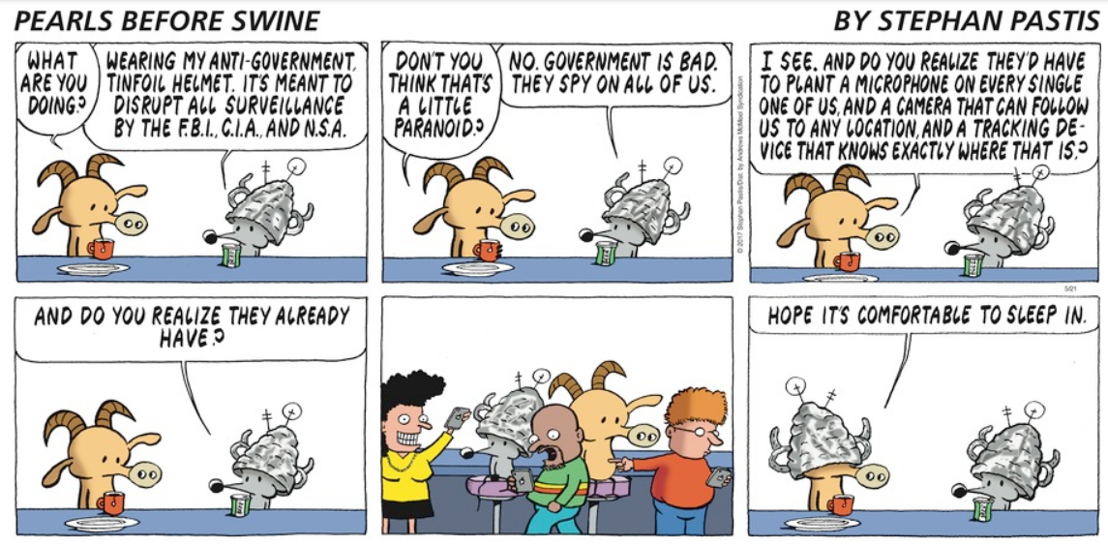
Surveillance (1)

Slide 24
Surveillance (2)
US govt under 1st Trump regime increased surveillance of social-media posts
DHS: “Shared Social Media Screening Service”
ICE: $100M contract to monitor social media of visitors
State Dept: 14.7M applicants for work/tourist visas submitted social-media identifiers
FBI: task force monitored social-media posts
Surveillance chills expressions of criticism of government / society
Discriminatory monitoring well documented (e.g., Black Lives Matter members monitored)

Slide 25
Identity Theft using Social Media (1)
Authentication is tying an identifier (e.g., user name) to a specific person (i.e., YOU).
If someone forgets a password, systems may ask for additional authentication using secret questions chosen by the user.
Some authentication routines allow users to choose whose answers are supposedly unknown by others
What was the name of your school in grade 3?
Who was your prom date in high school?
What was the name of your first pet?

Slide 26
Identity Theft using Social Media (2)
However, anyone can see public information from social media
Including answers to all the secret questions!
Identity thieves can use the information to impersonate victim
ID theft can result in
Theft of $$ via credit cards, banks, loans
Spoofing identity to tarnish/destroy reputation using fake accounts
Use social-media settings to restrict access to such information
E.g., “Friends only”

Slide 27
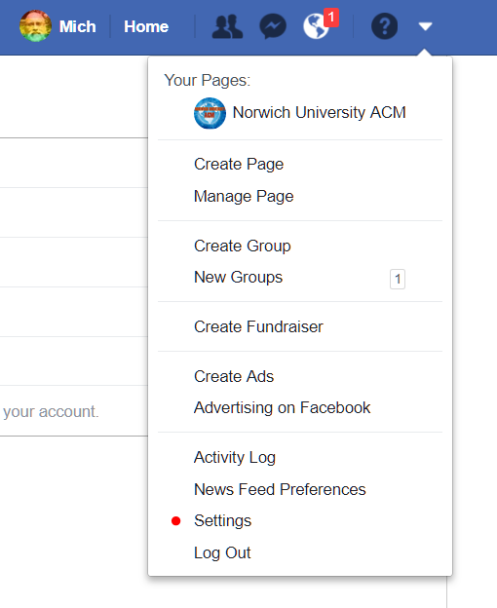
Facebook Settings (1)

Slide 28
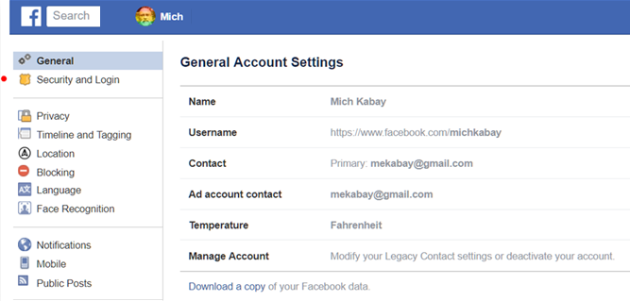
Facebook Settings (2)

Slide 29
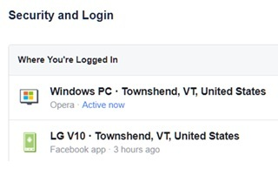
Facebook Settings (3)

Slide 30
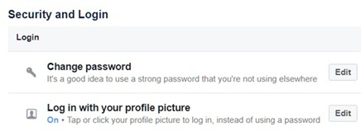
Facebook Settings (4)

Slide 31
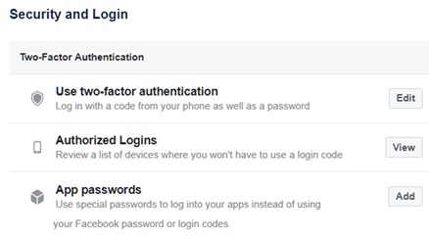
Facebook Settings (5)

Slide 32
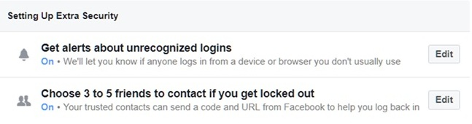
Facebook Settings (6)

Slide 33
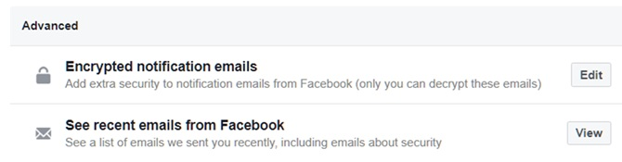
Facebook Settings (7)

Slide 34
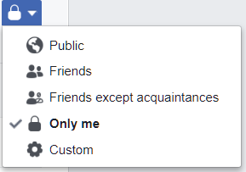
Facebook Settings (8)
Can control who can see EVERY ELEMENT of your Facebook profile

Slide 35
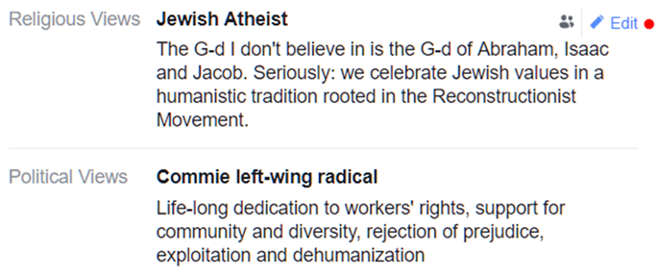
Facebook Settings (9)

Slide 36
Practical Guidelines
Set social-media controls to permit only “friends” to comment on your posts
When evaluating a “friend request”, examine the sender’s own page to see what they are like
If you receive hostile comments, block the sender
If you receive offers of love, profit, or requests for money, block the sender
Block all attempts from strangers to get you to reveal confidential information
Don’t repost “news” without checking its validity

Slide 37

OK, STAY SAFE!

