Slide 1
Staying Safe Online
Montpelier Senior Center
Week 7
Protecting Your Systems
M. E. Kabay, PhD
Emeritus Professor – BSc & MSc Cybersecurity Programs
Norwich University
https://tinyurl.com/3b6p3h8s

Slide 2
Topics
Some of these topics have been mentioned in
earlier lectures. They are so important that
more details
are provided in today’s review.
Issues
Antimalware
Firewalls
Locking
Parental Controls
Passwords
Updates
Software
BYOD

Slide 3
Issues
Unprotected systems liable to immense trouble
  Theft of information (e.g., SSN, bank info)
  Insertion of malicious software (malware)
  Ransomware (encrypting data & demanding money to release info)
Visitors or intruders can abuse systems
  Harmful websites
  Illegal activities (hacking, data theft, pornography, threats….)
  Accidental or deliberate data destruction or modification

Slide 4
Antimalware (1)
Malware (viruses & Trojans) cause enormous harm
  Direct loss of money (access to credit-cards and bank accounts)
  Downtime (especially bad for businesses)
  Reputational damage (embarrassing)
  Legal & regulatory penalties (US laws)
Viruses
  Self-replicating programs
Trojans
  Downloaded by mistake

Slide 5
Antimalware (2)
Internet of Things (IoT) damage can be serious
  Medical equipment
  Manufacturing problems
Malware increasing in complexity – harder to fight
Total damages in $100 billion range/year in US alone
Essential to run updated antimalware products at all times

Slide 6
Antimalware (3)
Top-rated software for Windows, Mac, Android, iOS
  Bitdefender Total Security – $73/year
  Norton 360 Deluxe – $20/year
  ESET Home Security Ultimate – $125
  McAfee Total Protection – $20
  Malwarebytes Premium – $100
Be sure to check how many home computers or phones are covered by the license
Can be ordered online or at local stores such as BestBuy, Walmart, Office Depot, Staples etc.

Slide 7
Firewalls (1)
Firewalls control
  Access to your computer(s) & even phones
  Access to harmful Websites
Easiest & Cheapest: integrated into antimalware software
  Bitdefender Total Security
  Norton 360
  McAfee Total Protection
  Kasperky Total Security

Slide 8
Firewalls (2)
Some firewalls are hardware
  Offer detailed customization of traffic
  E.g., different access for guests
  Useful for controlling IoT (Internet of Things)
    Refrigerators
    Smart lights, etc.
More expensive than software
  Firewalla Gold SE – $479
  Netgate 1100 pfSense Security Gateway - $189
  Fortinet UniFi Dream Machine Pro - $379
  SonicWall TZ270W – $429

Slide 9
Locking Your Computers (1)
As discussed in previous lecture, important NOT to allow unauthorized access to systems
  E.g., accessing certain pornography sites involving images of children can result in prosecution
  Children have been known to rack up huge costs by buying things online without permission
  Hacking from your computer could result in charges under 18 US Code 1030(a)
    $250,000-$500,000 fines
    5 to 10 years in federal prison

Slide 10
Locking Your Computers (2)

Slide 11
Parental Controls (1)
Screen time limits
  Each child/user has specific logon ID
  Parents can set limits on how long each user can stay online in specific programs (e.g., games)
Content filters for specific browsers
  Strictly forbid access to specific types of websites
  E.g., porn & violence in games & pages

Slide 12
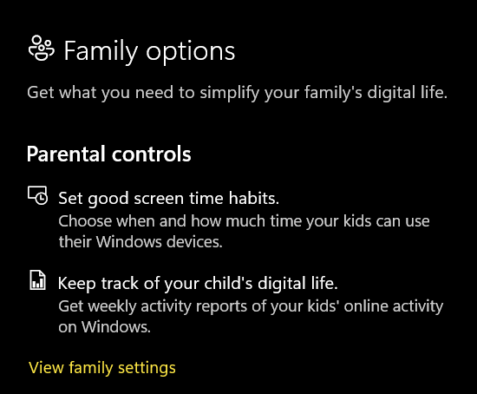
Parental Controls (2)

Slide 13
Parental Controls (3)
ASK YOUR CHILD TO SHOW YOU THE GAME THEY ARE PLAYING
  May be horrified by level of violence
  Car chases, gunfights, robberies
  Murdering characters
  Blood, explosions, amputations, decapitations
  Do not accept “Oh it’s only a game.”
Watch out for (just a few examples)
  Grand Theft Auto
  Call of Duty (e.g., Warzone & Modern Warfare)
  Mortal Kombat
  Hatred
  Doom

Slide 14
Passwords
Use complex passwords, not easy-to-remember
  NO to birthdays, favorite pets, old friends’ names
  YES to 8-12 characters
    Upper and lowercase letters
    Numbers
    Special symbols (as permitted by site)
  E.g., 8URn#v3J*w (no, not one used by prof!)
Use good password safes for Windows & Apple:
  Dashlane, Bitwarden, 1Password, Keeper, NordPass….

Slide 15
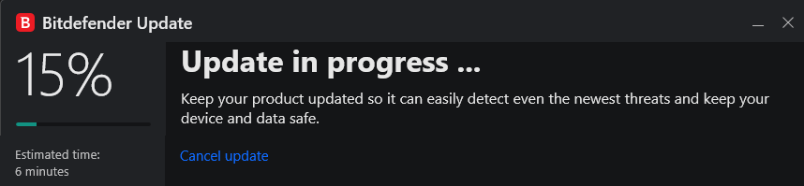
Updates
Software changes to adapt to new conditions
  Operating system (Windows, macOS, Android, iOS….)
  Software
    Utilities (word-processing, browsers…)
    Security (antimalware, firewalls…)
Best to allow automatic updates

Slide 16
Software Sources
DO NOT DOWNLOAD SOFTWARE WITHOUT CAREFUL EVALUATION OF SECURITY
  Don’t download from ANY link in an SMS message or unexpected email
  Always verify the source independently
    Look up the company or organization yourself
    If there are doubts remaining, phone the official phone number you have found yourself
Before buying or downloading any new software, look up reviews

Slide 17
BYOD
Bring Your Own Device
  May have to use a portable computer or phone outside the home or business
  Not all businesses or home owners will permit access to their internet service
If you do use an external internet service
  Be sure you have up-to-date antimalware/firewall software running
  NEVER do anything illegal on ANY service
    Could be sued or arrested for breaking terms of service or laws
Think carefully before allowing guests to use your home Internet – be sure you trust them

Slide 18

OK, STAY SAFE!

